Slide 1
Ethics in Business

Slide 2
Think – Pair - Share
Should a producer of chemicals sell to an overseas buyer that is suspects will be using the goods to produce chemical weapons?
Is tax avoidance acceptable? Should there be tougher consequences?
Your thoughts? Why / why not?
Tax Avoidance video
https://www.youtube.com/watch?v=VcZF_DxQ5cU
Notes:
Starter

Slide 3
Ethical Issues – Learning Objectives
By the end of this week you should be able to:
Define the term ‘ethics’ and explain the meaning of ‘business ethics’
Explain the meaning of ‘corporate social responsibility’
Understand the types of ethical issues a business will face

Slide 4

Business Ethics
Ethics are about what is ‘right’ and what is ‘wrong’?
Morally correct behaviour
Highly subjective nature
Tension between different stakeholders

Slide 5
Ethical dilemmas
Should an advertising agency accept a cigarette manufacturer as a client?
Should a firm relocate to a country paying lower wages?
Should a firm always pay suppliers on time or should it delay as long as possible?

Slide 6
Types of ethical issues
Environmental issues (dealt with as separate topic)
Animal rights
Treatment of workers
Treatment of suppliers
Treatment of customers

Slide 7
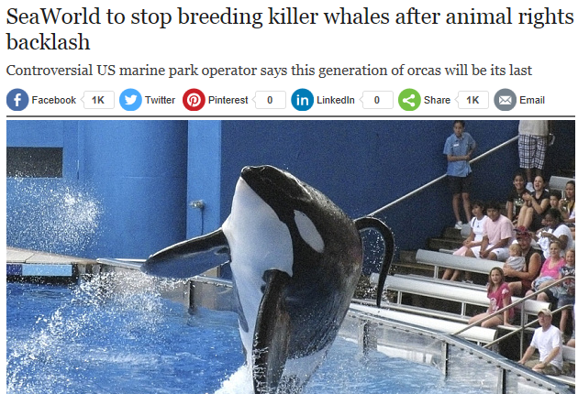
Animal rights
Animal testing and REACH
https://www.youtube.com/watch?v=Q37oCNq-vI0

Slide 8
Treatment of workers
Rana Plaza Bangladesh disaster
https://www.youtube.com/watch?v=vP1cXvQKluA
https://www.bbc.co.uk/news/world-asia-22275597
https://www.theguardian.com/global-development/2018/apr/24/bangladeshi-police-target-garment-workers-union-rana-plaza-five-years-on
Foxconn
https://www.youtube.com/watch?v=vj6Z7wqO9jQ

Slide 9


Treatment of suppliers
Supermarkets and dairy farmers
https://www.youtube.com/watch?v=IuGujpxpVJM
Supplier payment terms
  Length of credit
  Premier Foods - Right to supply
  http://www.bbc.co.uk/news/business-30338663

Slide 10
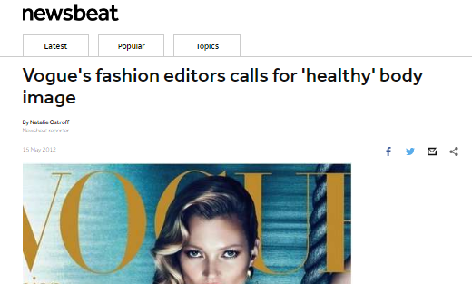
Treatment of customers
VW emissions scandal
http://www.bbc.co.uk/iplayer/episode/b06q6nh2/panorama-the-vw-emissions-scandal (first 5 mins and last 5 mins)
Vogue

Slide 11
Task 1 – Complete page 3 of scrapbook
Explain the different types ethical issues (using examples)
Use the exam board notes, the lesson slides, pages 1-3 of the scrapbook AND YOUR OWN RESEARCH

Slide 12










Task 2: Research task – pg 4
For one of the organisations we have considered, carry out further research into the ethical issues facing it.
How well has the organisation responded?

Slide 13
Corporate Social Responsibility (CSR)
“Doing well by doing good”
Organisations have a responsibility to all stakeholders and not just shareholders (e.g. responsibilities to the community or the environment)

Slide 14
Codes of Practice
Written set of principles to determine employees’ behaviour:
  Personal behaviour
  Corporate behaviour
  Behaviour towards society and the environment
May include obligations over and above legal obligations
https://www.co-operativebank.co.uk/assets/html/bank/ebooks/ethical-policy/index.html#

Slide 15
CSR: Porter and Kramer 2006
Moral Obligation: businesses should “do the right thing” and acknowledge that stakeholders may have either a legal or moral stake in the activities of the organisation.
Sustainability : meeting the needs of the present without compromising the ability of future generations to meet their own needs.
Licence to Operate: every organisation needs tacit / explicit permission of stakeholders to conduct business (legitimacy).
Reputation: CSR will improve a company’s image and ultimately build the brand equity.
https://www.youtube.com/watch?v=zds5rdUo58k

