Slide 1
Legal Factors Affecting Business
Consumer Protection
Competition policy
Data Protection

Slide 2
What it’s about
This is about the government’s role in safeguarding the interests of various groups which might be exploited by firms in a free market.
Changes to the law can restrict business behaviour and increase costs, however, it can also create business opportunities.
Notes:
Consumers (Consumer law)
Employees (Employment law)
Other Firms (Competition policy)

Slide 3
Learning Aims
Explain the main laws that concern businesses
Evaluate the impact of legislation of businesses and their stakeholders

Slide 4
Consumer laws
These are designed to protect the consumer from unscrupulous firms
Main laws:
Consumer Rights Act (supercedes Sale of Goods Act)
Consumer Protection from Unfair Trading Regulations
Consumer Contracts Regulations (supercedes Distance Selling Regs)
Weights and Measures Act
Trade Descriptions Act
Food Safety Act
...to name a few

Slide 5
Consumer Rights Act
Goods: all products must be of satisfactory quality, fit for purpose and as described.
If not, consumers have rights to reject / repairs / replacement
Services: the service must be performed with reasonable care and skill, and any information said or written can be relied on by the consumer.
If not, the services must be re-done or the consumer can claim a price reduction.

Slide 6
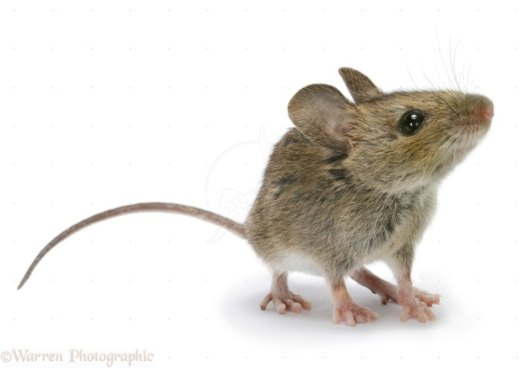
Have I got laws for you?
Chinese restaurant in Greenwich handed

Slide 7
Chinese restaurant in Greenwich handed record fine for hygiene breaches
An unannounced inspection found mouse droppings among packets of food, next to plates and even inside a roll of cling film in the kitchen
Given a record fine of £54,000 and its owners have been banned from running restaurants in the future
The Caterer, 23 January 2012
Breach of Food Safety Act

Slide 8
Have I got laws for you?
Currys and Comet staff “misleading” customers, watchdog finds

Slide 9
Currys and Comet staff “misleading” customers, watchdog finds
Britain's biggest electrical chains, including Currys and Comet, are routinely misleading shoppers by offering either poor quality advice or failing to honour basic consumer rights, according to an undercover investigation by a leading watchdog.
The Telegraph, 25 January 2011
Breach of Sales of Goods Act

Slide 10
Have I got laws for you?
Tesco 'half-price Strawberries' deal prompts red faces and £300,000 fine

Slide 11
Tesco 'half-price Strawberries' deal prompts red faces and £300,000 fine
Tesco has been fined £300,000 for mislabelling its strawberries, selling them at "half price" for three months after they were on sale at the full price for just seven days.
Tesco made a £2.3m profit from the promotion. [The judge said] that the case was "shocking by its very nature" because customers had a high degree of trust in national chains.
The Guardian, 19 August 2013
Breach of the Consumer Protection from Unfair Trading Regulations Act

Slide 12
Implications for businesses
Improved quality
Less waste
Builds consumer relations and trust
BUT
Increased costs of production
Increased time on legal scrutiny for compliance
Risk of claims / contingency planning
Impact on UK competitiveness

Slide 13
Competition laws
This regulates the way in which firms compete in the market
Rationale: to make sure consumers get a fair deal by making sure businesses in the market act fairly
Main laws
Competition Act (unfair dealing)
Enterprise Act (control of mergers and takeovers)
Enforced by: The Competition and Markets Authority (CMA)
Notes:
Competition Commission: recommends whether a monopoly or a proposed merger is in the public interest.
The Director of the CMA can fine companies for anti competitive behaviour – can be up to 10% of turnover

Slide 14
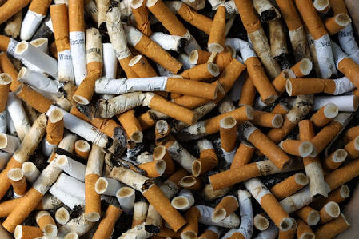
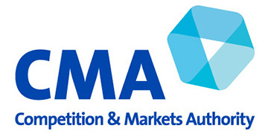
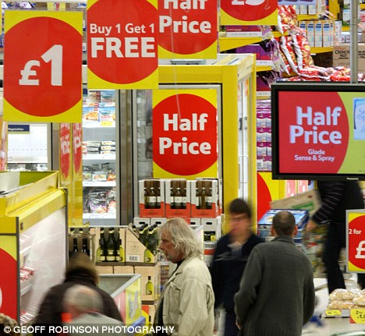
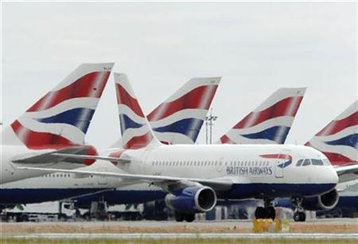
Fines for breaches
Issues guidance
Approves mergers
Investigates consumer complaints
Prosecutes cartels
Notes:
Imperial Tobacco and various supermarkets fined £225million for price-fixing of tobacco products
Guidance issued to creators for childrens apps on in-play purchases
Ongoing investigation following Which ‘supercomplaint’ into confusing and misleading special offers in supermarkets
BA and Virgin cartel re fuel surcharges for customers
Approved recent merger of PureGym and LA Fitness

Slide 15
Implications for businesses
Lower prices (benefits consumers)
Lower profit margins
‘Fair’ competition – risk of fines / imprisonment
Market leaders especially need to take care
Internal compliance / legal advice
Benefits to small firms – levels the playing field

Slide 16
Data Protection Act
Aims to protect how and where information can be stored and used. It says data must be:
Fairly and lawfully processed
Adequate, relevant and not excessive
Accurate
Not kept for longer than necessary
Processed in line with employees rights
Secure
Not transferred to other countries without adequate protection

Slide 17
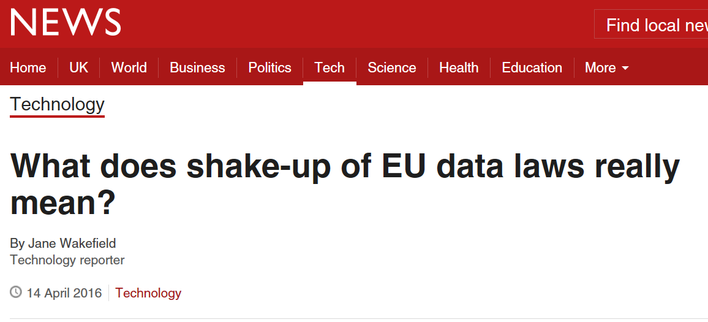
Reacting to changes…
Need to comply with new law by 2018
“The European Parliament has voted on the biggest shake-up of data protection laws for 20 years.
The data protection regulation's stated aim is to give citizens back control of their personal data as well as simplifying the regulatory environment.
It could mean huge fines for companies that breach the law and offer some complex problems about how they store, delete and return data to citizens.”

Slide 18
Implications for businesses
Risk of fines / imprisonment
Employ ‘data protection officer’
IT systems, continuously manage and update
Clear communications with consumers and staff
Internal compliance / legal advice
Reputational risk
http://www.bbc.co.uk/news/technology-36037324
http://www.bbc.co.uk/news/uk-34611857

Slide 19
Government Bodies
The government has set up certain organisations to ensure compliance with these regulations.
Examples include:
The CMA (The Competition and Markets Authority)
Note: This body replaces both the CC (Competition Commission) and the OFT (The Office of Fair Trading)
Trading Standards
The Foods Standards Agency
Information Commissioner’s Office

Slide 20
Knowledge Activity
Read pages 706 – 711 (stop at The European Union) and answer the following questions:
For what reasons might consumers need more protection today?
Explain five of the main consumer protection laws
In what ways might businesses be affected by consumer protection legislation?
What are the possible advantages and disadvantages of monopolies?
How is a monopoly defined by UK law?

Slide 21
Research Activity
The Office of Fair Trading has now been replaced by the Financial Conduct Authority and the Competitions and Market Authority.
Carry out research to help you explain the role of each of these bodies.
Carry out your own research into the impact of consumer protection legislation and competition policy on Wild Wood
(See activity in the legal scrap book).
Extension: Answer question 2 on page 708

