Slide 1
REPRESENTATION THEORISTS
A level media studies

Slide 2
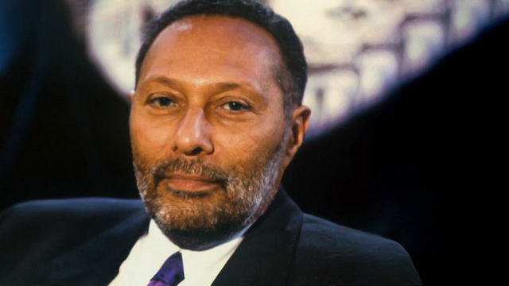
STUART HALL – representation theory
His theory includes:
the idea that representation is the production of meaning through language, with language defined in its broadest sense as a system of signs - ‘ a shared conceptual roadmap’
the idea that the relationship between concepts and signs is governed by codes
the idea that stereotyping, as a form of representation, reduces people to a few simple characteristics or traits
the idea that stereotyping tends to occur where there are inequalities of power, as subordinate or excluded groups are constructed as different or ‘other’ (e.g. through ethnocentrism).
A Jamaican-born cultural theorist, political activist and sociologist who lived and worked in the UK from 1951. Died 2014.

Slide 3

DAVID GAUNTLETT – THEORY OF IDENTITY
the idea that the media provide us with ‘tools’ or resources that we use to construct our identities
the idea that whilst in the past the media tended to convey singular, straightforward messages about ideal types of male and female identities, the media today offer us a more diverse range of stars, icons and characters from whom we may pick and mix different ideas.
British sociologist and media theorist Professor of Media and Communications at the University of Westminster
Born 1971

Slide 4
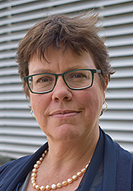
LIESBET VAN ZOONEN – feminist theory
the idea that gender is constructed through discourse, and that its meaning varies according to cultural and historical context
the idea that the display of women’s bodies as objects to be looked at is a core element of western patriarchal culture
the idea that in mainstream culture the visual and narrative codes that are used to construct the male body as spectacle differ from those used to objectify the female body.
Dutch professor of Popular Culture. Born 1959

Slide 5
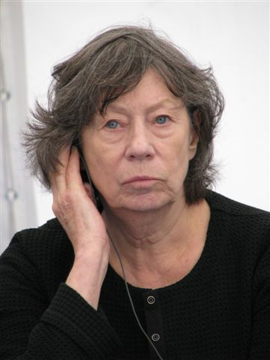
Laura mulvey – male gaze theory
British feminist film theorist
Currently Professor of Film and Media Studies at Birkbeck, University of London
Born 1941
Coined the term ‘Male Gaze’ in 1975 in the essay ‘Visual Pleasure and Narrative Cinema’. In film the male gaze occurs when the audience is put into the perspective of a heterosexual man.
The camera lingers on the curves of the female body, and events which occur to women are presented largely in the context of a man’s reaction to these events. This relegates women to the status of objects.
The female viewer must experience the narrative secondarily, by identification with the male.

Slide 6
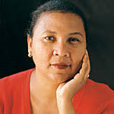
Bell hooks – FEMINIST THEORY
the idea that feminism is a struggle to end sexist/patriarchal oppression and the ideology of domination
the idea that feminism is a political commitment rather than a lifestyle choice
the idea that race and class as well as sex determine the extent to which individuals are exploited, discriminated against or oppressed.
American author, feminist and social activist. Born 1952

Slide 7
Bell hooks – media representation cont’d
The colour codes: lighter skinned women are considered more desirable and fit better in to the western ideology of beauty.
Black women are objectified and sexualised in some media (e.g. rap/hip hop) reflecting the colonialist view of black women (sexually disposable).
Commodified blackness, a mediated view of black culture that is considered the norm.

Slide 8
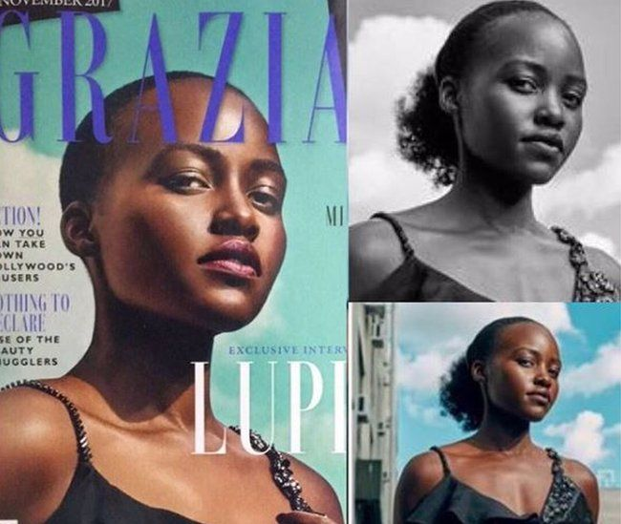
Grazia got in to trouble for how it represented lupita Nyong’o (November 2017)

Slide 9
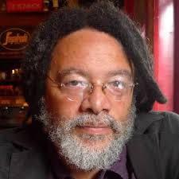
Paul Gilroy – ethnicity & post colonial theory
the idea that colonial discourses continue to inform contemporary attitudes to race and ethnicity in the postcolonial era
the idea that civilisationism constructs racial hierarchies and sets up binary oppositions based on notions of otherness.
British writer and cultural theorist
Professor of American and English Literature at King's College London.
Born 1956

Slide 10
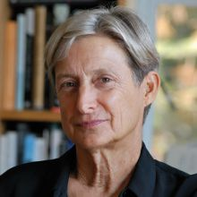
Judith butler – theories of gender performativity
the idea that identity is performatively constructed by the very ‘expressions’ that are said to be its results (it is manufactured through a set of acts)
the idea that there is no gender identity behind the expressions of gender
the idea that performativity is not a singular act, but a repetition and a ritual.
American philosopher and gender theorist. Born 1956

