Slide 1
Measuring Social Class
Learning Outcomes
To understand the objective and subjective measures of social class
To evaluate the usefulness of these measures
If you were measuring someone’s class using a questionnaire, what questions would you ask them? Write a list of examples

Slide 2
Key Concepts:
Class
Ascribed
status
Inequality
Achieved
status
Meritocracy
Life
chances
Blue collar
work
White collar
work
Stratification

Slide 3
What is (social) class?
Class refers to economic differences between groups of people. These groups are arranged in some kind of hierarchy.

Slide 4
Is class easy to define?
Not really. Class are multifaceted and include at least 4 aspects:
A shared economic situation.
Shared attitudes, beliefs, values and behaviour e.g. class subcultures.
Awareness of membership (class consciousness).
Action to promote their shared interests (class action e.g. trade unions)

Slide 5
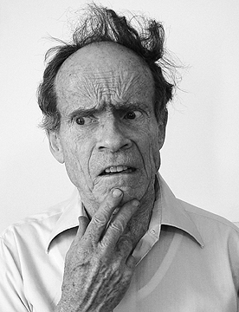
What class are you?
What class would you consider yourself to be in?
Why have you come to that conclusion?

Slide 6
Operationalisation
Operationalisation is the process of clearly defining a concept/key term. This can be done for several reasons. For interepretivists it is so that readers know exactly why and how a term has been used. For positivists, it allows them to measure a concept because the key aspects have been defined.

Slide 7
Ways of operationalising the concept of “class”?
Indicators of class?

Slide 8
Defining class
Class is so hard to define because as well as dealing with objective indicators/measures e.g. what your income is, how much wealth you posses.
But, it also includes subjective indicators e.g. how people feel about themselves, what it means to be in one class etc.

Slide 9
Subjective measures of class
How people interpret their own social class position
People from WC backgrounds in MC roles (according to objective scales) may still consider themselves WC (values, ideals, experiences)
Not many people will answer “class 7” when asked which social class they belong to
Giddens (1991) argues that employment/occupation is being replaced by patterns of consumption as an indicator of the social class people see themselves belonging to (postmodernism link)
Savage et al (2001) used in-depth interviews to discover how people classified themselves. People were reluctant to classify themselves in a social class and valued being ‘normal’ and ‘just like everybody else’.
Southerton (2002) found that people found it difficult to identify with a social class and considered issues of ‘us’ and ‘them’ more important. Class identification had been replaced by consumption patterns as a way of identifying others’ and your own class position.

Slide 10
Evaluating the usefulness of subjective measures
Strengths | Limitations
Using your knowledge of research methods, identify strengths and limitations of subjective measures of social class
Validity | Reliability
Interpretivism | Social desirability
Representativeness | Positivism

Slide 11
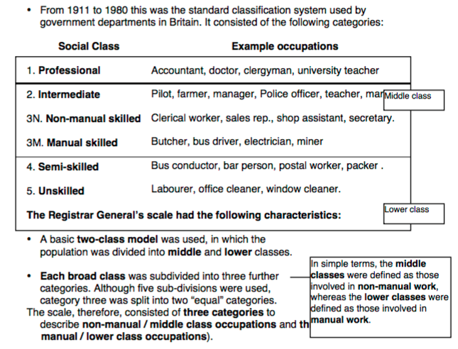
Objective Measure: The Registrar General Scale

Slide 12
Objective Measures
The NSSEC replaced the RG as the official government scale and was used from 2001. Like the HG scale, it uses the following to classify people:
Employment relations – if people are employed, self employed, do they have authority?
Market conditions – salary, promotion prospects, control over hours etc
The Hope-Goldthorpe Scale was created from a sociological perspective, moving away from the RG scale created by the government
It recognised the growth of the middle class, especially the self-employed
Classified people on their market position (income and life chances e.g. their promotion prospects, control of hours etc)
Employment relations – did they have authority over others?
Creation of an intermediate class as both manual and non manual workers may share some similarities in work situation
The ‘service class’ in the HG scale is those whose employment relationship is based on a code of service – trust is a key element. It is linked to jobs with high levels of autonomy. (This class does not link to ‘service sector’ job roles)

Slide 13
Objective Measures: A Feminist Perspective
They identified 8 different social classes with class 6 as having two distinctions
6a – sales and personal services
6b – skills manual
This reflected the changing nature of the economy, with the service sector growing and also allowed for women to be included in their own right.
Arber et al (1986) created the Surrey Occupational Schema scale, which attempted to reflect more closely the types of women did and to include them in the scale separately from their husbands
They have criticised the previous measures of social class for having a patriarchal bias
However, this scale has been criticised as it has failed to give a meaningful insight into women’s life experiences as a whole.

Slide 14
Objective Measures: Social Class in the UK today
https://www.youtube.com/watch?v=zInIRiBOp44
Mike Savage and Fiona Devine used three different types of capital to establish the social class of 160,000 people through an online survey through the BBC
Activity in booklet p.5- read and answer the questions.

Slide 15
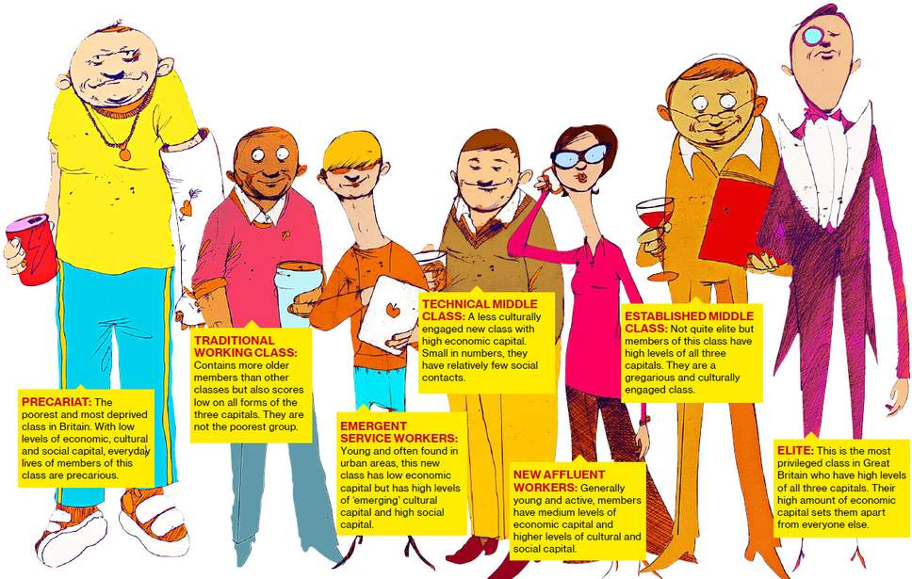

Slide 16
Exam Question
Outline and explain two ways in which social class has been measured by sociologists (10 marks)

Slide 17
Problems with using occupation to measure social class
They exclude those that don’t work but are very wealthy – this hides some very real differences in society
Unpaid workers are excluded
They tend to focus on only one worker (highest paid) in the household so ignore dual income households, which could have a very different class position to a single income household
There are significant differences within each category identified
They assume people in the same category have the same values and behaviours but this does not account for the people who have been socially mobile

Slide 18
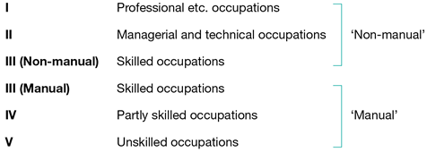
Objective measures of social class p. 5-6
Strengths of the Hope-Goldthorpe Scale
Weaknesses of the Hope-Goldthorpe Scale
There have been a number of attempts to measure social class and scales have been replaced as society develops and changes. “Official” scales are recognised by governments and their statistical agencies for the purpose of measuring social class. “Unofficial” scales have been produced by sociologists, psychologists, market researchers etc.
Strengths of the Registrar General’s Scale
Weaknesses of the Registrar General’s Scale

Slide 19
Strengths of the GBCS | Weaknesses of the GBCS
Strengths of the NSSEC | Weaknesses of the NSSEC

Slide 20
Measuring Social Class: Exam Questions
Outline and explain two ways in which social class has been measured by sociologists (10 marks)
Outline and explain why consumption may not have replaced class as an indicator of social class (10 marks)
Outline and explain two problems with using the occupation of the father to explain the social class position of the whole family (10 marks)
Item A
Postmodernists suggest that subjective class is as important as occupation in defining a person’s social class, as in our fluid occupational structure, an individual may change jobs many times thus changing their identity. Consumption patterns may play a part in their self-classification. Marxists, however, would suggest that objective social class is the most important aspect of an individual’s position in society.
Applying material from Item A, analyse two problems with using subjective social class as an indicator of an individual’s position in society (10 marks)
Item A
Due to the deskilling of many occupations, both those formerly considered middle class and those considered working class, it no longer makes sense to speak of the UK as being divided into upper, middle and working class. Rather, sociologists argue there are a multitude of classes. However, Marxists would disagree.
Applying material from Item A, analyse two reasons for suggesting that class definitions based on occupation are no longer relevant to the UK today (10 marks)
Item B
Marxists suggest that occupation is still the most efficient way of describing the social class of both an individual and the family they belong to at any point in their lives. Most studies have concentrated on the occupation of the man in the household. Some feminists would argue that to fully understand the class position of a family, the occupation of both parents should be considered.
Applying material from Item B and your knowledge, evaluate the extent to which occupation is a useful indicator of an individual’s social class (20 marks)

