Slide 1
Social class
Changes in inequality and class structures- ppt 3

Slide 2
Key Concepts:
Boundary
problems
Class
fractions
Cultural
capital
Social
closure
Primary and
secondary industries
De-skilling
Embourgeoisement
Convergence
Proletarianization

Slide 3
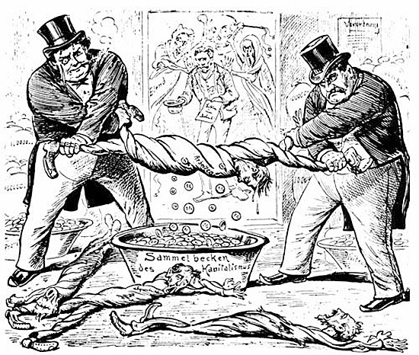
The changing class structure in the UK
Historical social classes: 2 classes- Bourgeoisie and Proletariat
Traditional social classes: 3 class structure: upper, middle, working
Traditional Marxism
EMBOURGEOISEMENT
Functionalists and the New Right: class stratification is necessary. It reflects a meritocratic society where people are rewarded for the ability
THE NATURE OF SOCIAL CLASS IN THE UK TODAY
Weberian/ neo Marxism
THERE IS A GROWING MIDDLE CLASS
THE RICH HAVE GOT RICHER
SOCIAL CLASS HAS FRAGMENTED
POLARISATION: GAP BETWEEN RICH AND POOR NOW BIGGER
Marxism/ neo Marxism
WORKING CLASS IDENTITIES HAVE CHANGED
UNITED VS DIVIDED
Marxism/ neo Marxism
IMPACT OF GLOBALISATION
TRANSNATIONAL CAPITALIST CLASS
GROWTH OF AN UNDERCLASS
CLASS IDENTITIES ARE DEAD/IRRELEVANT
CHANGES TO TRADITIONAL IDENTITIES
PRECARIAT
Postmodernism
PROLETARIANISATION
Notes:
Opening scene Sense and Sensibility https://www.youtube.com/watch?v=WX6Iikuz9uI

Slide 4
Recap of theories of social class
Marx (ism) | Weber | Neo-Marxism | Functionalism and New Right | Postmodernism
Bourgeoisie gain their power via their control of economic systems i.e. owning businesses, land (the means of production). The middle class will disappear as the bourgeoisie and proletariat polarise (get further away from each other). | Weber claims that power can be gained in three ways; party power, status and economic (market) power. Accepts that a middle class exist. It is permeant. Social mobility is possible between classes because of the interaction between different forms of identity (not just economic power) | The middle class is a permeant feature. It allows its members to be controlled and controllers. The working class is changing and being remade. Woking class can now fluctuate between working and middle class identities. Melds Marxist and Weberian ideas [Cross over with ‘Muddle class’ identities] | Social class inequality is inevitable and essential in a meritocratic society. Competition is healthy and those who do the best should be rewarded with higher positions in society. Most important jobs are secured by the most able people. | Class is dead and irrelevant. People no longer see themselves in social class terms. Globalisation has changed identities and mean divisions today are now status divisions. We live in an individualised society. Social exclusion now more significant based on poverty, ethnicity, gender, etc.

Slide 5
Social Class in the UK today
4 key debates, Class is now:
Polarised | Fragmented | Divided/ meritocratic | Dead/irrelevant
The gap between the rich and poor has widened and the middle class has either been stretched out or polarised into different camps. Globalisation has led to a transnational capitalist class. | The traditional class structure has split, divided and is no longer coherent. Class lines have blurred. Inequality is still an issue. | Society remains unequal but this is normal. The most talented rise and the least talented fall. Society benefits from competition. | Class divisions are not useful- we identify ourselves in a number of ways.
Associated with Marxists and neo-marxists | Associated with Weberians and some neo-marxists | Associated with functionalists and the new right. | Associated with some postmodernists

Slide 6
Social Class in the UK today
So what about the classes:
Upper Class | Middle class has got bigger | Middle class is united | Working class
Rich have got richer. Globalisation has led to a transnational capitalist class. | Class lines have blurred. More people are now middle class (embourgeoisement). There are lots of different groups that fit under the middle class heading. Inequality is still an issue. | The middle class are united based on selling their mental labour (Giddens) | Is now bigger (owing to the rich getting richer). A process of deskilling and proletarianisation has led to this. Traditional working class identities have broken down – leading to creation of new w/c: salariat, precariat, underclass
Associated with Marxists and neo-marxists | Associated with Weberians and some neo-marxists | Associated with functionalists and the new right. | Marxists

Slide 7
Activity
What do the following slides show us about salaries for jobs in the UK today?
Where could some of these examples fit into the research you have done?
https://www.findcourses.co.uk/inspiration/articles/average-salary-uk-2018-14105#average-salary-uk-infographic

Slide 8
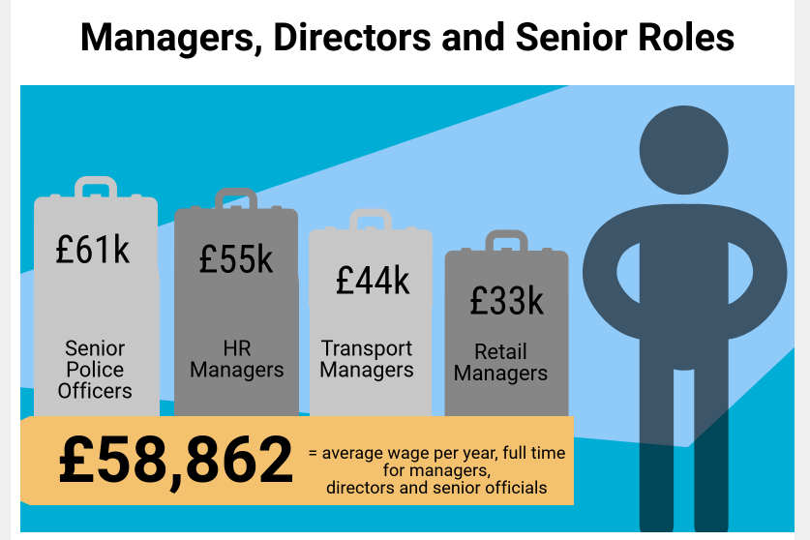

Slide 9
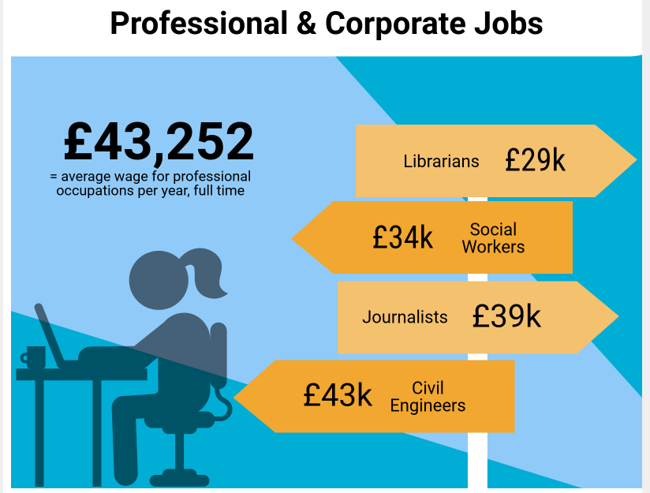

Slide 10
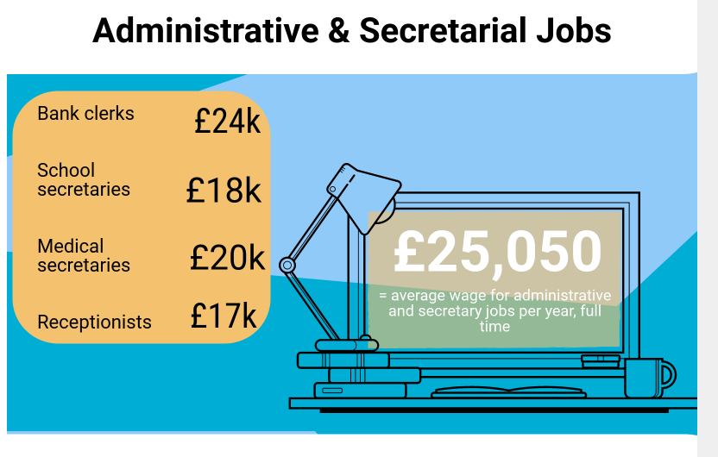

Slide 11
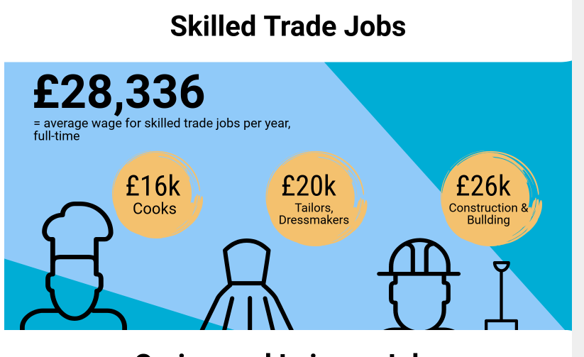

Slide 12
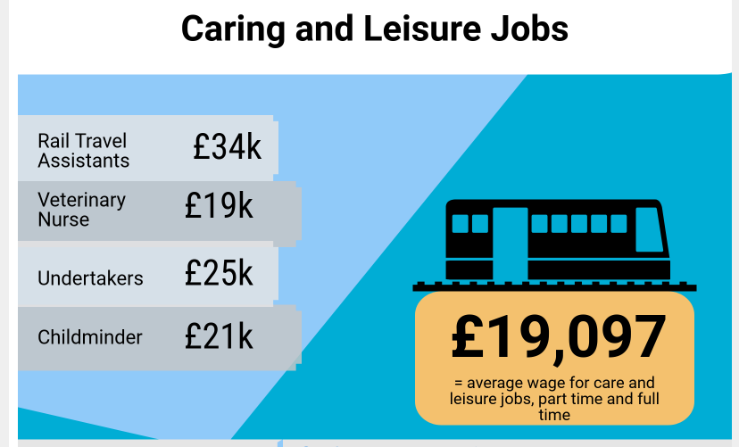

Slide 13
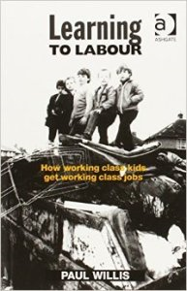
Nature of the Working Class historically:
TRADITIONAL ARGUMENTS
Marxism: Working class considered to be both manual and routine non-manual workers. Does not own the means of production.
Lockwood: Studied traditional working class subculture – the proletarian traditionalists. Living in close knit communities, working in traditional industries. Strong sense of camaraderie and solidarity.
Engels: “workers speak different dialects, have other thoughts and ideals, other customs and moral principles, a different religion and other politics than those of the bourgeoisie.”

Slide 14
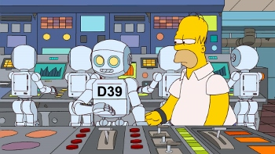
The working classes today?
VS
EMBOURGEOISMENT
Goldthorpe (Weberian): Advanced industrialism requires a highly educated, trained and skilled workforce = higher pay + occupational status.
Middle range incomes = middle range lifestyles.
This leads to a breakdown of traditional working class communities.
Workers become indistinguishable from their white collar neighbours i.e. plumbers who make more money than nurses.
PROLETARIANISATION
Braverman: many jobs in capitalist society (particularly white collar) now subject to a pattern of ‘deskilling’.
Traditionally middle class jobs becoming more like working class jobs.
Upper Class
Middle Class
Working Class

Slide 15
Middle Class or Middle Classes?
No clear agreement among sociologists about the position of the middle class, or classes in the stratification system.
Should manual workers should be placed in the middle class category?
Is the middle class united and homogeneous OR divided and heterogeneous?

Slide 16
Middle Class or Middle Classes?
A single middle class: | Fragmented middle class – middle classes:
Giddens | Goldthorpe Roberts et al Savage et al As a result of embourgeoisement – there are a greater number of people in the middle class with different identities
VS
Outline and explain two reasons why the middle class is not united [10]
Notes:
Students to detail the debate of middle class vs middle classes – using Haralambos (6th Edition) pages 42-47, as well as Middle classes in Britain article – Mike Savage, Sociology review, November 1995.

Slide 17
Nature of upper class:
The dominating ruling class: private ownership of capital.
(Westergaard and Resler: Marxist)
Consists of 5-10% of population… the major owners of the means of production
(Westergaard and Resler)
Concentration of wealth in the hands of a small minority
(Westergaard and Resler)
What is the upper class?
A small group of people who have considerable wealth and more power than other members of society – an influential economic elite rather than a ruling elite- he argues much of the wealth of this group is tied up in pensions so does not have political power
(Saunders: New Right)
The most powerful class in a global system. Transnational capitalist class – their power goes beyond national boundaries
(Sklair)
A class united by family contacts, achieving a high degree of social closure.(Scott: Marxist)
Notes:
Using pages 26 – 31 of Haralambos (6th Edition) in groups create PowerPoint's about each of these studies, giving details as well as evaluation of their views of the upper class. When presenting students to write summaries of the studies on page 12 of their class workbooks.
Toffs and snobs article – Sociology Review 2003.

Slide 18
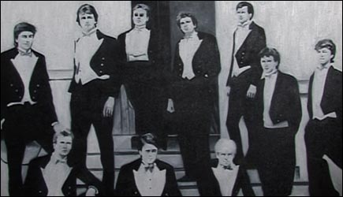
Nature of the upper class
https://www.virgin.com/richard-branson/how-i-bought-necker-island
https://www.itv.com/news/2019-07-23/boris-and-the-bullingdon-club-where-are-they-now/

Slide 19
Exam question
Outline two ways in which the elite promote their shared (class) interests [10 marks]
Possible sources
‘How the middle class hoards wealth and opportunity for itself’
https://www.theguardian.com/inequality/2017/jul/15/how-us-middle-classes-hoard-opportunity-privilege

Slide 20
Is class no longer significant?
People now see themselves as individuals, they can pick and choose their identity
Pakulski and Waters: Postmodern)
The most powerful class in a global system. Transnational capitalist class – their power goes beyond national boundaries. Does this mean class is less significant on a national level? (Sklair)
Disadvantage is no longer linked to social class. It is due to inequalities between certain social groups:
Single parent vs dual-career.
Homeowners vs. renters
Secure jobs vs. temporary low paid work
Ethnic minorities
Elderly and young people
(Diamond and Giddens: New Egalitarianism)
Class not significant?
The vast array of arguments and theories about social class may mean it is no longer significant. Much more challenging to operationalise now.

Slide 21
Activity
You will complete an A3 sheet. This will cover the key debates related to changes in the class structure in the UK.
More sources of info on this can be found in:
OCR Sociology, Waugh, p.186-208 (at the end of your booklet)
Sociology AQA A-Level, Year 2, Chapman (at the end of your booklet)
Sociology for AQA, Browne (in the classrooms or library)

Slide 22
Essay question
Evaluate the view that social class is becoming less significant in the contemporary UK [20]
Evaluate the view that the middle class does not have a united identity [20]
Evaluate the view that social class is still an important feature of the contemporary UK [20]

