Slide 1
Framework | Theorist | Prompts | Component 1: Section A: Language and Representation
 |  |  | Marketing | Advertising | Music Video | Newspaper
 |  |  | Kiss of the Vampire | Tide | Formation | The Times
 |  |  |  | WaterAid | Riptide | Daily Mirror
Media Language | Roland Barthes | The 5 Codes (SEARS) | Y | Y | Y | Y
 | Tzvetan Todorov | Equilibrium
 | Levi Strauss | Binary | Y | Y | Y | Y
 | Steve Neale | Genre
 | Baudrillard | Post-Modernism
Representation | Stuart Hall | Stereotyping and inequality | Y | Y | Y | Y
 | David Gauntlett | Pick ‘n’ Mix | Y | Y | Y
 | Butler | Performative
 | Liesbet van Zoonen | Gender is constructed | Y | Y | Y
 | Bell hooks | Patriarchal oppression
 | Gilroy | Ethnicity |  | Y | Y
Industries | Curran and Seaton | Power and Industries |  |  |  | Y
 | Livingstone and Lunt | UK regulation |  |  |  | Y
 | Hesmondhalgh | Cultural industries |  |  |  | Y
Audience | Albert Bandura | Media Effects |  | Y
 | George Gerbner | Cultivation |  | Y |  | Y
 | Stuart Hall | Reception x 3 |  | Y |  | Y
 | Jenkins | Fandom
 | Shirky | End of Audience |  |  |  | Y

Slide 2
Audience theories
A-LEVEL MEDIA STUDIES

Slide 3
Effects models
PASSIVE AUDIENCE
Early 20th century concerns were that mass media aimed at a mass audience would be influenced by the same ‘mass’ message. This idea suggests that mass media has power as seemed apparent in Nazi Germany who used media – films such as Triumph of the Will – as propaganda tools to ‘inject’ ideas making them dominant amongst the German public. It has also been proposed that advertisers manipulate audiences in such a way.
This was known as the hypodermic model – where the media ‘inject’ ideas into a passive audience. Suggesting a direct, immediate and impactful effect on the audience

Slide 4
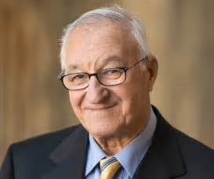
Although audiences are seen as less passive than during the 1950’s, the hypodermic theory is still used by those in authority to generate moral panics – including effects of the content of teens magazines on teenage girls, violent video games/films and their contribution to violent behaviour etc. Where the media is ‘blamed’ for the wrongs in society. This links to work on social cognitive theory by the psychologist Albert Bandura with the bobo doll experiment. However, is there contemporary evidence to give this theory relevance?
PASSIVE AUDIENCE

Slide 5
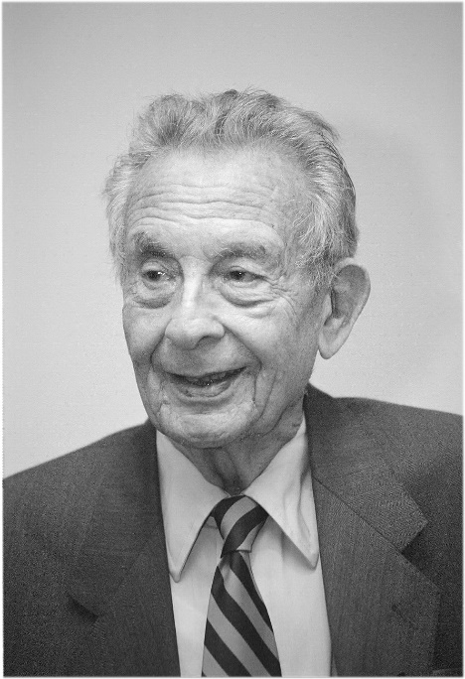
This theory is a more refined version of the effects model – where repeated exposure of the same messages/ideologies will eventually have an effect on the audience’s attitudes/values. This type of effect is cited when critics say that the audience has become desensitised, making the audience less sensitive to, for example, violent crimes in films/tv. Also, that exposure to repeated patterns of representation over long periods of time can shape and influence the way in which people perceive the world (cultivating particular views and opinions). Cultivation reinforces mainstream values (dominant ideologies)
CULTIVATION THEORY
GEORGE GERBNER
PASSIVE AUDIENCE

Slide 6
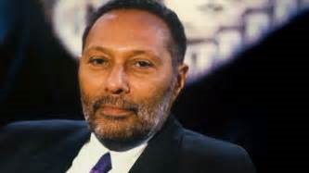
Reception Analysis STUART HALL When a producer constructs a text it is encoded with a meaning or messages that the producer wishes to convey to the audience. In some instances audiences will ‘correctly’ decode the message or meaning and understand what the producer was trying to say. Which is why there are 3 different ways for an audience to decode a text: Preferred/dominant reading Negotiated reading Oppositional reading
ACTIVE AUDIENCE

Slide 7
Preferred/dominant reading – Where the target audience receives the text they understand, and accept and share the messages/dominant values that were encoded by its producer (hegemonic reading) Negotiated reading – Where audience members receive the text and understand the messages/dominant values of the producers but will modify meaning or argue against certain messages (such as representations of groups etc.) To suit their own values and position. Oppositional reading – Where audience members not part of the target audience reject the preferred reading/dominant values of the producers and receive and construct an alternative meaning (counter hegemonic).
ACTIVE AUDIENCE

Slide 8
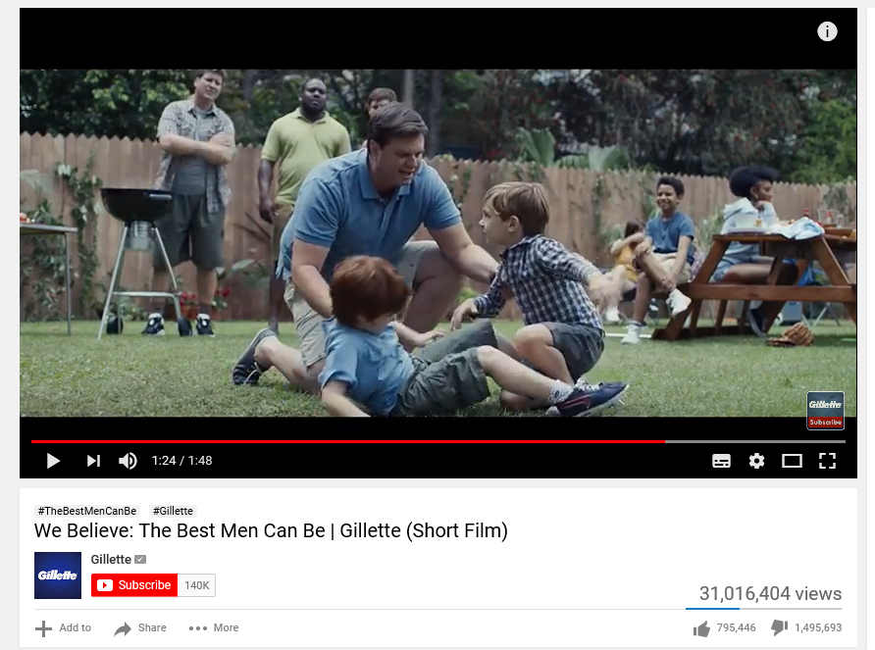
Reception Analysis: AN Example
ACTIVE AUDIENCE
What is the intended (preferred) meaning of this advert?
What techniques do they use to encourage this preferred reading?
Why did people have a preferred, negotiated or oppositional reading?
Buzzfeed
Pretty52
Campaign Live

Slide 9
FANDOM theory Henry Jenkins’s
ACTIVE AUDIENCE
Henry Jenkins (an American media academic) has developed the idea that fans are active participants in the construction and circulation of textual meanings.
Fans construct their own culture by appropriating and remixing texts and reading them in ways that are not fully authorised by the media producers (‘textual poaching’). Through this "poaching", the fans carried out such creative cultural activities as rethinking personal identity issues such as gender and sexuality; writing stories to shift focus onto a media "storyworld's" secondary characters; producing content to expand on the timelines of a storyworld; or filling in missing scenes in the storyworld's official narratives order to better satisfy the fan community.

Slide 10
‘End of audience’ theory Clay Shirky
ACTIVE AUDIENCE
Shirky (writer and academic) developed idea that the internet and digital technologies have had a profound effect on the relationship between the media and individuals.
The concept of audience members as passive consumers of mass media content is no longer tenable in the age of the internet, as media consumers have become producers who ‘speak back to’ the media in various ways, as well as creating and sharing content with one another.

Slide 11
For help revising theorist use your notes and have a look at….

Slide 12
ADVERTISING REGULATion
The Advertising Standards Authority (ASA) is the UK’s independent advertising regulator across all media platforms (TV, radio, press, billboards, online, leaflets…)
The ASA makes sure ads across UK media stick to the advertising rules (the Advertising Codes).
The Committee of Advertising Practice (CAP) is the sister organisation of the ASA and is responsible for writing the Advertising Codes.

Slide 13
Regulator TASK
Access the ASA links on GoL and in a word document answer the questions below:
Who are the ASA?
What are the regulations companies have to abide by?
How have companies broken those regulations?
Find examples of adverts which have broken ASA rules (include pictures if you can) and identify how they broke the rules

Slide 14
Quiz Questions
5 minutes
Write 3 quiz questions on audience:
Primary/secondary/tertiary
Mass/niche
Demographics
Socio-economic segmentation
Psychographics
Active/Passive
Theorists
Bandura
Gerbner
Hall
Jenkins
Shirky

Slide 15
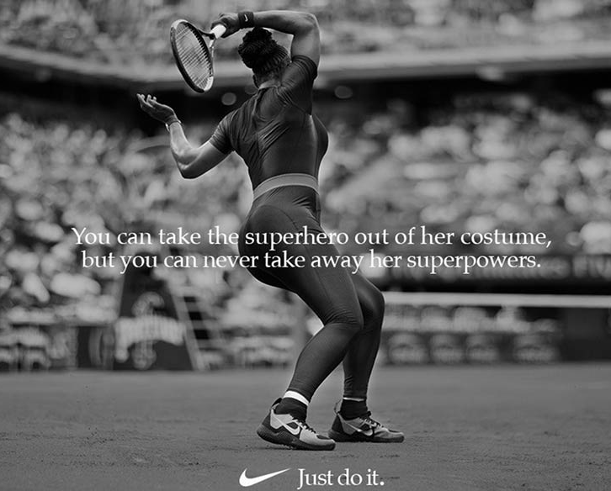
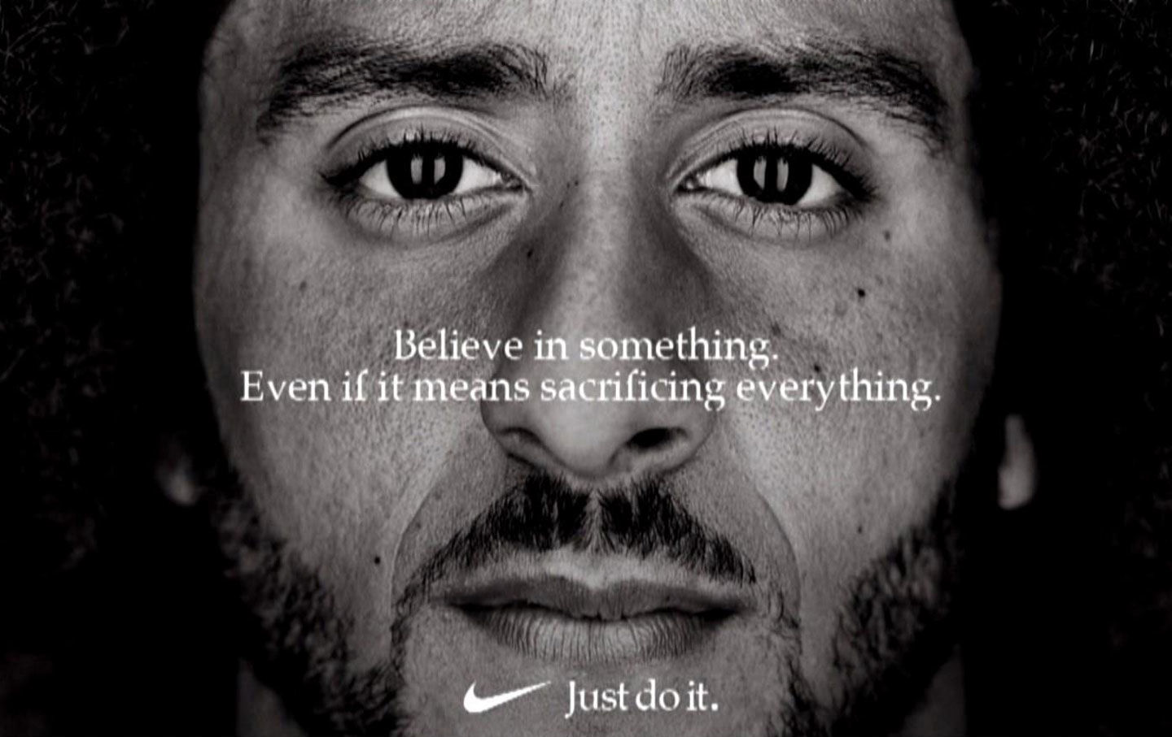
Can you write down the different decodings of the following adverts:
Preferred reading
Negotiated reading
Oppositional reading

