Slide 1
Enterprise
Needs, wants and identifying opportunities

Slide 2
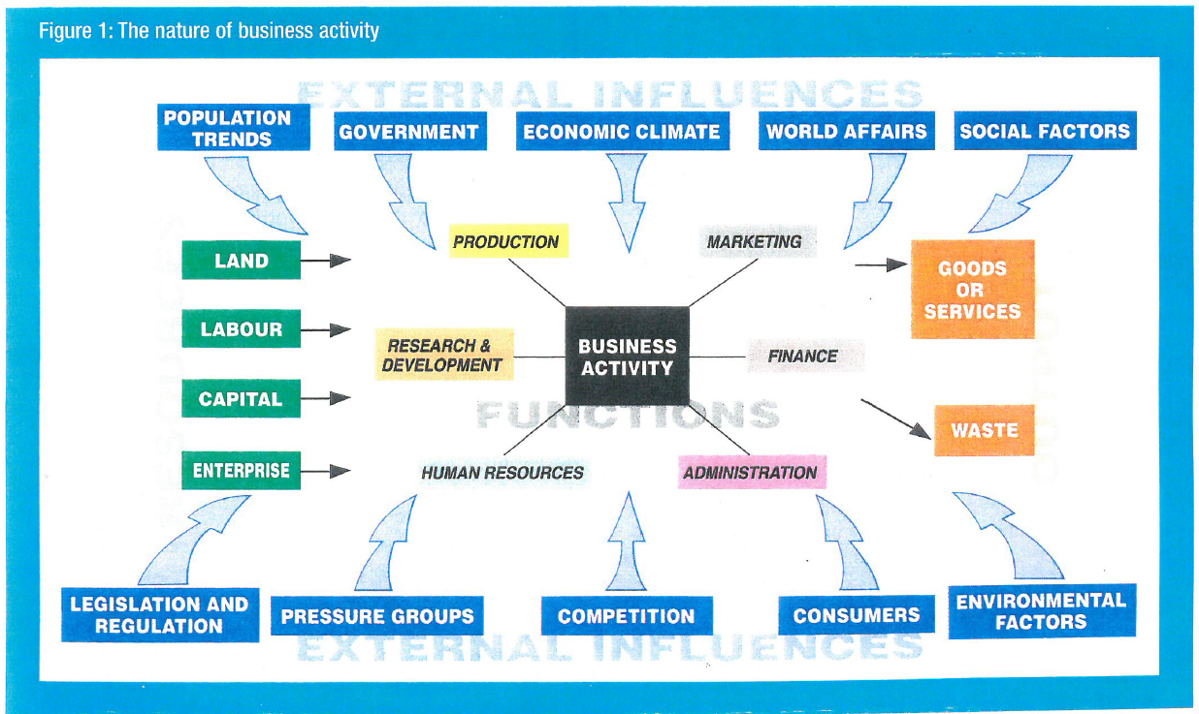
Notes:
5 mins

Slide 3
Enterprise, SMEs and Entrepreneur
With the person next to you discuss what the meaning of the three terms above.
Write down a concise definition of each word.
5 minutes
Notes:
5 mins

Slide 4
Learning Objectives
Be able to identify the features of a successful business
Be able to explain the meaning of enterprise and SMEs
Be able to discuss how satisfying needs and wants can give opportunities to entrepreneurs
Notes:
1 min

Slide 5
Enterprise, SMEs and Entrepreneur definitions
Enterprise: an organisation whose purpose is to produce goods and service
SME: Small and medium enterprises
Entrepreneur: someone who takes a risk to create or start a new business enterprise or project
Notes:
2 mins

Slide 6
Features of a successful business
Think of a successful SME in your local area....
Notes:
Necessity (satisfy a need / want)
Growth - Survival
Break even
Good understanding of their customer base
Meet objectives
Entrepreneur driving business forward (link to new learning)

Slide 7
Satisfying Needs and Wants = Opportunity
Needs = limited
Wants = unlimited
Opportunities occur when a market need exists
Create a product or service that isn’t already available, or find one that be improved.
Notes:
10 minutes
Reflect on enrolment task: Discuss the needs and wants investigated.
Explain how these needs and wants are satisfied by different businesses / organisations and how they could provide business opportunities for entrepreneurs.

Slide 8
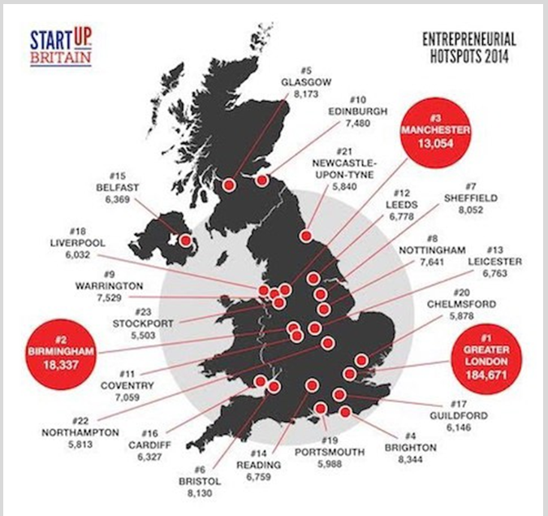
Identifying a business opportunity
Notes:
30 sec

Slide 9
What business to start in 2018
Startups.co.uk reveals growth trends and the hot new business opportunities you could seize in 2018…
Can you guess what they are?
Justify your answers.
Then lets look at the answers
5 minutes
Notes:
10 minutes

Slide 10

Boxing
There’s nothing new about boxing, but the sport is most definitely having a revival. A fun way to burn a lot of calories, get both lean and strong and bust some stress, it’s no wonder more people are turning to the sport for fitness.
Thanks to high profile boxing matches, endorsement from supermodels like Gigi Hadid and boxing mashups like piloxing, boxing is emerging from the shadows as the fitness trend for 2018.

Slide 11

Superfoods – Algae!
One of the most nutrient dense foods on the planet – blue algae (or spirulina) is the superfood ingredient you’ll hear everyone talking about in 2018...
In its top food trends for 2018 report, Whole Foods named super powders such as spirulina as “serious power players” for the year ahead.
And as more and more people turn to plant-based and vegan diets, it’s a trend that is only set to rise – as consumers look to find substitutes for protein and other essential vitamins and minerals they may lack from their diet. 60% of algae is made up of protein, music to the ears of fit-foodies.
Notes:
Next 6 slides 5 minutes in total

Slide 12

Premium mixers
With the likes of gin, mezcal and vodka all experiencing a resurgence in recent years, (albeit with some reinvention for more upmarket appeal), it was only a matter of time before the discerning UK public called out for a premium mixer to add to their tipple.
In fact, in 2017 UK tonic sales rose 35% from 2016 levels, with volume sales reaching 122,280 litres for November 2017 – a rise of 13% compared to the same period last year, and this trend shows no sign of stopping anytime soon.
With 25% of the UK’s population now enjoying cocktails regularly, the most obvious way to capitalise on this growing trend is to produce your own premium mixer that people can enjoy in a cocktail or as a drink in its own right.
Key to setting yourself aside from generic store brand mixers, as well as gaining the ‘healthy’ tag, will be to use real ingredients, natural flavours and to market yourself with an air of superiority.

Slide 13

Care home developer
In Britain, property development continues to be big business. And one industry segment which presents rich business opportunities for budding property entrepreneurs in 2018 is the care home market.
Increasing demands from the UK’s ageing population – now living longer than ever before – is putting a strain on the country’s existing care homes with a disparity between the number of care home beds available and the number of care home beds needed.
In fact, property experts predict 2018 is the year the care home market will hit a crisis point.
Becoming a care home developer in 2018 is a good business idea because there is a huge gap in the market: demand for care homes outweighs supply and is only expected to rise.

Slide 14

Women’s health tech
From period-tracking apps to smart contraceptives, this fledgling market is already busting taboos around the world – and 2018 is the time to join it
According to a report from Research and Markets, the global women’s health market is set to hit $51.3bn by 2025 – though you don’t need a figure to understand that there’s an immense audience to tap into here; roughly half of the population, in fact.

Slide 15
From the Topic notes
According to the Department of BIS [Business, Innovation and Skills] data, 99.2% of all UK businesses are defined as ‘small’ (i.e. they have between 0 and 49 employees).
SMEs make up 67% of UK private sector jobs.
Interestingly, this 99.2% of businesses is responsible for 47% of all private sector employment in the UK, and around one third of all turnover created by private enterprise.
Think – Pair – Share
Is this good / bad for the economy? Why / why not?
Notes:
5 minute discussion

Slide 16
From the Topic notes
Surprisingly, the number of people deciding to start up businesses on their own has increased each year since 2000, despite the recession. The Government estimates that the total number of business entities increased from 3.5m to 4.9m between 2000 and 2013.

Slide 17
Mid point summary
Identify 3 features of a successful start up.
In a short paragraph, explain how SMEs contribute to the economy.

Slide 18
Identifying business opportunities
In pairs and on computers:
Identify and investigate at a successful SME in your local area.
Choose businesses that you are interested in!
Find out:
What makes the business successful?
What inputs (factors of production) are required to meet the needs and wants of customers.
How could the business be improved?
20 minutes
Notes:
20 mins research
10 mins pair up and share with classmate / rest of class

Slide 19
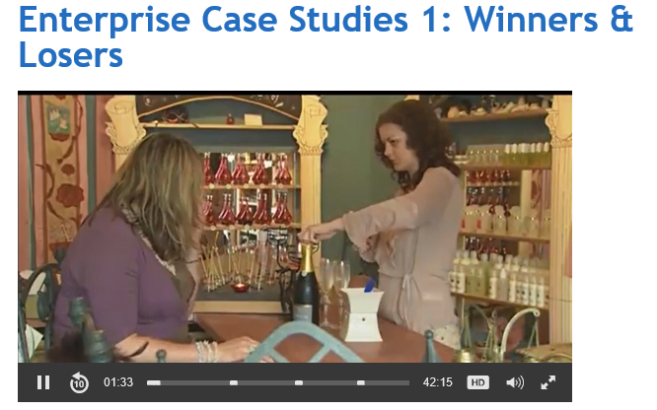
Winners and losers
Watch the following clips and identify
  Reasons for success
  Reasons for failure
Notes:
TV Choice - http://tvchoicestreaming.com/videos/enterprise-case-studies-1-winners-losers-full/
username: godalming-college
password: gc6Cvyg8nss964

Slide 20
Plenary
“Big businesses make the headlines, so why bother about the growth of small businesses?”
Do you think this statement undervalues the importance of SMEs to the UK economy?
(justify your response)
5
minutes
Notes:
5 minutes writing / 5 minutes chat
Write down response first. Then choose students (ideally with differing responses) to share with group.
Whilst students are writing response, circulate room checking knowledge and understanding via points being made.

