Slide 1
Starter
Identify 3 features of a successful start up.
In a short paragraph, explain how SMEs contribute to the economy.
Notes:
Necessity (satisfy a need / want)
Growth - Survival
Break even
Good understanding of their customer base
Meet objectives
Entrepreneur driving business forward (link to new learning)

Slide 2
Enterprise
Characteristics and motives of entrepreneurs

Slide 3
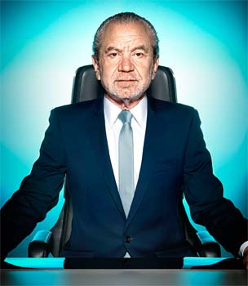
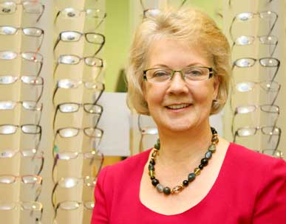
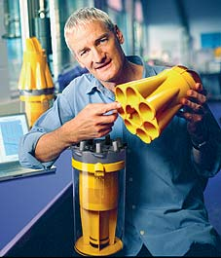
Think – Pair – Share Consider the successes of the following entrepreneurs... What characteristics/skills do they have?
Notes:
5 mins
Sir Alan Sugar, Dame Mary Perkins, James Dyson, Sophie Cornish and Holly Tucker, Sir Richard Branson
Use to instigate discussion. What are the similarities / differences between their skills / characteristics?

Slide 4
Learning Objectives
Explain the role of the entrepreneur in creating, setting up, running and developing a business
Explain the financial and non-financial motives of entrepreneurs
Explain the characteristics and skills of entrepreneurs

Slide 5
It takes risk and initiative!

Slide 6
In pairs, rank these skills/characteristics in order of importance.
Write a brief justification of your top 3 choices.

Slide 7
The role of the entrepreneur
Consider the process of starting (or taking over) an enterprise.
In bullet points, note down the tasks/responsibilities of an entrepreneur in creating, setting up, running and developing the business.
5 minutes
Notes:
Starter: 5 mins
2 mins comparison with classmates and feeding back to class.

Slide 8
The role of the entrepreneur
Owns (start up capital)
Organises (hiring / buying / decision making )
Take risks (loss of money / security)
Notes:
Choose students to share their responses before displaying on board
Discuss

Slide 9
Risk, reward and opportunity cost
Being an entrepreneur is risky. If the business fails:
May leave debts
May have left well paid employment
May find it difficult to return to working for someone else
Success and failure have an opportunity cost.
Opportunity cost = the benefits lost from the next best alternative
Notes:
Opportunity cost for a successful entrepreneur is likely to be lower than the benefits of owning a business.
If unsuccessful, the opportunity cost is likely to be higher. Unsuccessful entrepreneurs are likely to close the business.

Slide 10
Motivations of entrepreneurs
What would motivate you to start your own business?
Notes:
Build on work from the enrolment task
2 minutes for first part

Slide 11
Financial and non-financial motives
Financial | Non financial
To gain a profit (survival) | To be their own boss
To use redundancy money | Personal satisfaction
Grow personal wealth | To turn a hobby/passion into a business
 | Change in personal circumstances

Slide 12
Words from Richard Branson...

Slide 13
Paired investigation task
Select 3 entrepreneurs:
Describe the nature of their business
Identify their particular skills/characteristics
Explain the reasons for their success.
Were their motivations financial or non-financial?
Be prepared to share your findings with the class.
Notes:
Encourage students to choose at least one young entrepreneur from the ‘Being a young entrepreneur’ link on GoL.
They should create a presentation (slide on each entrepreneur).

Slide 14
Why are entrepreneurs important for the economy?
Create businesses that hire people
Add to national income
Crate demand for products which in turn create jobs for other businesses
Introduce new technologies to the market
Community development

Slide 15
Plenary
To what extent do you agree with the statement “All successful entrepreneurs are risk takers”
Do you agree / disagree?
Why / why not?
Justify your response.
Notes:
Do they agree / disagree? Why / why not?
Justify
Discuss other skills / attributes required to be a success...

Slide 16
Prep work due Monday 17th September
Read the stakeholders notes
Define the term ‘ stakeholders’
Summarise the interests of each of the different stakeholder groups
One side of A4!

