Slide 1
Enterprise
The importance of entrepreneurs and SMEs

Slide 2
Getting started....
Reflect on what you learnt about stakeholders from your prep work
Suggest what the main objectives are of at least two different stakeholder groups
Notes:
5 minutes

Slide 3
Learning Objectives
Identify the various stakeholders who are affected by a business
Explain the importance of entrepreneurs and SMEs to the primary, secondary and tertiary sectors of the UK economy.
Evaluate the impact of entrepreneurs and SMEs on businesses and the economy

Slide 4
Stakeholders
Any individual or group which is affected by the business and so has an interest in its activities.
Stakeholders are not all driven by the same objectives
Not unusual for stakeholder groups to have conflicting views regarding a business’s activities – why?
In pairs – identify possible conflicts between different stakeholders...
Notes:
Choose students to identify the different stakeholders.
Use slide to define.
Use questioning to get students to explain why conflict exists between particular stakeholder groups

Slide 5
Possible conflicting aims of Stakeholders
Shareholders
High profit levels, positive corporate image, long term growth
Employees
Job security, good working conditions, high levels of pay, promotional opportunities
Customers
High quality products and services, low prices, good service, wide choice
Suppliers
Regular/increasing orders, prompt payment, steady growth
Local community
Employment opportunities, acting in a socially responsible manner
Government
Efficient use of resources, employment and training, complying with legislation
Notes:
Provide on handout

Slide 6
Stakeholders

Slide 7
Why are entrepreneurs important to business and the economy?
They are innovative
Drive business forward
Create businesses that hire people /create new jobs
Boost economy by providing new products
Create demand for products which in turn create jobs for other businesses
Increase exports
Government benefits from taxation
Community development
Notes:
Can provide better ways of doing things which can lead to new business
Help government through taxation

Slide 8
Business Activity
Business activity can be conveniently divided into three sectors:
Primary
Secondary
Tertiary

Slide 9
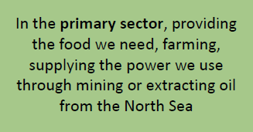
Primary Sector
Extractive – produces raw materials e.g. iron ore (goes into making steel) and oil (that makes petrol, plastics etc.)
Producing final products e.g. fish, oranges.

Slide 10
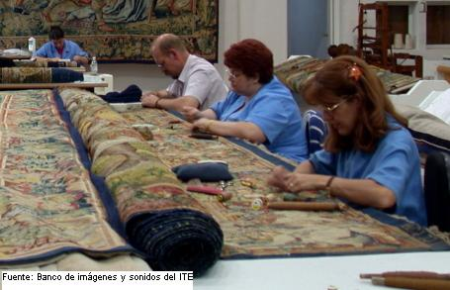
Secondary Sector
Manufacturing and construction industries make, build and assemble products

Slide 11
Tertiary Sector
Includes the provision of services.
Services give value to people but are not physical goods.
Direct services (to people e.g. police, hairdressing)
Commercial services (to business e.g. business insurance, financial services etc.)

Slide 12
Activity 1
Look back at the notes you made about 2 successful entrepreneurs.
For one of the entrepreneurs consider the impact they have had on businesses and the economy.
Which business sector? How has their contribution helped that sector grow?
What impact has that entrepreneur made on the economy?
Impact on stakeholders?
Notes:
20 minutes

Slide 13
Activity 2
Using the resources on Godalming Online, and other websites, gather information and statistics to help you explain the importance of entrepreneurs to:
The primary, secondary and tertiary sector
The UK economy
You should also find out more about the different sectors
Notes:
Show the resources to use on screen and point out areas of interest (e.g. stats about employment that SMEs provide – pg 4 / SMEs by industry sector pg 12 of Business Population document)
Use the information found to write a succinct paragraph explaining the importance....

Slide 14
What does explain mean? (AO3)
Explain (AO3): You will need to make a point, explain why the point is important and explain its significance to the question
Cause and effect
Knock on implications

Slide 15
What does evaluate mean? (AO4)
You will need to discuss two sides of an argument and consider more than one perspective
You will be required to consider limiting factors It is useful to consider the long term and short term issues
Involves you weighing up options and coming to a judgement/conclusions

Slide 16
Activity 3
Complete the Enterprise past paper questions.
Be mindful of the command words in the questions and the structure of your answer

Slide 17
Plenary
Explain how the interests of the owners of a business may conflict with the employees?

Slide 18
Homework
Complete the online enterprise quiz on GoL
Read and summarise the business plans notes
Purpose of business plans
Headings to include in business plan
Advantages of drawing up a business plan
(one side of A4 maximum)
Due Monday 19th September
Answer the James Dyson question
Due Tuesday 20th September

