Slide 1
LOCATION OF INDUSTRY

Slide 2
The location of a business can have a significant effect on its success
It can effect:
Demand
Costs e.g. cost of land, leasing, transport, labour
Job satisfaction

Slide 3
An organisation must consider
access to customers;
access to factors of production;
minimisation of costs.

Slide 4
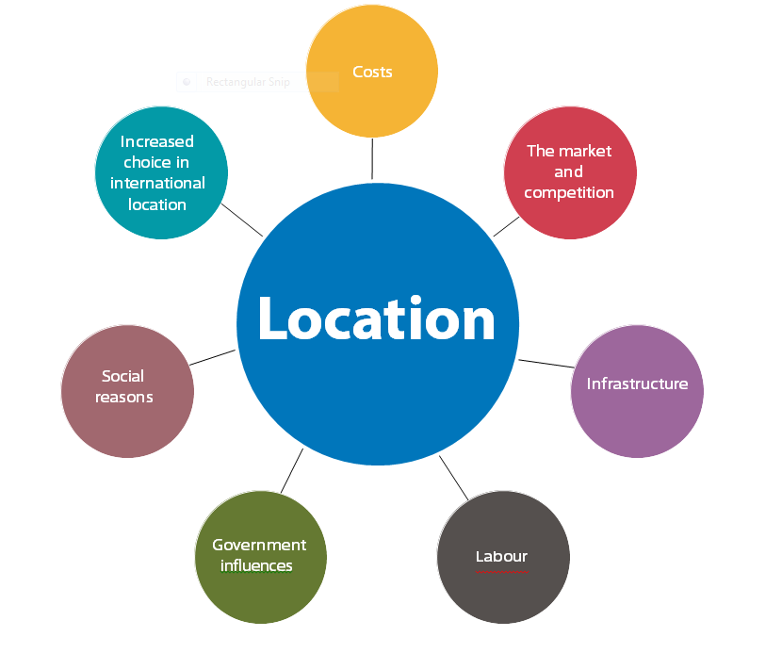

Slide 5
Cost is a key factor
The setting up of a new business will incur a number of location costs including:
• planning permission
• purchasing or rental/leasing
• refurbishment
• business rates
• labour costs
• transport costs

Slide 6
Competition
Most commercial B2C exchanges (buying and selling in consumer markets) still take place face-to-face, so a physical location is required.
Next to other similar businesses?
Away from other similar businesses?

Slide 7
Infrastructure = access to markets
Infrastructure is used to mean roads, rail and shipping.
However, a more modern definition includes electronic communication systems, training agencies and financial services.

Slide 8
Labour (people working)
Location affects
The cost of labour
The availability of labour
The available labour skills

Slide 9
Other influences
Government grants – to encourage organisations to locate in specific regions
Social reasons – living near family, friends or schools
Qualitative factors
  e.g. reputation of an area, convenience, quality of life, inertia, USPs

Slide 10
Footloose
Footloose businesses are those that move from location to location, basing themselves wherever best suits their needs at a particular point in time:
• changing patterns of trade
• improved communications
• freer flows of capital

Slide 11
International businesses will consider
Economies of scale.
Costs of international transport and containerisation have fallen (25-5%)
Wage levels in different countries
Taxation levels in different countries
Skills of the workforce
Legislation (freedom from restrictions – ethics of this?)

Slide 12
Activities
BBC News: IKEA opening riots http://news. bbc.co.uk/1/hi/england/london/4252421. stm | Explain three likely reasons why IKEA chose this location.
Reuters: How Starbucks avoids UK taxes http://uk.reuters.com/article/2012/10/15/ us-britain-starbucks-tax- idUSBRE89E0EX20121015 | Explain how Starbucks takes advantage of transfer costing.

Slide 13
Evan Davis at Exeter University Why is London so dominant in the UK? https://www.youtube.com/watch?v=scCH_ M5D9PQ The Shoreditch roundabout https://www.bing.com/videos/search?q=shoreditch+roundabout&&view=detail&mid=C12A44FD76D6C81A0F34C12A44FD76D6C81A0F34&&FORM=VRDGAR | Is London’s growing success good for the UK in general? Will improved infrastructure help close the economic gap between London and Manchester/Leeds/Bradford? What factors influenced the decision of the UK’s tech companies’ to locate in Shoreditch?

Slide 14
Discussion/questions
Discuss the following statement:
‘Location is the key to business success’
Discuss the following statement:
‘Access to customers is the most important
location factor.’
Explain what is meant by ‘footloose’

Slide 15
Conclusion
The right location can make the difference between success or failure.
It can affect
  Costs of production
  Sales
  Image
  Ease of getting your product to market
  The right location is crucial to the success of a business unfortunately it may not be able to choose the right location due to issues such as lack of finance.

Slide 16
Summary of factors to consider
Cost of location
Competition
Legal issues
The market
Suppliers and resources
Infrastructure
If you were setting up a business in Godalming what other factors would you take into consideration?

