Slide 1
90:
30: Starter
What is an economy? Key Words: Households, Firms, Financial Institutions, Government, Foreign Countries….what are they and what role do they play in the economy?
What is an Economy – Note taking and silly pics
Key players in the UK economy – PM, Chancellor and Bank of England
Intro to PPF
UK Economy
PREP:
45: Macroeconomic Indicators and Objectives Research – Research table to fill in
45: UK Economy Today – Articles and summary mindmap
45: Circular Flow of Income – read and comprehend
90:
Circular Flow of Income Model
Production and Production Possiblity Frontiers
Macroeconomic Indicators and Objectives – plus what are the big issues in the UK today?
RWS:

Slide 2
WEEK 1

Slide 3
90
Notes:
NEED
WSHT – UK Economy 2019

Slide 4
Homework (4.5 Hours) – Resources on GOL and Online Textbook Due for Tuesday 17th September
REMEMBER MY EMAIL ADDRESS IS ods@godalming.ac.uk if you have any questions or queries….no question is a stupid question remember! Make sure you clarify your understanding.
MICROECONOMICS (2.25 hours)
45mins: Economic Systems: Capitalism and Socialism. Read (1) revision worksheet and (2) Article and summarise onto one side of A4 mind map stating what the two systems are with examples and some advantages and disadvantages
45mins: Production and Productivity. Read pages 55-57 and pages 59-60 and define the following key terms and provide a possible example for each one:
Production
Productivity
Specialisation
Division of Labour
45mins: Production Possibility Frontier INTRO – complete the 3 exercises on the worksheet on GOL – have a go; do not worry if you get the wrong answer! You need to attempt to complete it.
MACROECONOMICS (2.25 hours)
45mins: Macroeconomic Indicators and Objectives Research – Research table to fill in, using the internet (worksheet on GOL)
45mins: UK Economy Today – Find an article from the BBC News Website to do with the UK Economy. Summarise the article. What are the main points of the article? Is the article optimistic or pessimistic about the UK economy? Why?
45mins: Circular Flow of Income – read and try to complete the worksheet

Slide 5
45

Slide 6
RWS 1: Introduction to MACROECONOMICS
STARTER ACTIVITY: The following Key Words are important to an understanding of how the ‘macroeconomy’ works. See if you are able to explain what they are and what their function might be in an ‘Economy’…
Households
Firms
Financial Institutions
Government
Foreign Countries
TODAY
What is an Economy?
Who’s Who in the UK Economy
What is Macroeconomics

Slide 7
ECONOMICS: Production and Growth
What is OUTPUT?
INPUTS
(resources)
Labour
(Human Workers)
(Entrepreneurs – Business People)
Capital
(Physical/Natural Resources)
(Man Made Resources)
PRODUCTION
(by a firm)
OUTPUTS
(GDP)
Goods and Services:
Primary
Secondary
Tertiary
“Quaternary”???

Slide 8
What is an Economy?
Notes:
Teacher led country exercise leading to the 4 main economic indicators

Slide 9
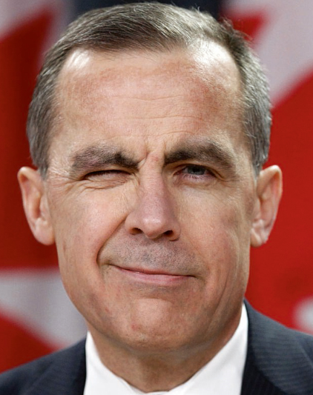
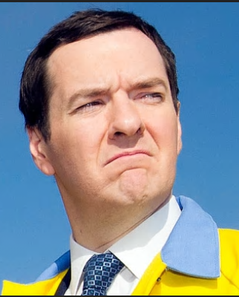
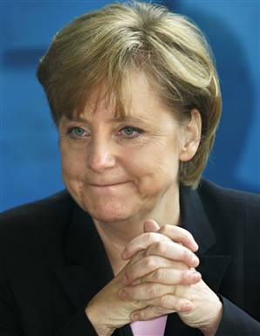
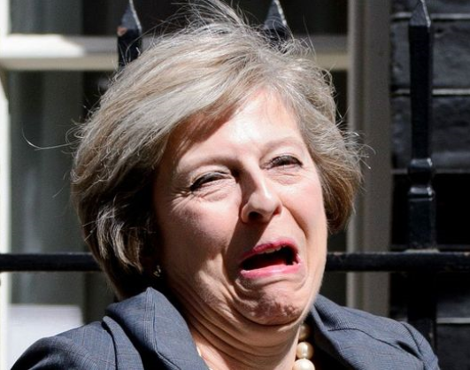
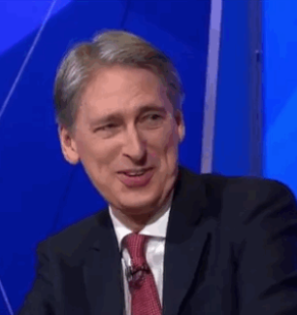
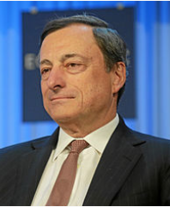
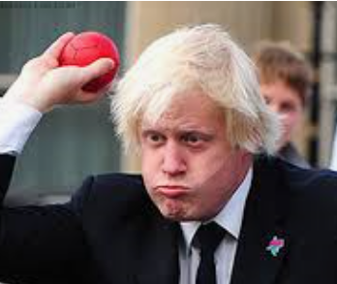
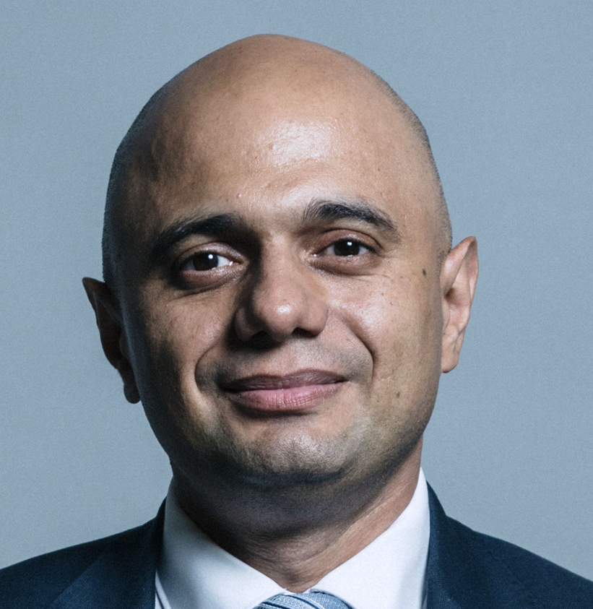
1
4
5
2
3
9
8
6
7
Notes:
4 = Jerome Powell
8 = Mario Draghi

Slide 10
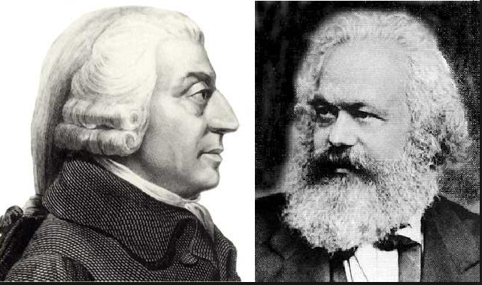
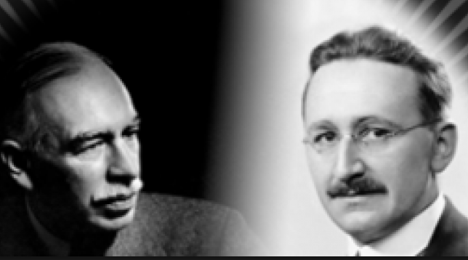
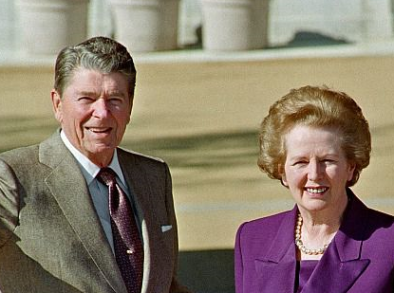
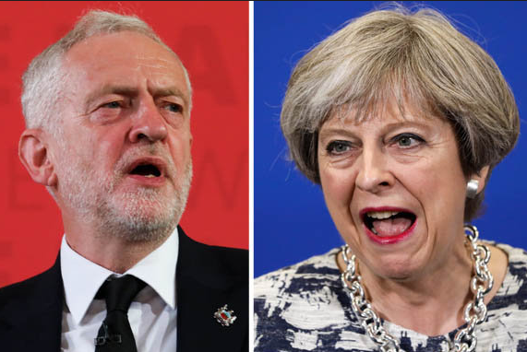
HISTORY OF MACROECONOMIC THOUGHT
Pure Planned Economy
Pure Market Economy
Pre 1930’s: Classical Economics (Hayek, Smith, Ricardo, Say etc)
1930’s-1945: Hayek .v. Keynes
1945-1973: Keynes
1973-1979: Downfall of Keynes?
1979-2007: Neo-liberalism (Classical resurgence?)
2007-today: What now? Austerity? Rising inequality? Are we ‘all in it together’?

Slide 11
45

Slide 12
Economic Models Circular Flow of Money Model Introduction

Slide 13
UK Economy ARticle
INDIVIDUALLY: Read the article and try to write what the title of the article is?
“UK economy falters as slowing global growth adds to recession risk”
GROUP READING and DISCUSSION: As we read through, make notes around the article

Slide 14
WEEK 2

Slide 15
90

Slide 16
Production Possibility Frontier
Simple Model: Representing Capacity in the Economy
CLASS
Draw this model and the letters
What do you think ‘capital goods’ and ‘consumer goods’ are?
GROUPS
Which letter represents unemployment in the economy?
What might point B represent in the economy?
Can the economy be at C?
What might be the short run and long run implications of producing at E rather than D?
Capital Goods
C
E
B
A
D
Consumer Goods
Notes:
Capital Goods: Machinery etc. Goods that produce other goods
SR = Drop in standard of living
LR = Potential for better technology and production possibilities (mean expanding PPF)
Consumer Goods: Goods that are produced for ‘end consumption’ – e.g. ice cream, dishwashers, cars etc.
SR = Increased standards of living – people have more stuff
LR = Less scope for PPF to expand

Slide 17
TODAY: MACROECONOMICS
RECAP – 1st 3 minutes to answer these questions in groups ready to get picked on/show off your knowledge!
What does PPF stand for?
What does a PPF model in Economics show?
If there is a movement from one point on the PPF to another, what does this represent?
If the PPF expands outwards, what does this mean?
If the PPF contracts inwards, what does this mean?
How does the PPF show productive efficiency and why?
TODAY
What is Macroeconomics
History of Macroeconomics
Who’s Who in Macroeconomics
What is an Economy?
Application of the PPF Model
New Model = The Circular Flow Model - 2, 3, 4 and Open Economy Sectors

Slide 18
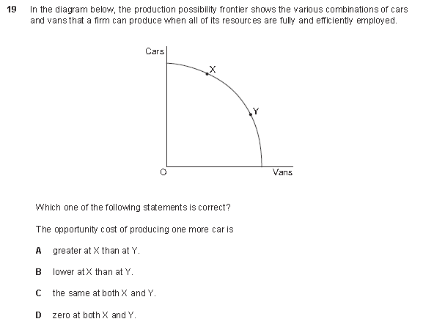
Notes:
ANSWER: A

Slide 19
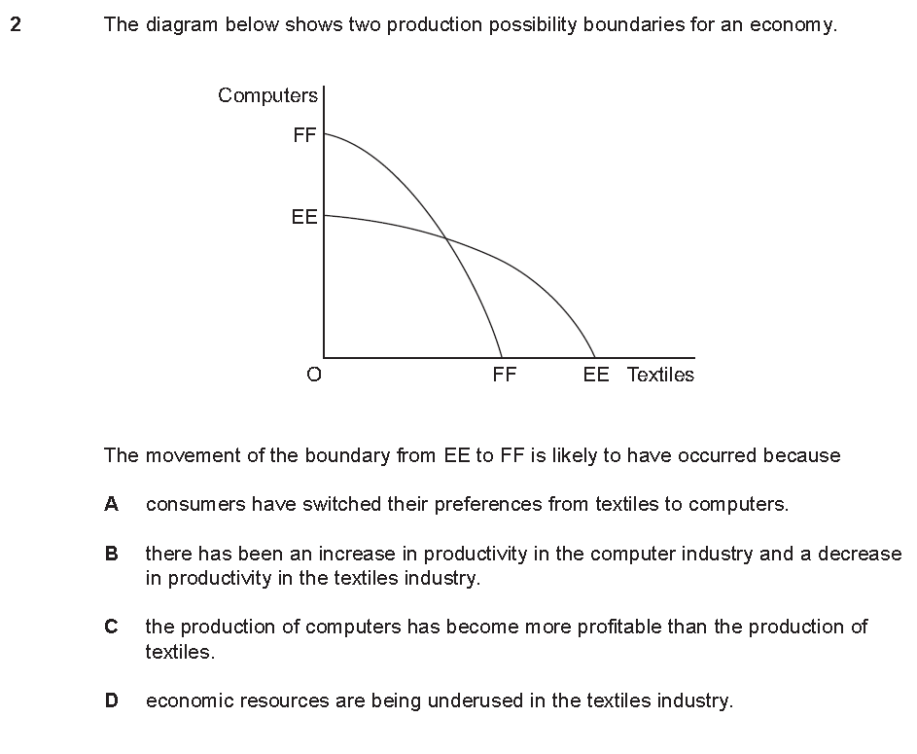

Slide 20
30

Slide 21
MACROECONOMIC MODEL: THE CIRCULAR FLOW OF INCOME
The 1 Sector Model (Households)
COMMENTARY:
The economy is represented by the blue box. If the box gets bigger, then the economy has experienced ECONOMIC GROWTH
Imagine a scenario where the economy consisted of only four households (a desert island?)
If we assume the economy has a currency of “pounds”; to begin with, one household may start trading goods and services for pounds
Soon, all the different households will start trading with each other to obtain more goods and services
A VERY SIMPLE ECONOMY
GOODS / SERVICES
HOUSEHOLD
HOUSEHOLD
PAYMENT
PAYMENT
PAYMENT
GOODS / SERVICES
GOODS / SERVICES
PAYMENT
HOUSEHOLD
HOUSEHOLD
GOODS / SERVICES

Slide 22
MACROECONOMIC MODEL: THE CIRCULAR FLOW OF INCOME
The Basic 2 Sector Model (Households and Firms)
COMMENTARY
We now have the more realistic assumption of households and firms. Households consist of workers who earn money to spend money on goods and services. Firms are profit making enterprises, set up by individuals from the households (entrepreneurs) and specalise in the production of goods and services
If we assume that all households own the inputs or resources in an economy, then a bright entrepreneur will see a gap in the market and want to produce a good (think about Dragon’s Den) using the resources from the household (like labour and land)
Households will be expected to be compensated for their trouble (i.e. hours worked) and will receive wages and an income
The firms will take these resources or inputs and produce some output (a good or service)
Firms will not be giving out goods and services for free, they will except to be compensated. Households will pay firms for the goods they provide. This is called expenditure or consumption.
OUTPUT (GDP)
EXPENDITURE (Consumption)
HOUSEHOLD
FIRM
INCOME (Wages, Profits etc.)
INPUT (Labour, Capital etc.)
QUESTION:
What additions to this model would make it more realistic?

Slide 23
Key Terms to Help:
Agents in the Economy
Household: Consumers who work and wish to buy things from the firms
Firm: A company who is trying to maximise profits
Government: The people who run the country – are they democratically elected? Or did they come to power because they had more tanks than another despot?
Financial Institutions: Banks, stock markets, equity markets, the City – all those kind of things.
Foreign Countries: “Johnny Foreigner” not only buys are goods but also sells stuff to us as well.
Movement of money in the Economy
Expenditure = Households consume goods and services, paying firms
Income = Households work for firms or entrepreneurs
Savings = firms and consumers might save money. They could put it in the bank or they might “invest” it in the stockmarket OR they might
Investment = ONLY firms can invest because it is defined as “purchasing capital” or factory machines, buildings etc.
Taxation = both firms and households get taxed by the Government. Firms have corporation tax they must pay which is a tax on profits. Consumers get taxed via VAT, income tax, inheritance tax. It all goes into the Governments “coffers” and helps to fund the Government Budget.
Government Spending = both firms and households receive Government spending. Governments might spend money on households through the NHS, education or benefits. Firms might receive subsidies etc.
Exports = Foreign countries will buy goods from firms. Consumers might also sell their possessions to foreign countries – for example on E-bay.
Imports = Consumers and firms will both buy imports from firms etc. in foreign countries. Consumers might be buying cars etc. whereas firms might be purchasing raw materials to make a product or goods to sell – e.g. Sainsbury’s buying flowers from Zambia to sell to the UK population
Build an Economic Model

Slide 24
MACROECONOMIC MODEL: THE CIRCULAR FLOW OF INCOME
The 3 Sector Model (Households and Firms - with Financial Institutions)
COMMENTARY
We now introduce the idea of leakages / withdrawals and injections into the circular flow. These still remain within the economy.
Households may not spend (consume) all of there money and might prefer to save, placing their money into a bank or stockmarket for example. Equally, firms might decide to save some of their profits and place them in a bank as well.
Banks use this money to invest in the economy by making loans to other firms who then use the borrowed money to invest specifically in their business. Greater investment means that the blue box gets bigger and there is greater output (or GDP/Economic Growth). More investment also means more demand for resources or inputs such as workers.
At the moment, the financial institutions are within the economy but for a very complex model, you could have some financial institutions outside the economy. These are off shore banks which a lot of people save money in.
INJECTION
INVESTMENT (I)
OUTPUT (GDP)
EXPENDITURE (Consumption)
FINANCIAL
INSTITUTION
HOUSEHOLD
FIRM
INCOME (Wages, Profits etc.)
SAVINGS (S)
INPUT (Labour, Capital etc.)
LEAKAGE
QUESTION:
Explain what would happen to the economy if consumers decided to save more?

Slide 25
MACROECONOMIC MODEL: THE CIRCULAR FLOW OF INCOME
The 4 Sector Model (Households, Firms and Governments – with Financial Institutions)
COMMENTARY
To make our model economy even MORE realistic, we now introduce Governments into the economy. Governments are important because they establish property rights (in other words people can own things without fear of them being taken away)
Governments normally require that households and firms pay tax. Taxes for households might include income tax, VAT, National Insurance etc. Whilst Firms may be faced with corporation tax (tax on their profits) and business rates. This money is received in tax revenues by the Government.
The Government will then spend this money on both households (welfare state - education, benefits, health) and firms (subsidies for new business etc.)
GOVERNMENT
SPENDING (G)
LEAKAGE
INVESTMENT (I)
OUTPUT (GDP)
INJECTION
EXPENDITURE (Consumption)
GOVERNMENT
FINANCIAL
INSTITUTION
HOUSEHOLD
FIRM
INCOME (Wages, Profits etc.)
SAVINGS (S)
INPUT (Labour, Capital etc.)
TAXATION (T)
LEAKAGE
INJECTION
QUESTION:
Explain what might happen in the economy if the Government decided to cut income tax and reduce the amount of money going to the Welfare State?

Slide 26
MACROECONOMIC MODEL: THE CIRCULAR FLOW OF INCOME
The 5 Sector Model (Households, Firms, Governments and World Economy – with Financial Institutions)
COMMENTARY
Foreign countries in the world economy are now added to the mix. They are outside the blue box because they are not part of the economy directly but can make it bigger or smaller
Firms import goods and services from abroad and sell them to households. As a result, money which might have been spent in the blue box (our economy), ends up in another country!
Firms also export goods and services. Firms will sell their goods and services to other foreign firms in the world economy.
GOVERNMENT
SPENDING (G)
LEAKAGE
INVESTMENT (I)
OUTPUT (GDP)
INJECTION
EXPORTS (X)
EXPENDITURE (Consumption)
WORLD
ECONOMY
GOVERNMENT
FINANCIAL
INSTITUTION
HOUSEHOLD
FIRM
INCOME (Wages, Profits etc.)
SAVINGS (S)
INPUT (Labour, Capital etc.)
IMPORTS (M)
TAXATION (T)
INJECTION
LEAKAGE
QUESTION:
Explain how a global recession would affect the UK economy?

