Slide 1
Jun 2011
Identify and explain the different types of anxiety that may affect a performer.
(3 marks)
Jun 2010
Using the ‘catastrophe theory’, describe how over-arousal may affect a player’s performance. (4 marks)

Slide 2
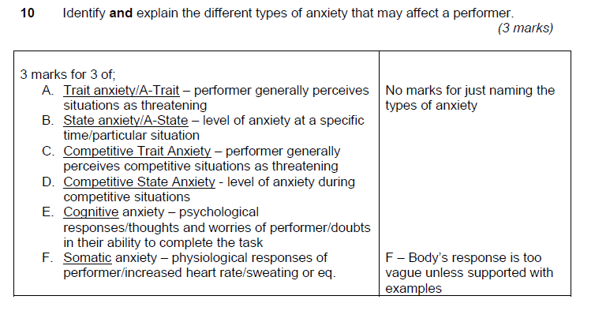

Slide 3
