Slide 1
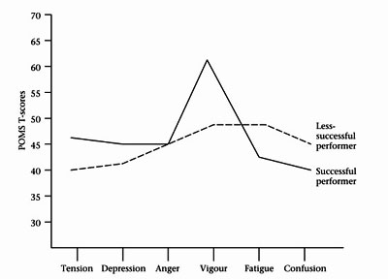
2
Psych
Profile of Mood States
A graph to indicate the general emotions of a performer
Six measures
Tension/depression/anger/vigour/fatigue/ confusion
Performers have higher levels of vigour and lower levels of other measures
This is known as the Ice berg profile
Some elite performers do not have this profile/some non-elite athletes display the profile.

Slide 2
Agree
Mood states are temporary/change depending on the situation/ unstable
More accurate than traits/stable traits
Successful performers display iceberg profile
Successful performers have higher levels of vigour/anger
Disagree
Some elite performers do not have this profile
Some non-elite athletes display the profile
Elite performers may develop positive mood states as a result of success/do not display required mood states before becoming successful

