Slide 1
5
Psych
Past examination questions
Jun 2008
Rugby is a team game that has high psychological and physiological demands. During a rugby match there is considerable physical contact, but incidents of aggression are relatively rare.
(i) Explain the terms hostile aggression, instrumental aggression and assertion. [3]
(ii) Explain how frustration may lead to aggression. [4]
(iii) How might a coach try to reduce the aggressive tendencies of one of their players? [3]

Slide 2
5
Psych
(i) Explain the terms hostile aggression and instrumental aggression. (2 marks)
2 marks for 2 of:
1. Hostile – reactive/solely to harm/planned/involves anger
2. Instrumental – channelled/means to a goal/no anger involved/use aggression to get result
(ii) Explain how frustration may lead to aggression. (4 marks)
4 marks for 4 of:
1. Performer tries to achieve goal
2. Opposition block/stop/tackle
3. Leads to frustration and possible aggression
4. Build up of frustration – more likelihood of aggression
5. Aggression reduces frustration/catharsis
6. (Berkowitz’s) aggressive cues – greater likelihood of aggression

Slide 3
5
Psych
(iii) How might a coach try to reduce the aggressive tendencies of one of their players? (3 marks)
3 marks for 3 of:
1. Praise/reinforce assertive behaviour
2. Remove cues/factors causing aggression
3. Remove/penalise aggressive player
4. Teach stress management techniques to reduce arousal/relaxation
5. Teach cognitive techniques/imagery/self-talk
6. Encourage performance-related rather than outcome related goals
7. Stop encouraging/reinforcing aggressive behaviour

Slide 4
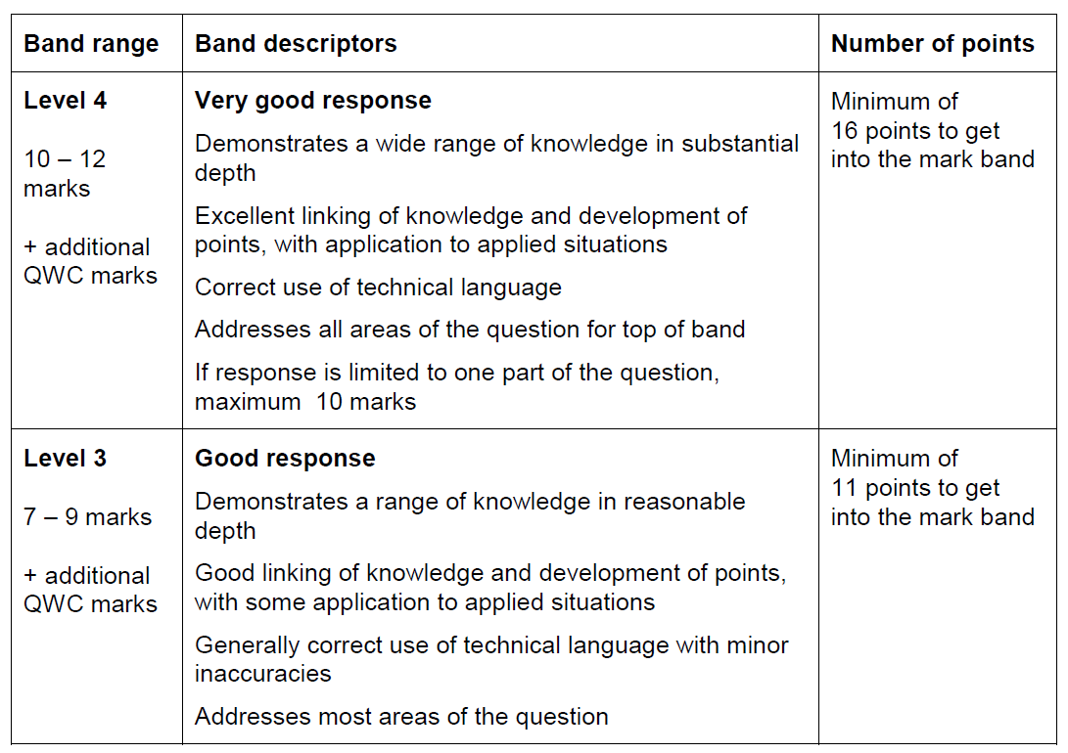
5
Psych

Slide 5
5
Psych
Aggression 14 Marker
Sporting contests require the performer’s full commitment, both physically and psychologically. The performance of some individuals can be hindered by over-arousal.
Explain, using appropriate psychological theories, the possible causes of aggressive behaviour during sporting contests and suggest strategies that a coach could use to develop the assertive behaviour of a performer.
Task 1
Produce a mark scheme listing all the possible key points – aim for 24!!
Task 2
Write your best possible answer in 20 minutes

