Slide 1
Mise-en-scene
Setting/ Location
Props
Costume & Make up
Lighting & Colour
Body Language

Slide 2
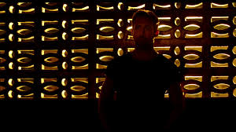
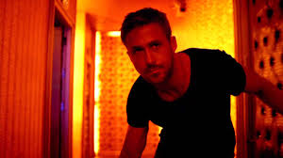
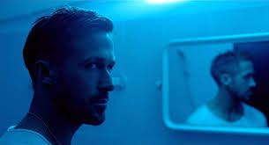
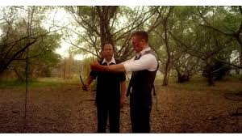
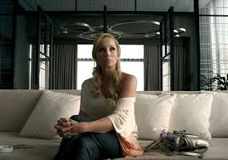
Lighting and Colour
Lighting articulates texture and helps to create a depth to the dimensions of the film screen using shadows and highlights to shape objects.
Importantly it can create mood and evoke a variety of reactions from an audience.

Slide 3
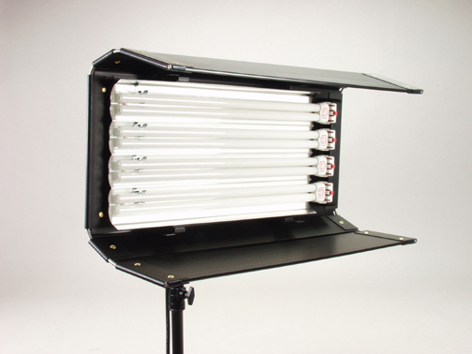
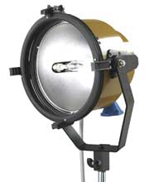
Examples of Lighting Equipment
Kino Flo
Blonde
Red Head

Slide 4
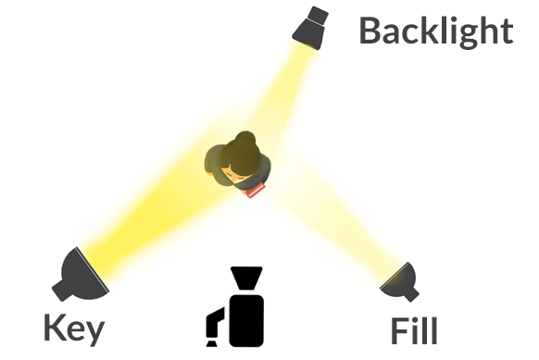
Three Point Lighting
A typical lighting setup will contain the following 3 lights:
We’ll go in the studio later to check out our set-up

Slide 5
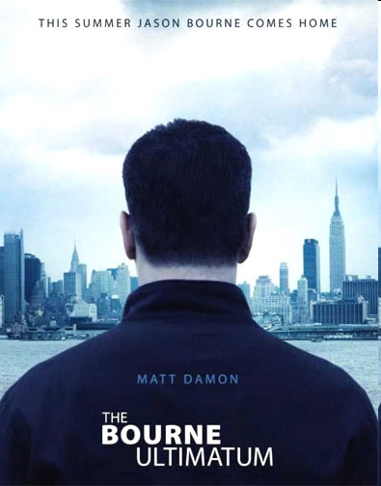
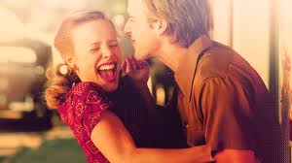
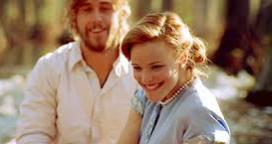
High Key Lighting

Slide 6
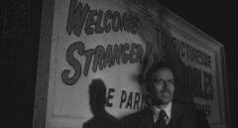
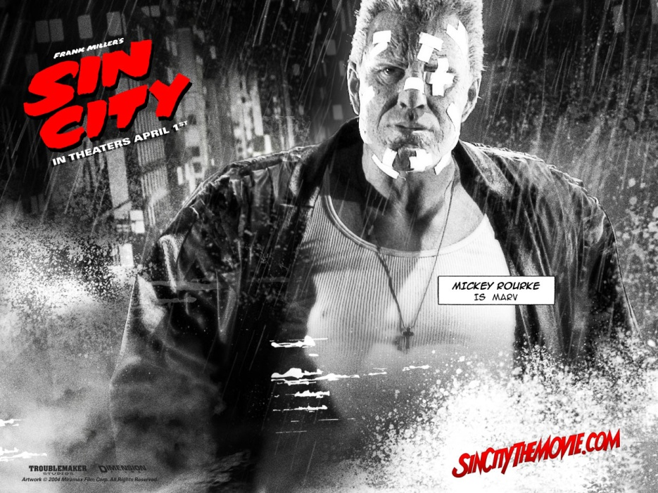
Low Key Lighting

Slide 7
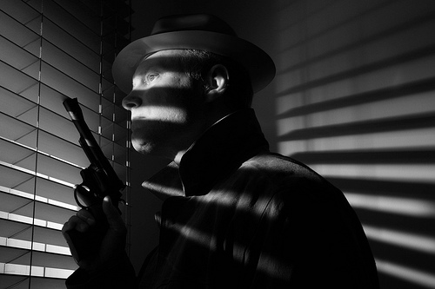
Attached Shadow

Slide 8
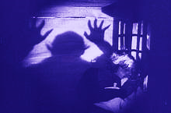
Cast Shadow

Slide 9
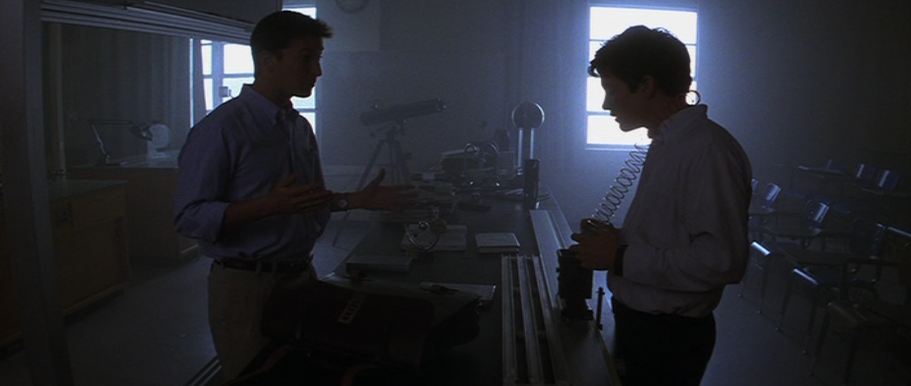
Donnie Darko (Richard Kelly, 2001)

Slide 10
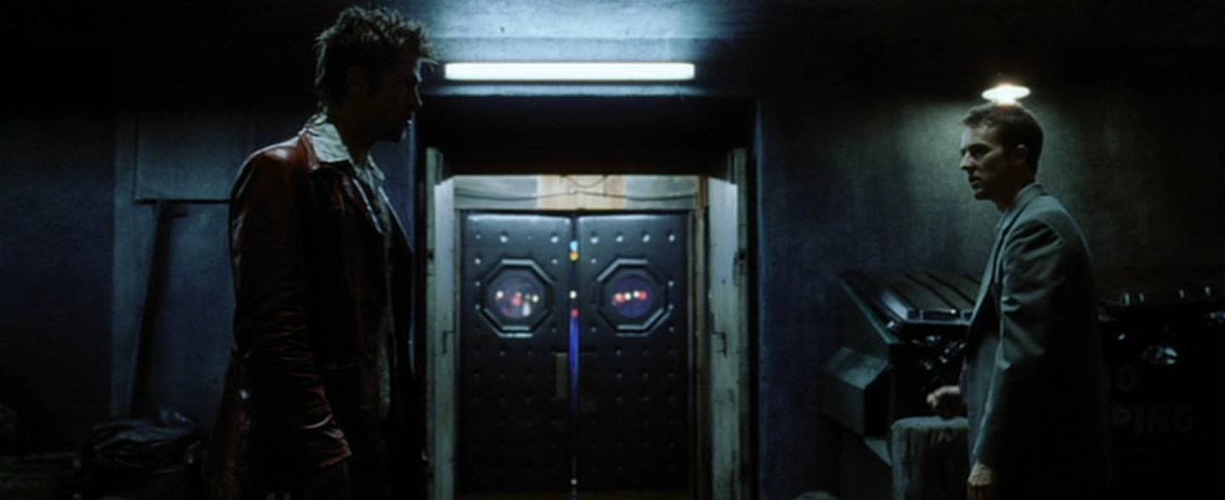
Fight Club (David Fincher, 1999)

Slide 11
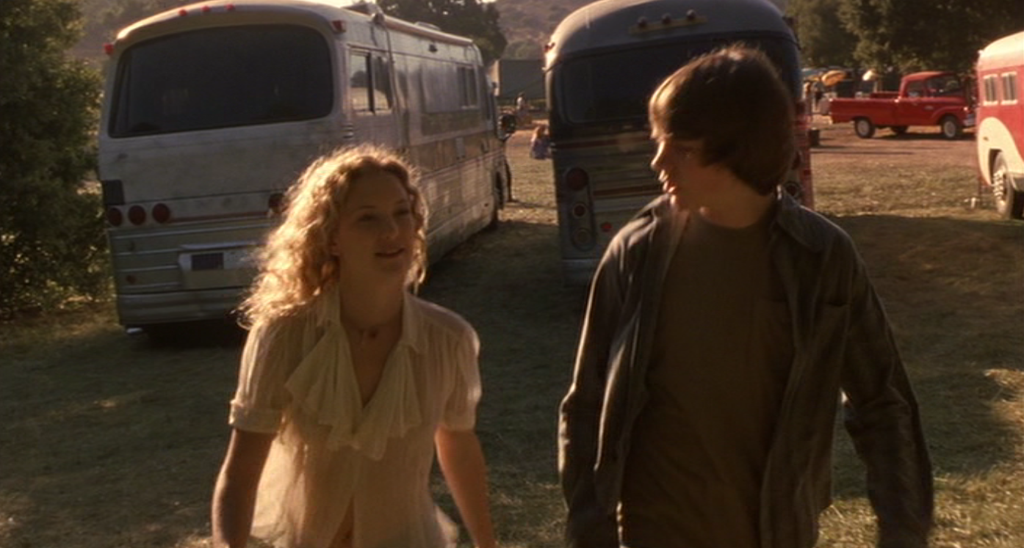
Almost Famous (Cameron Crowe, 1999)

Slide 12
Research Task
Find at least 1 interesting example of lighting from a fictional film, take a screen shot
Identify the types of lighting used (3 point lighting, key, shadows etc)
Analyse the effect it is having on the audience
What is their emotional response
How does it make them feel etc…
We’ll go into the studio 10 at a time

