Slide 1
1. Alkenes Naming and Isomers

Slide 2
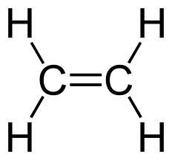
All about alkenes page 1
They contain carbon-carbon double bonds
They have the general formula C_{n}H_{2n}
Alkenes are unsaturated
ethene

Slide 3
Drawing structures of alkenes page 2

Slide 4
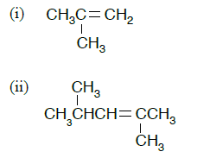
Naming alkenes page 2
Watch the video on how to name alkenes: https://www.youtube.com/watch?v=9kEzO7Ss1qg
Refer back to your alkanes booklet pages 6 to 8 notes for the rules for naming organic compounds
Use these rules to name the following compounds:
2-methylpropene
2,4-dimethylbut-2-ene
Not 2,4-dimethylbut-4-ene as the smallest
possible numbers are used for the C=C bond

Slide 5
ISOMERS
STRUCTURAL
ISOMERS
STEREOISOMERS
Chain
Isomers
Position
Isomers
Functional Group
Isomers
Geometric
Isomers
Optical
Isomers
Structural isomerism occurs when molecules have the same molecular formula but a structural formula
Stereoisomerism occurs when molecules have the same molecular formula and structural formula but a different spatial arrangement of the atoms

Slide 6

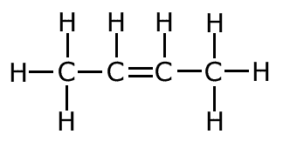
Structural isomers of C₄H₈
But-1-ene
But-2-ene
Positional isomers
Different positon of the functional group

Slide 7
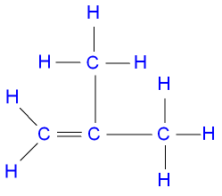
Structural isomers of C₄H₈
Methyl propene
but-2-ene
Chain isomers
As they have different branching

Slide 8
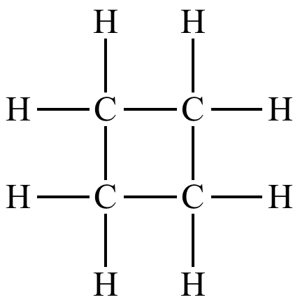
Structural isomers of C₄H₈
but-2-ene
cyclobutane
Functional group isomers
different functional group
They both have 4 carbons and 8 hydrogens so the same molecular formula

Slide 9
ISOMERS
STRUCTURAL
ISOMERS
STEREOISOMERS
Chain
Isomers
Position
Isomers
Functional Group
Isomers
Geometric (E/Z)
Isomers
Optical
Isomers
Stereoisomerism occurs when molecules have the same molecular formula and structural formula but a different spatial arrangement of the atoms
Watch this video about geometric (cis-trans) isomers (0-3 min) https://www.youtube.com/watch?v=eeuyu66kCXc
Geometric isomers are known as cis-trans or E/Z isomers and occur in alkenes (C=C bond)

Slide 10
Alkenes can have geometric (cis-trans isomers) because
X
CANNOT ROTATE AROUND C=C

Slide 11
trans but-2-ene
cis but-2-ene
trans (opposite)
Cis (same)

Slide 12
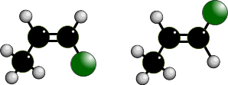
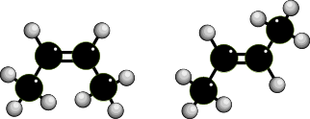
GEOMETRICAL ISOMERISM IN ALKENES
E/Z or CIS-TRANS
CIS /
TRANS
Should only be used when there are two H’s and two non-hydrogen groups attached to each carbon.
cis non-hydrogen groups / atoms on the
SAME side of C=C bond
trans non-hydrogen groups / atoms on
OPPOSITE sides of C=C bond

Slide 13
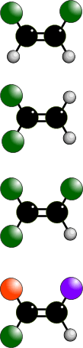
GEOMETRICAL ISOMERISM
How to tell if it exists
Two different atoms/groups attached
Two different atoms/groups attached
✓
GEOMETRICAL ISOMERISM
Two similar atoms/groups attached
Two similar atoms/groups attached

Once you get two similar atoms/groups attached to one end of a C=C, you cannot have geometrical isomerism
Two similar atoms/groups attached
Two different atoms/groups attached

Two different atoms/groups attached
Two different atoms/groups attached
✓
GEOMETRICAL ISOMERISM

Slide 14
GEOMETRIC ISOMERISM
trans but-2-ene
(E) but-2-ene
cis but-2-ene
(Z) but-2-ene
BOTH C ATOMS OF C=C MUST HAVE
TWO DIFFERENT GROUPS

Slide 15
GEOMETRIC ISOMERISM
identifying E/Z ISOMERS
Watch this video about geometric (E/Z) isomers (3 to 7 min) https://www.youtube.com/watch?v=eeuyu66kCXc
Cahn-Ingold-Prelog (CIG) Priority Rules
PRIORITY: H < CH₃ < CH₂CH₃
Look at atomic numbers of atoms attached to C=C (or subsequent atoms if the same).
Highest values opposite = E
Highest values together = Z “zame zide”
Z 2-bromo-3-fluorobut-2-ene
E 3-methylpent-2-ene

