Slide 1
3. Alkenes Polymerisation

Slide 2
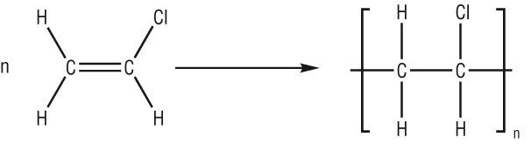
Addition polymerization page 15
Watch the video explaining how addition polymerisation works:
https://www.youtube.com/watch?v=oUaLYwiUW3s
1 repeat unit
monomer
(an alkene)
polymer
The equation is balanced using n, where n can be 1000’s or millions
This is an addition polymerisation reaction as 1 product is formed

Slide 3


Addition polymerization page 15
Process • during polymerisation, an alkene undergoes an addition reaction with itself
• all the atoms in the original alkenes are used to form the polymer
• long hydrocarbon chains are formed
the equation shows the original monomer and the repeating unit in the polymer
ethene poly(ethene)
MONOMER POLYMER
n represents a large number

Slide 4
Drawing and naming polymers page 15
Watch the video explaining how to draw and name polymers and
https://www.youtube.com/watch?v=9J29Yb8lk88
1 repeat unit
chloroethene
monomer
poly(chloroethene)
polymer
To name the polymer put ‘poly’ in front of the monomer name

