Slide 1
GCSE Media Studies
Narrative

Slide 2
The Plot:
What happens. This is the story of the programme or advert, just like studying a novel, you will pick up on events and characters and development.

Slide 3
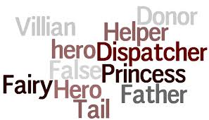
Narrative Theory
PROPP claimed that stories and their structures are determined by the role of characters. He studied a wide range of Russian folk stories and identified 8 key roles:

Slide 4
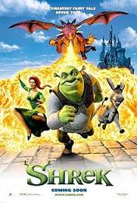
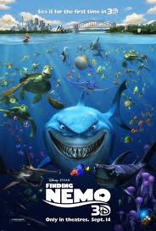
Character roles/stock characters
the villain – opposes the hero
the donor (provider) – helps the hero by providing a magic object
The sidekick – gives support to the hero
the hero – seeks something
the princess – the reward for the hero and needs to be protected from the villain
the dispatcher – send the hero on his way
the false hero – falsely assuming the role of the hero

Slide 5
Universal structure
In terms of narrative driven by character type, Propp can be seen to have been influential in identifying a “universal” structure that can be applied to virtually all stories and in particular classic Hollywood cinema.

Slide 6
For Example:

Slide 7
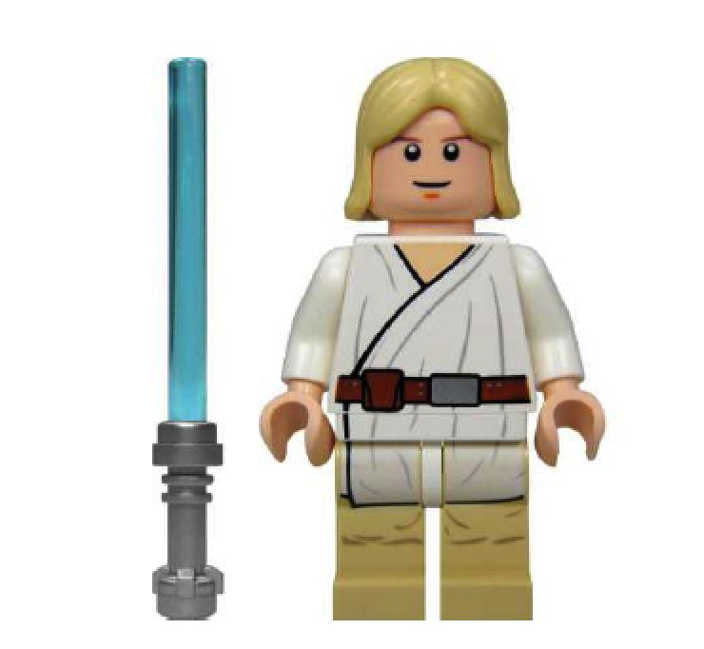
What Character Type is this?
Generally this character leads the narrative. The story being told is the story of this character. They are usually looking for something – a quest, or trying to solve something – a mystery. Usually they are the person we want to succeed in the story

Slide 8
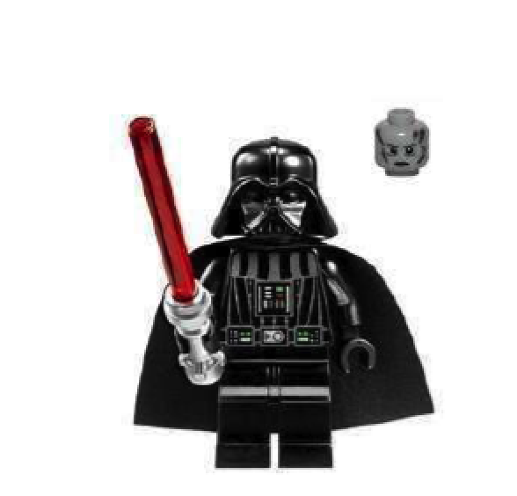
What Character Type is this?
This character struggles against the hero. This character is typically shown as being morally bad. This turns the audience against him and drives them to support the hero. This character’s lack of morals serves to highlight the goodness of the hero. This character may seek to prevent the hero from achieving the goal or may seek the same object as the hero

Slide 9
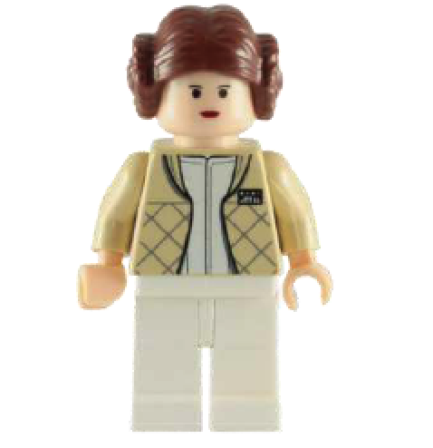
What Character Type is this?
This character may take two forms. First he/she may be the object which is deliberately sought by the hero, perhaps rescuing them from the villain. Secondly he/she may be the reward after the hero has completed the mission or achieve the goal. This character may be seen very little in the story or may be an important character that we see often and could accompany the hero on their mission.

Slide 10
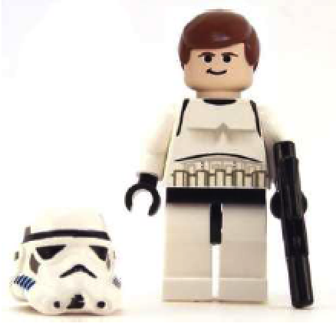
What Character Type is this?
This character is a person who gives the hero something special such as a magical weapon, or a clue, or a special power etc. This gift enables the hero to complete their quest. This role may be combined with that of a helper.
This character may not give up their gift without setting the hero another task, from a simple riddle to another quest.

Slide 11
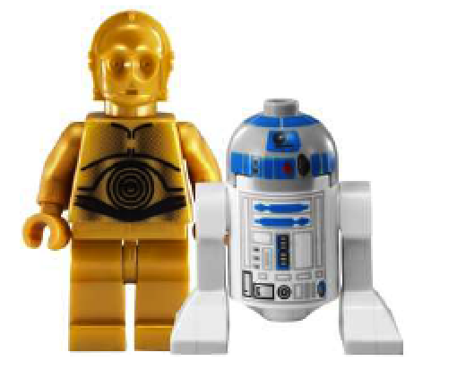
What Character Type is this?
The hero is supported in their quest by this character, who appears at critical moments to provide support. This character is involved in a supporting role, assisting the hero throughout the story. Often this character has a character flaw that the hero has so it helps to highlight this quality in the hero e.g. intelligence, determination, courage etc.

Slide 12
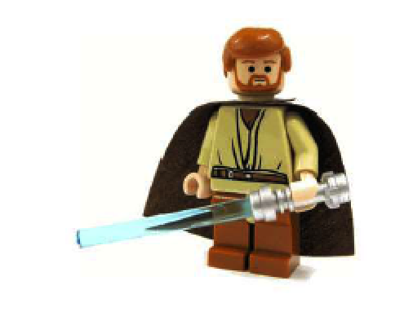
What Character Type is this?
This character gives the task to the hero. He is a key figure for the hero to persuade as they have protective character traits. This character may also be older and a figure of wisdom. He is a difficult character to define in modern stories and will often not be present or his role could be combined with another character type.

Slide 13
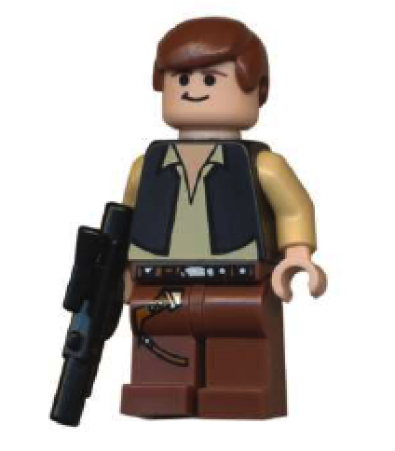
What Character Type is this?
This character appears to act heroically and may even be initially mistaken for the hero. This character will try to steal the hero's thunder, grabbing the credit and perhaps try to marry the princess. This character will often gain the respect of other characters, especially the princess’s father thus frustrating the hero’s ability to gain the hand of the princess

Slide 14
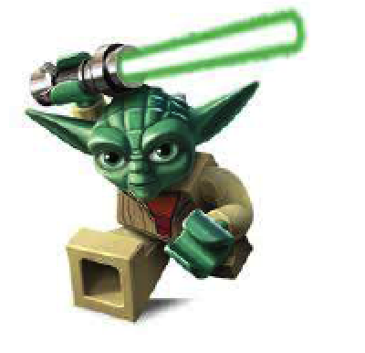
What Character Type is this?
An early role in the story is that of this character. They will send the hero on the mission. Sometimes this character can also be the princess’s father and will give the hero a set of quests to complete. This character can also be combined with the false hero who then follows along behind the hero.

Slide 15
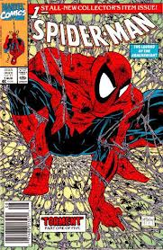
Tzvetan Todorov
Tzvetan Todorov, in his book The Fantastic
outlines several stages that a plot works through:
A state of equilibrium
A disruption of the equilibrium
A recognition of the disruption
Attempt to repair the disruption
Restatement of the (new) equilibrium

Slide 16
Task
Complete the Top Trumps Tasksheet

Slide 17
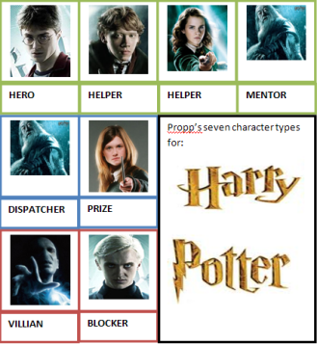
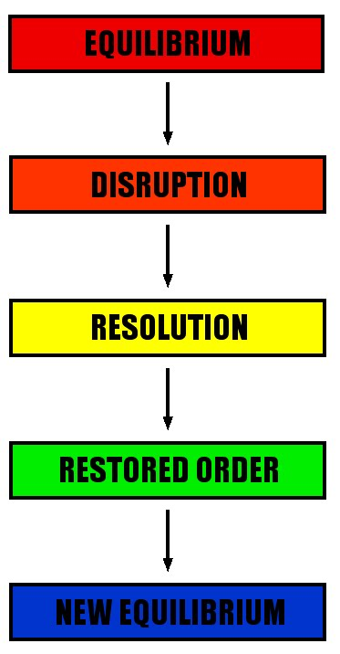
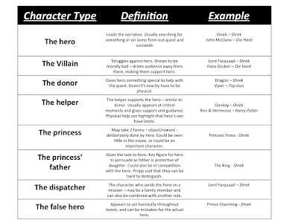
Task
In small groups you must come up with a film idea which will appeal to your age group and applies Todorov’s & Propp’s narrative theory.
The class will then vote for which films should be commissioned.
Add as much detail to your pitch as possible including:
a title,
a tagline,
actors,
director,
genre,
location,
Themes . . .

