Slide 1
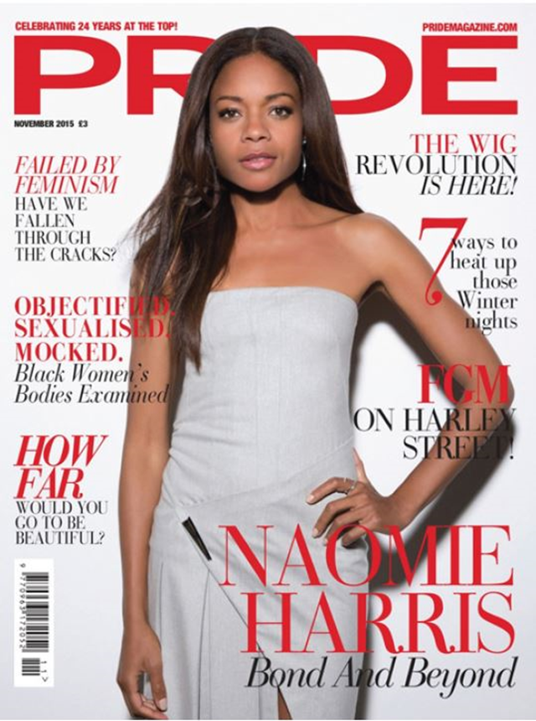
Codes and Conventions – language / content
Content reflecting social/cultural/historical context
Representation: How is Gender represented? Male/Female

