Slide 1
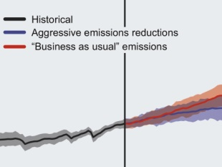
Further research – GHGs and Carbon
Climate change: Earth's giant game of Tetris - Joss Fong - https://youtu.be/ztWHqUFJRTs
How do GHGs actually work: https://www.youtube.com/watch?v=sTvqIijqvTg
A history of earth’s climate: https://www.youtube.com/watch?v=dC_2WXyORGA
Figure b5. The amount and rate of warming expected for the 21st century depends on the total amount of greenhouse gases that humankind emits. Models project the temperature increase for a business-as-usual emissions scenario (in red) and aggressive emission reductions, falling close to zero 50 years from now (in blue). Black is the modelled estimate of past warming.

