Slide 1
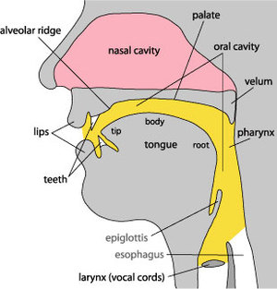
Understanding spoken language
Phonology & International Phonetic Alphabet

Slide 2
Consonants: Plosives
Created when the airflow is blocked for a brief time
Voiced:
/b/ - big, crab
/d/ - dog, cod
/g/ - garden, dagger, log
Unvoiced:
/p/ - pet, sport, cap
/t/ - tap, story, cot
/k/ - caravan, kick, sky, queasy

Slide 3
Consonants: Fricatives
Created when the airflow is only partially blocked and air moves through the mouth in a steady stream
Voiced:
/v/ - vein, give
/ð/ - this, smooth
/z/ - zero, hose, rows
/ʒ/ - leisure, beige
Unvoiced:
/f/ - fit, cough, phone, beef
/θ/ - thimble, fourth
/s/ - sauce, hiss, cinema
/ʃ/ - shop, lotion, mash, sugar
/h/ - hair

Slide 4
Consonants: Affricatives
Created by putting plosives and fricatives together
Voiced:
/ʤ/ - germ, jet, judge
Unvoiced:
/ʧ/ - champion, feature, catch

Slide 5
Consonants: Approximants
Created by a continuous, relatively unrestricted airflow
Voiced:
/w/ - wall
/r/ - ready, corrupt
/j/ - yawn

Slide 6
Consonants: Nasals
Created by air moving through the nose
Voiced:
/m/ - mould, numb, jam
/n/ - night, loan
/ŋ/ - singer, cling

Slide 7
Consonants: Laterals
Created by placing the tongue on the ridge of the teeth and then air moving down the side of your mouth
Voiced:
/l/ - laugh, below

Slide 8
Regional Consonants
Cockney:
/ɫ/ - milk, tell
/ʔ/ - butter, bottle
Scottish:
/ʍ/ - which
/x/ - loch

Slide 9
Long Vowels
Vowels are sounds made without closure or audible friction
/ɑ:/ -
/i:/ -
/ɜ:/ -
/ɔ:/ -
/u:/ -
bar, father
feet, speak
heard, bird
taught, port, saw, moor
moon, true, through, grew

Slide 10
Short Vowels
quick
/I/ -
/ɛ/ -
/ə/ (schwa) –
/i/ -
/ʌ/ -
/ʊ/ -
/æ/ -
/ɒ/ -
friend, said, bed
water, above
party
drunk, tough
full, put
spat
watch, hot

Slide 11
Diphthongs
A vowel in which there is a perceptible change in quality during a syllable
/eI/ -
/aI/ -
/əʊ/ -
/Iə/ -
/ɛə/ -
/aʊ/ -
/ɔI/ -
/ʊə/ -
pray, sleigh, grey, fade
fry, high, spider
go, bow, toe
hear, pier, beer
care, bear, flair, where
cow, bough
boy, noise
tour, poor

