Slide 1
Welcome to Explore + – LAW NEXT

Slide 2
What are we covering today? – Week 1
WHAT WILL BE COVERED ON THE COURSE?
WHAT DO WE MEAN BY THE TERM LAWYER?
INTRO TO ELS – CIVIL + CRIMINAL
WHO’S WHO IN THE ENGLISH LEGAL SYSTEM?

Slide 3
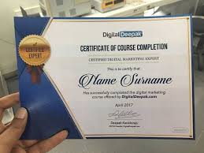
WHAT WILL BE COVERED ON THE 9 WEEK COURSE?
Your 9 week breakdown – see pages 2-3
A REMINDER OF WHAT’S EXPECTED OF YOU……….

Slide 4
MATERIALS ON GOL FOR YOU TO ACCESS AND USE OVER THE 9 WEEK COURSE.

Slide 5
True or False?
The majority of you are already studying law?

Slide 6
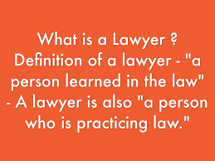
“LAWYERS” – WHAT DOES THIS TERM MEAN?
AMERICAN TERM!

Slide 7
“LAWYERS” – WHAT DOES THIS TERM MEAN?
In the UK we have three branches of the Legal profession BARRISTERS, LEGAL EXECUTIVES & SOLICITORS.
These branches are traditional and Have RIGHTS OF AUDIENCE ( right to appear and speak on behalf of their client) in DIFFERENT courts.

Slide 8
WHAT do Lawyers do and what kind of skills are required?
Advise on the law! The Legal Profession’s main purpose is to problem-solve by resolving disputes or enabling people to do so themselves.
Each area of law calls for a particular set of skills and personality traits - advocates in court think on their feet, family lawyers mediate and commercial lawyers negotiate.
Clients include multinational businesses, public sector e.g. local authorities, trade unions, accountants, bankers, directors, entrepreneurs, families, charities, individuals

Slide 9
- Are you ready to take on the role of a Juror? - Find out more about the English Legal System? - And find out more about the role of the Legal Profession and a Judge?
https://www.open.edu/openlearn/society/the-law/criminology/whats-your-verdict

