Slide 1
Task on Entry – Compound Interest
A bank account pays 2% compound interest every month to clients who hold a savings account. What is the annual percentage rate?
$$r={\left(1+0.02\right)}^{12}−1=26.8\%$$
Did you think this would be 24% Why were you wrong thinking this?
Think, Pair, Share

Slide 2
Maths for Personal Finance
Annual Equivalent Rate

Slide 3
Interest Calculations
When borrowing or lending money, sometimes it is not immediately clear how much you will pay (or receive) through interest repayments.
In order to standardise the industry and allow products to be easily compared, financial institutions must publish certain information.
APR – Annual Percentage Rate
AER – Annual Equivalent Rate

Slide 4
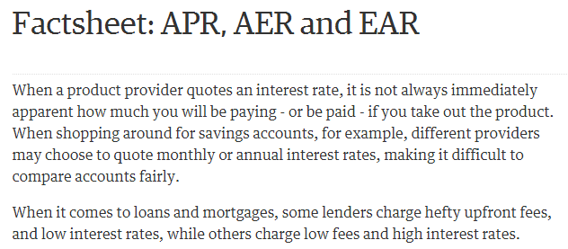
Standardising Financial Products
Read and highlight the article from the Guardian, particularly focussing on the AER section

Slide 5
Different banks pay interest on savings over different periods.
Monthly
Quarterly
Annually
Quoted when bank accounts are in credit (balance > 0)
Annual Equivalent Rate (AER)
AER allows us to compare which savings account will give us the best deal even if the banks are saying interest will be calculated on differing time scales
Would you prefer -
6.12% annually with interest paid monthly, or
6.25% paid annually?

Slide 6
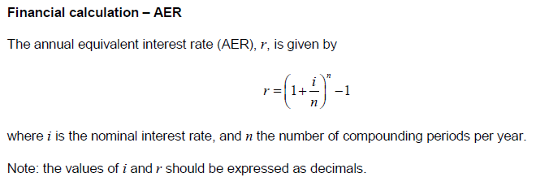
Annual Equivalent Rate
Accounts can be compared by calculating the AER for each account.
The formula for AER is given to you in the formulae booklet:

Slide 7
Skills Check
Write the following percentages as decimals:
2%
0.02
14%
0.14
2.2%
0.022
4.25%
0.0425
17.5%
0.175

Slide 8
Comparing Savings Accounts
You are looking to open a savings account and have found the following three accounts.
4.2% per annum with interest calculated annually
4.0% per annum with interest calculated monthly
3.9% per annum with interest calculated weekly

Slide 9
Comparing Savings Accounts
4.2% per annum with interest calculated annually
The interest is ALREADY being calculated annually.
Therefore the AER is 4.2%

Slide 10
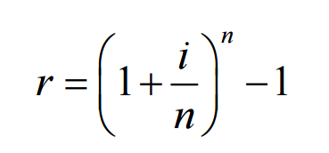
Comparing Savings Accounts
4.0% per annum with interest calculated monthly
$$Remember:interest rate must be in decimals. \\ Therefore, i=0.04$$
The interest is being paid monthly, so n = 12
$$r={\left(1+\frac{0.04}{12}\right)}^{12}−1=4.07\%$$

Slide 11
Comparing Savings Accounts
3.9% per annum with interest calculated weekly
$$Remember:interest rate must be in decimals. \\ Therefore, i=0.039$$
The interest is being paid weekly, so n = 52
$$r={\left(1+\frac{0.039}{52}\right)}^{52}−1=3.975\%$$

Slide 12
Comparing Savings Accounts
4.2% per annum with interest calculated annually
$$=4.2\% AER$$
4.0% per annum with interest calculated monthly
$$=4.07\% AER$$
3.9% per annum with interest calculated weekly
$$=3.975\% AER$$

Slide 13
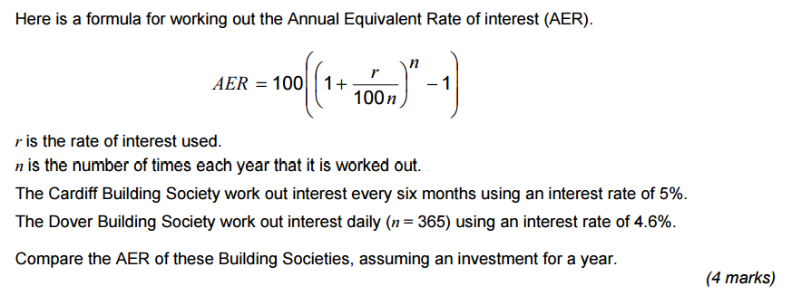
Annual Equivalent Rate

