Slide 1
Population data: Lesson 3
Representing data

Slide 2
Bar charts: Comparing continents
What can you conclude about European countries from this graph?
Discrete data:
gaps
Notes:
Start by reminding the students that this is the third in a series of data handling lessons using the context of world population data.
Review any homework, and then remind students that the last lesson looked at sampling. In this lesson, we are going to look at some ways of representing our samples using statistical diagrams.
Show the chart on the slide, and ask students to identify key features e.g. the gaps between countries on the horizontal axis, because we are dealing with discrete (categorical) data.
Then ask the question given at the bottom of the slide. Students should clearly see that for the countries in this sample, death rates match or exceed birth rates. Without any net immigration, we would expect the population of this sample to decrease over time.

Slide 3
Bar charts: Comparing continents
How does this compare to Africa? Use your sample of African countries to construct a similar bar chart.
Notes:
Now ask students to draw a similar chart for the sample of African countries that they selected in the previous lesson.
Note that it is certainly possible to draw this chart by hand – but very time consuming. For the remainder of this lesson, we will assume that students have access to a spreadsheet!
Once students have drawn their own charts, show them the example on the slide and discuss the differences between this and the previous chart.
The difference here is clear – in all of the countries shown, the birth rate is much higher than the death rate. It is also interesting to compare the actual numbers between the two charts; for example, look at the African death rates in comparison to the Eastern European ones.

Slide 4
Bar charts: Comparing continents
Each bar height represents the birth rate, whilst the height of each blue section is the corresponding death rate. What is the red region representing?
Calculate the net growth rate for each country.
Notes:
Now ask students to draw a stacked bar chart like the one shown, for their own sample of American countries.
In this chart, each total bar represents the birth rate, the blue bar is the death rate and the red region represents the excess of births over deaths.
Note that students may need to do some simple spreadsheet calculations in order to find the correct values to plot here.

Slide 5
The sample mean
Sample mean =
where: – ∑x = sum of the data values – n = number of data items
Calculate the sample means of the birth rates and death rates for the 10 selected countries in each of the five continents
Notes:
Introduce the idea of the sample mean as another way of comparing the values in a sample.
Ask students to calculate the sample means of the birth and death rates for each continent’s sample.
For students working in pairs, one could calculate the death rates and the other the birth rates.

Slide 6
Sample and population means
Europe sample: mean birth rate = (13 + 9 + 10 + 9 + 11 + 10 + 10 + 13 + 10 + 11)/10
= 10.6
What percentage error does this sample mean have, compared to the population mean?
Notes:
Here the population mean is the actual mean of the birth rates for all of the countries in Europe. Students will need to go back to the original data to find this. Notice that the summary figures in the data sheet are weighted averages, so do not agree precisely to the sample mean calculated here. You may wish to use the population figures from the data sheet to go through an exercise of calculating a weighted mean instead.

Slide 7
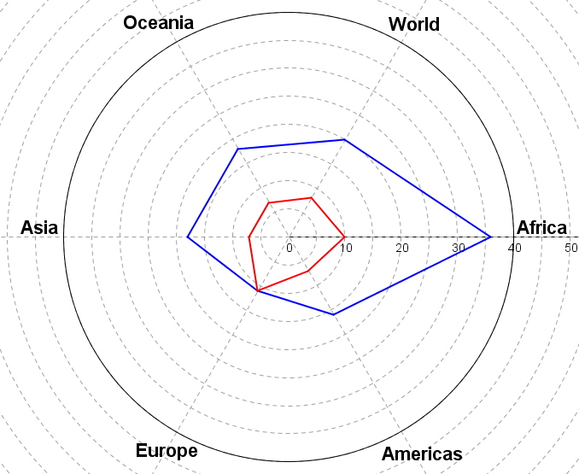
Birth and Death rates: radar chart
18
20
7
8
10
36
18
7
7
11
16
Notes:
Show students this ‘radar chart’, which plots the summary values for birth and death rates from the original data sheet. Now ask them to produce a similar chart for their samples for each region. Then ask students to compare their chart with the one shown – how good a job do their samples do of representing the true picture?

Slide 8
Radar charts
Plot the following information on the radar chart provided
Region | Life expectancy | % Urban | Population density
Africa | 59 | 40 | 37
Americas | 76 | 79 | 23
Europe | 78 | 72 | 32
Asia | 69 | 46 | 99
Oceania | 77 | 70 | 5
World | 71 | 53 | 53
Notes:
If time permits, ask students to select another selection of data that could usefully be represented on a radar chart. This slide shows one possibility; the resulting chart is shown on the next page.

Slide 9
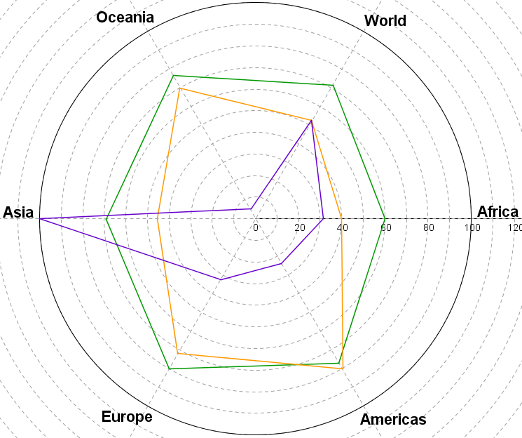
Radar charts
Notes:
Finish by reviewing the key points from this lesson; we have used charts and calculations to summarise data and to check the validity of our sampling methods. For homework, students could explore other forms of representation – including perhaps the interactive formats available at Gap Minder.

