Slide 1
WATER AID (2016) Charity Advert Component 1: Media Products, Industries and Audiences
USE THE CONTEXT MIND MAP TO MAKE NOTES FROM THIS POWERPOINT AND BRING TO YOUR FIRST WATER AID CLASS

Slide 2
COMPONENT 1: INVESTIGATING THE MEDIA
EXAM 35%
Section | A | A & B | A | A & B
Sector | Marketing | Advertising | Music Video | Newspaper
Text | Kiss of the Vampire | Tide | Formation | The Times
 |  | WaterAid | Riptide | Daily Mirror
Media Language | Y | Y | Y | Y
Representation | Y | Y | Y | Y
Industries |  |  |  | Y
Audiences |  | Y |  | Y
Contexts | Y | Y | Y | Y

Slide 3
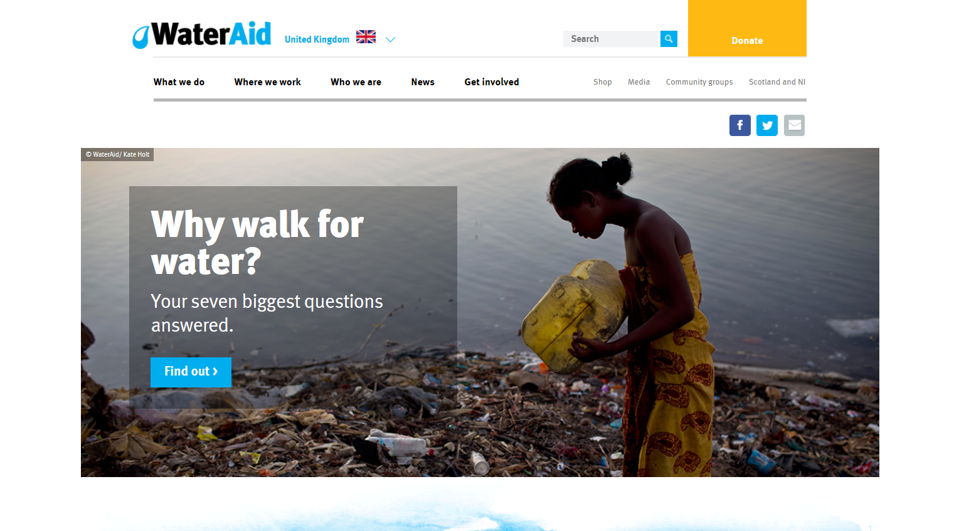
Water Aid – background
The charity Water Aid was established in 1981 as a response to a United Nations campaign for clean water, sanitation and water hygiene education. It now works with organisations in 37 African, Asian and Central American countries plus the Pacific region. Since 1991 its patron has been Prince Charles.
Click the linked picture to visit the Water Aid website, make at least 5 bullet point notes on what the charity does and how they help people

Slide 4
Cultural context:
Add the notes below to your mind map
Following 1984’s Do They Know It’s Christmas? single for Band Aid, 1985’s Live Aid was the first global charity event aiming to raise funds for relief of the ongoing famine in Ethiopia.
The Comic Relief telethon was launched by Richard Curtis and Lenny Henry in 1985 with the same initial famine relief aim, and went on to raise over £1bn for charitable causes across Africa and in the UK. The contemporary audience for this advert could be assumed to be familiar with the codes and conventions of both audio-visual adverts and those for charitable organisations in particular.

Slide 5
Social and Cultural Context: Charity advert and controversy…
1a) https://twitter.com/i/events/1101130534355329031
1b) https://www.theguardian.com/commentisfree/2019/mar/03/cant-we-accept-that-some-white-saviours-really-want-to-help-stacey-dooley-comic-relief?CMP=share_btn_link
1c) What is white saviour syndrome?
1d) Why is David Lammy MP critical of Comic Relief?
1e) https://twitter.com/comicrelief/status/1101081663449247744/photo/1
1f) What do you think of Comic Relief's response to white saviour syndrome criticism?
2 https://www.youtube.com/watch?v=VO1jse1Vt1g (important information from 3:55 – 7:35 minutes)
2a) What is Colonialism?
3. https://www.teenvogue.com/story/hollywoods-white-savior-obsession-colonialism
3a) Why is white saviour syndrome problematic in Hollywood?
4a) https://www.theguardian.com/voluntary-sector-network/2012/aug/30/charities-should-abandon-shock-advertising 4b) https://www.theguardian.com/voluntary-sector-network/2014/sep/29/poverty-porn-charity-adverts-emotional-fundraising
4c) Why may empowering, positive images in charity advert be more effective?
Click the links, read and answer the questions on the back of the mind map

Slide 6
Production context
Created by Atomic London in October 2016, this advert (titled Rain For Good) stars 16 year-old Zambian student Claudia and aims to show how communities benefit from clean water by depicting everyday chores such as farming and laundry.
Add the notes above to your mind map

Slide 7
Genre
For each genre category there are specific visual and narrative expectations called codes and conventions.
CODES: WHAT YOU EXPECT TO SEE
Credits/Typography
Setting
Lighting:
Costume
Props
Iconography
CONVENTIONS: WHAT YOU EXPECT TO HAPPEN
Character types
Particular stars
Plot
Resolution
Soundtrack
A particular message
Charity Adverts are their own genre so have their own set of codes and conventions

Slide 8
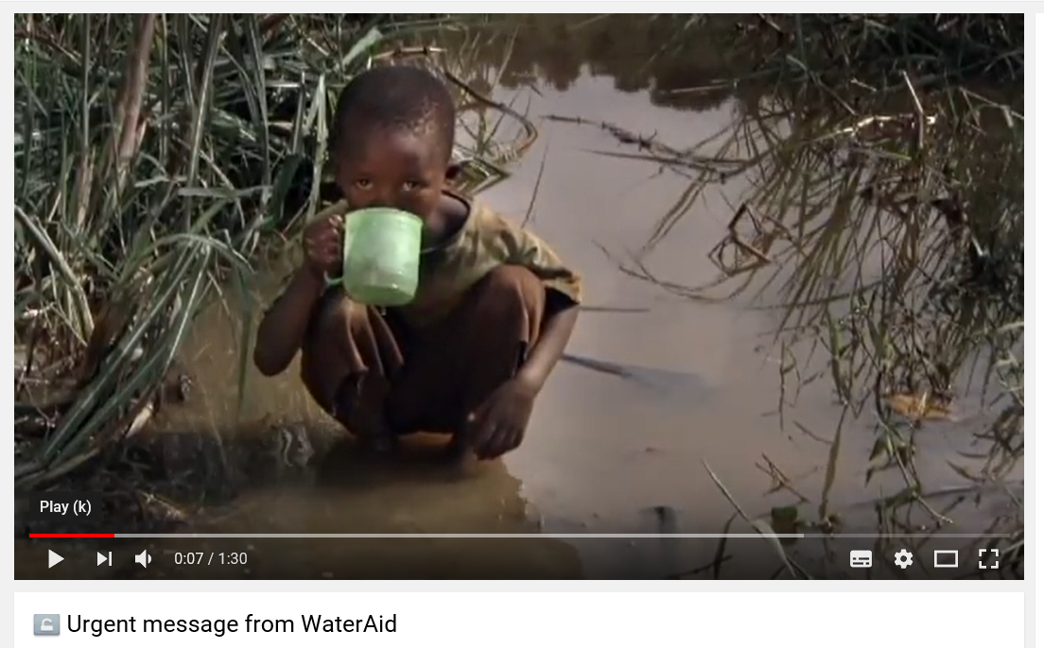
Genre: Charity advert 1
NOT YOUR SET TEXT
Click the linked picture to watch a WaterAid advert
Using the blue Codes and Conventions table on the top of mind map tick which you spot in this ‘Advert 1’

Slide 9
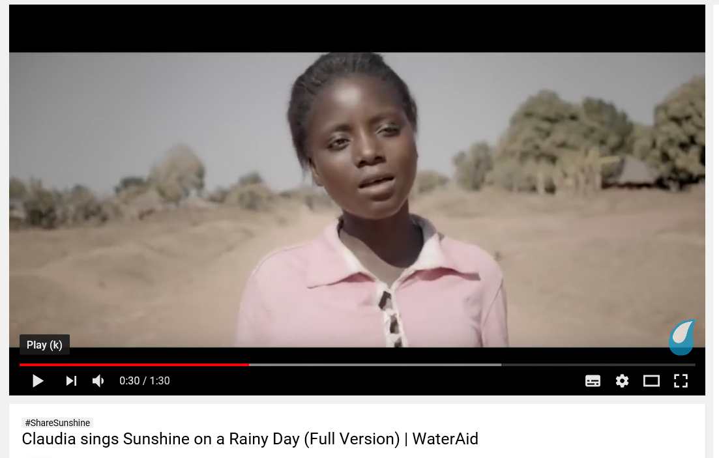
Genre: Claudia Charity advert
YOUR SET TEXT
Click the linked picture to watch your WaterAid set text advert
Using the blue Codes and Conventions table again tick which you spot in this ‘Claudia, Rain for Good Advert’

Slide 10
Genre: Charity adverts
Codes | Conventions
Tragic and upsetting images | Sad, orchestral music
Poverty/suffering | Solemn voice over
Black and white images | Direct appeal for money
Facts and Statistics | Personalised story
Contact details
Add the notes below to your mind map
The Water Aid advert reinforces charity advertisement conventions by including key information about the concern; a personalised narrative to which this information is relevant, and a direct appeal to the audience for money.
However, the fact it lacks a non-diegetic voiceover, melancholic audio codes and black and white visual codes could all be seen as unconventional of this advertising sub-genre.

