Slide 1
Markets (4) Demand and Supply 1
The markets in which a business sells its products or products are part of the external environment in which a business operates

Slide 2
External Factors
Competition
Economic factors and the state of the economy
Government objectives and government policy
Legislation
Population
Social factors
Political factors
Environmental issues
Technology

Slide 3
Demand
Demand is the amount of a product that consumers are willing and able to purchase at any given price.
Demand is concerned with what consumers are actually able to buy (what they can afford to and would buy) rather than what they would like to buy.
Within any market, price is determined by the interaction of demand and supply.

Slide 4
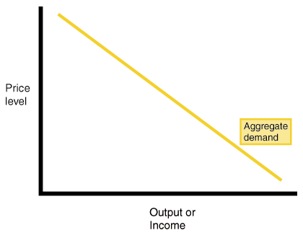
The Demand Curve
The demand curve slopes downwards from left to right. As price falls, demand rises. As price rises, demand falls. The higher the price the lower the quantity demanded, the lower the price the higher the quantity demanded.

Slide 5
What causes changes in demand?
Income
The price and demand for other goods
Changes in tastes and fashion
Changes in population
Advertising
Legislation

Slide 6
Supply
Supply is the amount of a product which suppliers will offer to the market at a given price.
The higher the price of a particular good or service, the more will be offered to the market

Slide 7
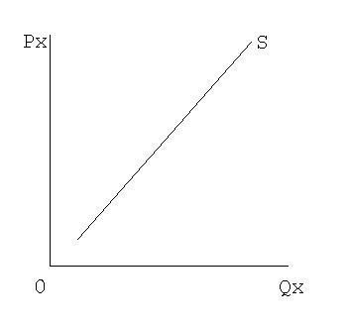
Supply Curve
The supply curve slopes upwards from left to right there is a positive relationship between supply and price.
As price rises producers offer more goods to the market. A fall in price will lead to the quantity supplied falling.

Slide 8
Market Mechanism
The market mechanism works by the interaction of supply and demand (they are affected by each other)
Within a market, price is determined by the interaction of supply and demand
That is how much consumers are willing to buy combined with how many goods suppliers are willing and able to supply. This will set the market price

Slide 9
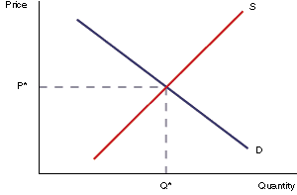
Market Equilibrium
The price in any market for any good is determined by the interaction of supply and demand.
The equilibrium point is where Supply = Demand. At this point all goods produced are sold.

Slide 10
What causes changes in demand?
PIRATE
Population (changes)
Income
Related goods and services (price and demand for these)
Advertising
Taste and fashions/preferences
Expected price changes
Notes:
Price and demand for other goods: demand for one product often depends on the price of and demand for another (e.g. the demand for one brand of tea bags can be influenced by the price of other brands)

