Slide 1
Markets (4) Shifts in Demand and Supply 2
The markets in which a business sells its products or products are part of the external environment in which a business operates

Slide 2
Learning Objectives
Construct and interpret demand and supply diagrams
Understand the factors that cause the demand and supply curves to shift and the effect this has on equilibrium price and quantity
Analyse and evaluate the factors that affect demand and sup0ply and equilibrium

Slide 3
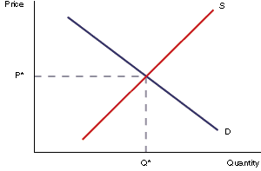
Market Equilibrium – what if it changes?
The price in any market for any good is determined by the interaction of supply and demand.
The equilibrium point is where Supply = Demand. At this point all goods produced are sold.

Slide 4
Factors that cause the demand and supply curves to shift
Demand | Supply
Income of consumers | Costs of production
The price and demand for other goods (substitutes/complementary) | Change in production
Changes in taste and fashion | Legislation
Changes in population | The objectives of a firm
Advertising | The weather
Legislation | Expectations
Seasonal factors | Availability of Labour

Slide 5
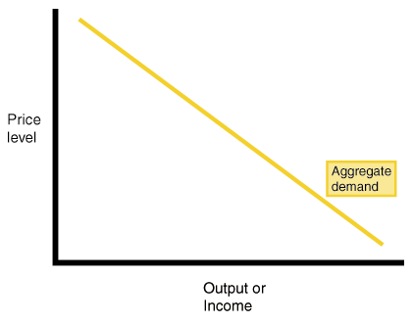
How to change the Demand Curve
We can represent demand by drawing a demand curve.
Demand curve is downward sloping from left to right because demand and price have a negative relationship. When price increases, demand falls
A change in price will lead to a change in quantity demanded
As price falls, demand rises.
As price rises, demand falls.
The higher the price the lower the quantity demanded.
The lower the price the higher the quantity demanded.
Quantity demanded
Notes:
Curve slopes downward left to right because the quantity demanded is likely to be higher at lower prices and lower at higher prices

Slide 6
Example – Market for beef after BSE crisis Step 1 – draw a basic D&S diagram
D
S
P
P1
S
D
0
Q1
Q

Slide 7
Step 2 – decide which curves are affected and add to diagram
Remember LEFT is LESS
P
D1
S1
D2
P1
S
D
D2
0
Q1
Q

Slide 8
Step 3 – show new equilibrium price and quantity
P
D1
S1
D2
P1
P2
S
D
D2
0
Q2
Q1
Q

Slide 9
Step 4 – provide a written explanation
Consumers are worried about the health risks in eating beef and may switch to other meats such as pork or lamb (substitutes)
There has been a change in tastes and less is now demanded by consumers at each and every price
The demand curve shifts to the left creating a new equilibrium. Price falls from P1 to P2 and quantity falls from Q1 to Q2

Slide 10
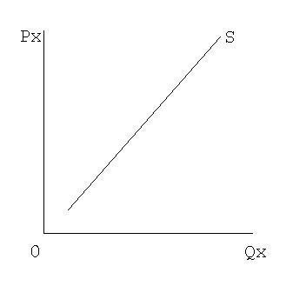
How to change the Supply Curve
The supply curve slopes upwards from left to right there is a positive relationship between supply and price. When price increases, supply increases.
As price rises producers offer more goods to the market. A fall in price will lead to the quantity supplied falling.
Again, a change in price will cause a movement up or down the supply curve but the curve will not change position
Notes:
Curve slopes downward left to right because the quantity demanded is likely to be higher at lower prices and lower at higher prices

Slide 11
Market for bread following an increase in the price of flour
Flour is an essential ingredient in making bread and any increase in its price will increase the costs of production
Producers will therefore be less willing to supply as much at each and every price
This will shift the supply curve to the left and cause an increase in price from P1 to P2 and a fall in quantity from Q1 to Q2

Slide 12
Market for bread following an increase in the price of flour
S2
D1
S1
P
P2
Remember LEFT is LESS
P1
S2
S1
D1
0
Q2
Q1
Q

Slide 13
Demand and Supply Diagrams
You may be asked to show the effect of certain events upon the market for a good or service
You will need to decide if these events will shift the demand curve, the supply curve or both
You will need to show these changes on a D&S diagram, showing any changes to equilibrium price and quantity
You will have to explain your reasoning in writing

Slide 14
Now try these
Market for Daz washing powder following an increase in the price of Ariel washing powder
Market for foreign holidays following an increase in income tax
Market for apples following a fine autumn and a bumper harvest

Slide 15
Market for Daz washing powder following an increase in the price of Ariel washing powder
D2
S1
P
D1
P2
P1
D2
S1
D1
0
Q1
Q2
Q

Slide 16
Market for Daz washing powder following an increase in the price of Ariel washing powder
Daz and Ariel are to an extent substitutes.
If the price of Ariel rises some consumers will substitute the now relatively cheaper Daz for their normal Ariel.
More Daz is now demanded by consumers at each and every price.
The demand curve shifts to the right creating a new equilibrium.
Price rises from P1 to P2 and quantity increases from Q1 to Q2

Slide 17
Market for foreign holidays following an increase in income tax
D1
S1
D2
P1
P2
S1
D1
D2
0
Q2
Q1

Slide 18
Market for foreign holidays following an increase in income tax
More income tax means less disposable income and so consumers may well cut back on luxuries such as these.
Less foreign holidays are now demanded by consumers at each and every price.
The demand curve shifts to the left creating a new equilibrium. Price falls from P1 to P2 and quantity falls from Q1 to Q2.

Slide 19
Market for apples following a fine autumn and a bumper harvest
P
D1
S1
S2
P1
P2
S1
D1
S2
0
Q1
Q2
Q

Slide 20
Market for apples following a fine autumn and a bumper harvest
A natural occurrence such as a good harvest will make more apples available at each and every price.
This will shift the supply curve to the right and cause an fall in price from P1 to P2 and an increase in quantity from Q1 to Q2.

Slide 21
TASK
Work your way through the demand and supply worksheet
Extension: Use the internet to investigate how the recent recession and disposable income levels affected the demand/supply of certain goods and services such as holidays, alcohol and the motor industry. Show the changes with diagrams

