Slide 1
Markets (4) Price elasticity, income elasticity and types of goods
Demand and supply 3

Slide 2
Income elasticity of demand (YED)
measures the responsiveness of demand to a change in income
Price elasticity of demand (PED)
measures the responsiveness of demand to a change in price

Slide 3
Price inelastic a change in price causes little or no change in demand
Price elastic a change in price causes a bigger change in demand

Slide 4
The importance of elasticity of demand?
Helps business managers predict the impact of changes in price/income on likely levels of demand.
Helps with decision making
Helps with the marketing of goods

Slide 5
YED and types of goods
Inferior Goods
Those that you will lose interest in buying if your income increases
Normal Goods
Those that demand remains relatively unchanged if your income increases
Superior Goods
Those that demand increases if your income increases.

Slide 6
Other types of goods
Complementary Goods. Goods which are used together, e.g. TV and DVD player.
Substitute Goods. Goods which are alternatives, e.g. Pepsi and Coca-Cola.

Slide 7
For the products below, do you think a rise in price will lead to a large or small change in demand? Why?
Notes:
Habit = inelastic

Slide 8
Price Inelastic Goods

Slide 9
Price Elastic Goods

Slide 10
Conclusion
Price elastic/Price sensitive: a change in price will cause a more than proportional change in the quantity demanded
Price goes up – demand falls dramatically
Price goes down – demand increases dramatically
Likely in markets where there is lots of substitutes/competition
Price inelastic/Price insensitive: a change in price causes a less than proportional change in the quantity demanded
Price goes up – demand falls just a little
Price goes down – demand increases just a little
Likely in markets where there are few substitutes
Goods are necessities or addictive

Slide 11
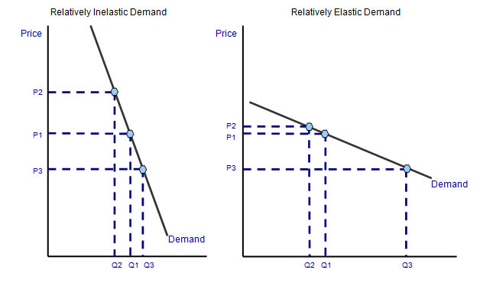
Elasticity on a graph

Slide 12
Practice tasks (use text and diagrams)
Explain the factors that are likely to determine the demand for petrol
Explain the factors that determine the demand for housing
Explain the effect of the living wage on employment

