Slide 1
Markets (2) Market Segmentation

Slide 2
What is it?
A way of breaking down the market into segments (sub-groups) that have common features or individuals who make purchasing decisions on common factors

Slide 3
What makes targeting a segment worthwhile?
They must be recognisable
Must have critical mass (be big enough to be worthwhile)
Targetable – have their own identity that can be promoted to

Slide 4
Methods of segmentation
Geographic segmentation – where do customers live, where do they buy?
Demographic segmentation – groups based on age, sex, ethnic background, occupation and income
Behavioural segmentation – looking at usage patterns, levels of brand loyalty, elasticity of demand
Psychographic segmentation – lifestyle groups, personal values and attitudes
NOTE! You have to give specifics in your exam answers not just the category!!

Slide 5
Reasons for segmentation
Targeted marketing
Better serving of customers needs and wants
Higher profits
Opportunities for growth
Sustainable customer relations
Stimulating innovation
Higher market share

Slide 6
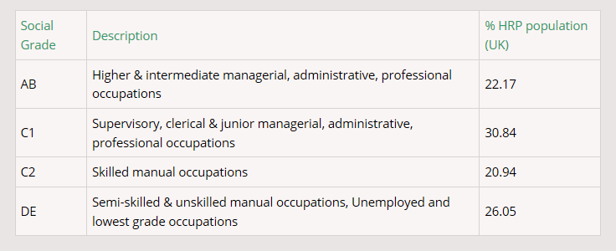
Socio-economic groups

Slide 7
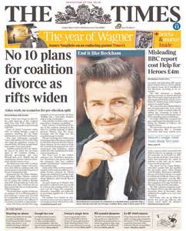
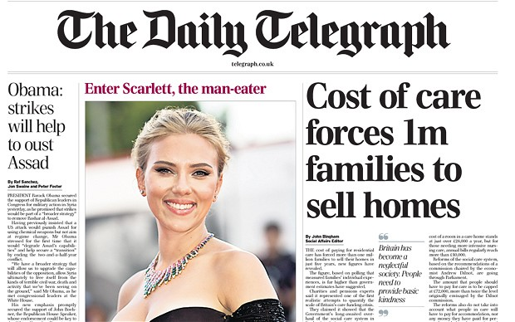
Socio-economic groups activity
In pairs, can you link the newspapers to socio economic groups? Why would a newspaper want to do this?

Slide 8
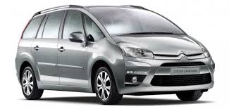
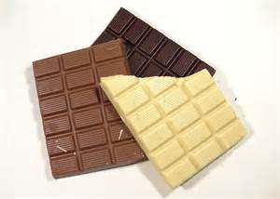
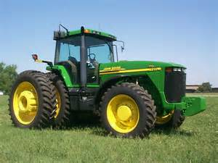
Can you segment these products?

