Slide 1
Markets (1)
Market Data. Market Share and Market Growth

Slide 2
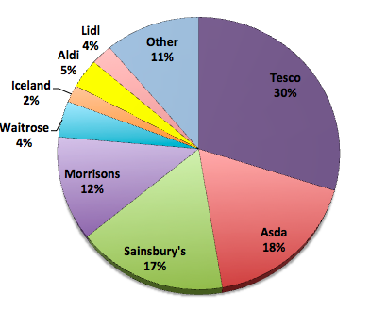
What is a market? What is competition?

Slide 3
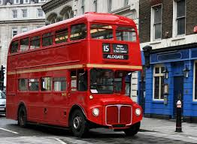
Types of markets
Local, national, global?
Mass or niche?
Trade (B2B) or Consumer (B2C)?
Product or Service?
Constant sales or seasonal?

Slide 4
Market Share
Measured by value or volume.
Market share is usually measured as a percentage
Market share is calculated by: No of sales/total market sales
Question
The 2012 January-March UK car sales were 563,556 of which Ford UK sold 82,848 cars. What is the market share of Ford UK?

Slide 5
Market Share
Question
The 2012 January-March UK car sales were 563,556 of which Ford UK sold 82,848 cars. What is the market share of Ford UK?
Answer
No of sales/total market sales
Answer = (82,848 / 563,556)*100 = 14.7%

Slide 6
Reasons to increase market share
Increased profitability
Increase sales in a stagnant industry
Increased bargaining power
Economies of scale
Reputation

Slide 7
Reasons not to increase market share
Firm is near its production capacity
Overall profits in decline due to increase advertising spend or by reducing prices
Price war
Threat from a niche competitor
Competition issues (Competition Commission)

Slide 8
Ways to improve market share
Product
Price
Place
Promotion
Discussion – can you think of any examples of supermarkets using these?

Slide 9
Ways to improve market share
Product
Price
Place
Promotion
Discussion
Can you think of any examples of supermarkets using these?

Slide 10
Ways to improve market share
Product? M&S adding branded products to their stores
Price? – price matching and comparison across supermarkets (especially price matching to Tesco)
Place? – M&S and Waitrose at service stations
Promotion? promoting price matching on branded items

Slide 11
Market growth
Market growth measures the increase in value of a whole market, not just the sales of any individual firm within the market.
Market growth is usually measured as a percentage, and calculated as:
New value – Previous value | = %
Previous value

Slide 12
Market growth
For example. The 2012 March UK car sales were 372, 835 compared to 366, 243 cars for the same period in 2011. What is the change in market growth?
New value – Previous value | = %
Previous value

Slide 13
Market growth
For example. The 2012 March UK car sales were 372, 835 compared to 366, 243 cars for the same period in 2011. What is the change in market growth?
New value – Previous value | = %
Previous value
372, 835 - 366, 243 | x 100 = +1.8%
366, 243

Slide 14
Quick task in pairs What drives market growth?

Slide 15
What drives market growth?
Increase in real incomes
Fashion
New technology
Health concerns
Effective marketing

Slide 16
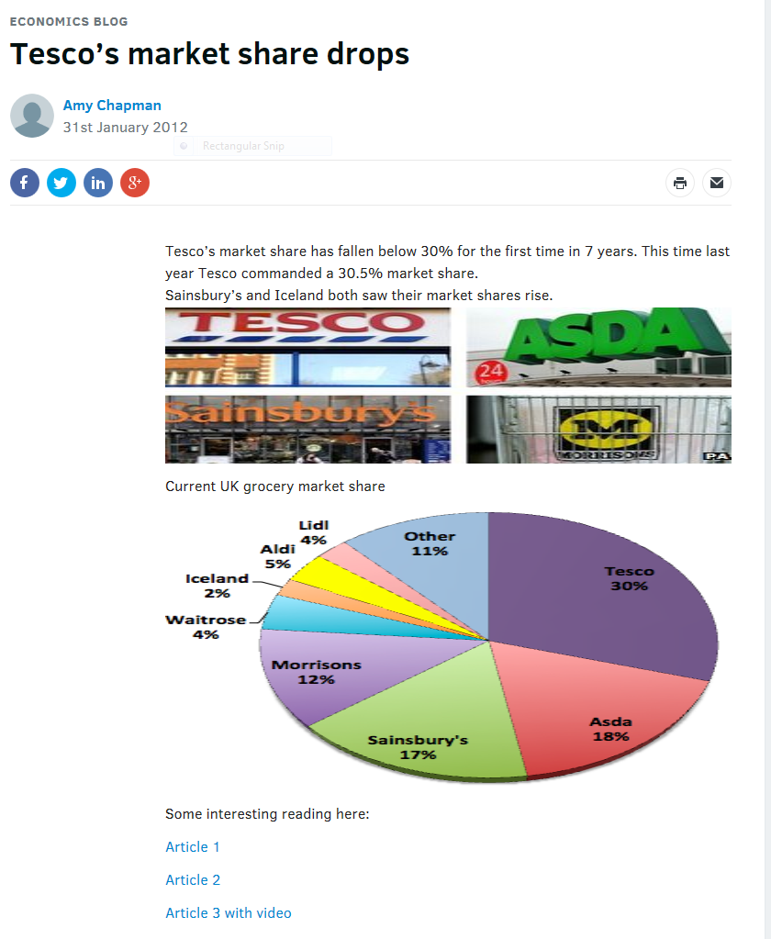
Extension/research
Use the tutor2u website to investigate recent news items about market share and growth
Add any relevant facts
to your revision notes to hand in
http://beta.tutor2u.net/economics/blog/tescos-market-share-drops

