Slide 1
Public or Private?
What is the difference

Slide 2
The Public and Private sector
Learning Objectives
Explain the aims of the public sector
Explain the role of the public sector in providing goods and services
Evaluate the roles of the public and private sectors in the provision of goods and services

Slide 3
Key Terms
Public sector: business organisations which are owned or controlled by central or local government or public corporations
Public corporations: organisations set up by law to run services on behalf of the Government.
Public goods: good were consumption by one person does not reduce the amount available to others and, once provided, all individuals will benefit.
Merit goods: goods which are underprovided by the private sector

Slide 4
The Public sector
The UK economy is described as a “mixed” economy with private and public sectors
UK’s GDP by sector percentage & value (2016-17)
Gross Domestic Product: the total value of all goods and services produced in a country
So the UK government is responsible for almost half the economy’s income every year

Slide 5
The Public and Private sector
What is similar and different about the two sectors?:
Similar: provide goods and services to customers
Different: Some ownership and aims
Private sector
Ownership is “private”
Aims include
Survive
Quality
Profit
Grow
Meet customers’ needs
i.e. very similar to public sector!!!
Public sector
Government owned and run
Aims include
Survive
Quality
Value for money
Meet customers’ needs
Do not waste tax payers’ cash

Slide 6
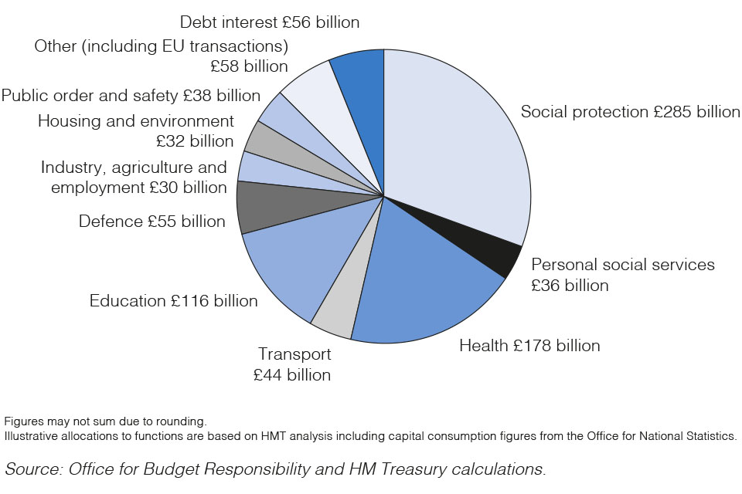
The Public and Private sector
Notes:
Social protection doesn’t just include benefits and tax credits; personal social services like child protection are included in this figure, as well as pensions paid to former public sector employees.

Slide 7
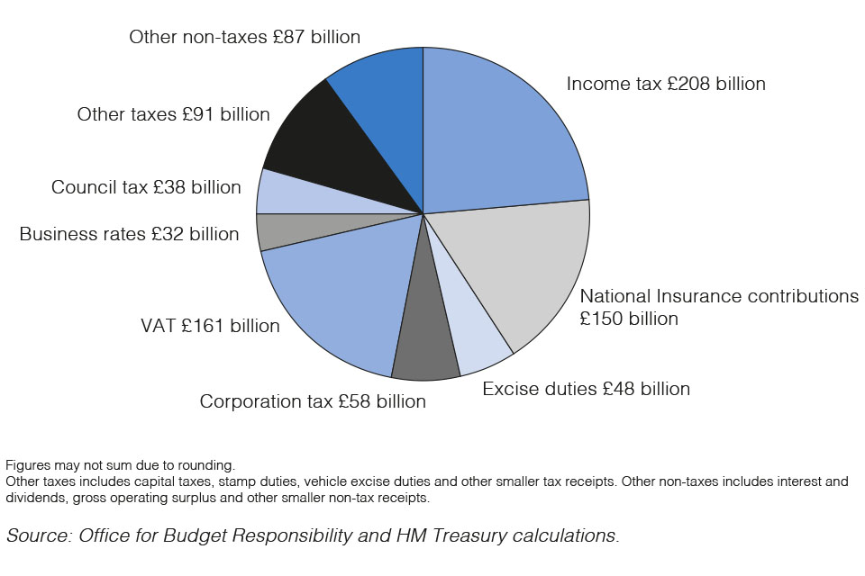
The Public and Private sector
Where does the cash come from for the two sectors?
Private: investors’ capital, loans, sale of assets, profits
Public:
Taxes (see chart),
Debt,
Investment income,
Sale of assets

Slide 8
The Public and Private sector
Think & Share
Why does the Public sector provide these services rather than the Private sector providing some or all of them?

Slide 9
Public goods
Public goods (and services) have two characteristics:
1 Firstly, individuals cannot be excluded
from enjoying the benefits of the public good
once it is produced:
the “non-excludable” effect: everyone has access to use them, and their use does not deplete their availability for future use. You cannot exclude a certain person or group of persons from using such goods
Secondly, one individual’s consumption of a good or service does not prevent others from gaining from the good or service:
the “non-rivalry” effect
e.g. : street lighting, police, defence
There is a benefit to society from the production of these goods and services, so they are financed by taxation and “free”
Note: not all goods provided by government can be called Public goods. E.g. YES – Defence, NO – Health care

Slide 10
Merit goods
Merit goods & services are:
A good or service that society deems is ‘good’ for people irrespective of their ability to pay, but is under provided by the market
If left to the private sector alone, merit goods would be underprovided.
Example: Education, health care, welfare, road safety
For example, the more society educates
its people (on average) they are
healthier, happier, live longer and
contribute more to the economy.
If there were only private schools, not everyone would be able to go as they are expensive / profit making.
Notes:
2009 Road injuries and fatalities cost UK economy £33, with each road death costing £1.6 million.
These costs include: costs to the NHS and emergency services; costs to the police from investigating the crash and bringing cases to court; costs to individuals through higher insurance rates; costs from lost worker productivity; human costs; and damage to property.
Public information films

Slide 11
The Public and Private sector
Activities:
1. Read pages 1, 2 and 3 of the Business Structure notes on GOL
- Summarise key points onto one side of A4
2. Past paper question :
Distinguish between merit goods and public goods
4 marks – 6 minutes
10 - 15 minutes
6 minutes

Slide 12
The Public Sector Structure
The ONS definition of the public sector is comprised of the following sub-sectors:
Central Government (CG): includes Government Departments and their Executive Agencies and Non-Departmental Public Bodies. They supply some important services and are used to implement policies (e.g. The Ministry of Defence)
Local Government (LG): those types of public administration that only cover a specific locality and supply local services (e.g. Recreation)
Public Corporations (PC): organisations set up by law to run services or industries on behalf of the government (controlled by either Central Government or Local Government e.g. the BBC)

Slide 13
Privatisation and Nationalisation
Privatisation: When government owned industries are sold to private investors
Nationalisation: When the Government takes over the ownership of a whole industry
Relevant key terms
Nationalised industries = Public corporations previously part of the private sector which were taken into state ownership
Deregulation = lifting restrictions that prevent private sector competition
Notes:
Provide Pros and Cons on handout

Slide 14
The Private Sector – Privatisation
What is it?
The transfer of public sector resources to the private sector
The reasons for it:
Generates income for the government
Nationalised industries were inefficient (as they lacked the incentive to make a profit)
Forced to improve their service and charge competitive prices (due to deregulation)
Should increase accountability
Increase share ownership
Notes:
Key terms students will need to know for this discussion:
Nationalised industries = Public corporations previously part of the private sector which were taken into state ownership
Deregulation = lifting restrictions that prevent private sector competition

Slide 15
Privatisation and Nationalisation
- Activity -
Read the Privatisation and Nationalisation text book pages on Godalming Online (up to Question 3)
Privatisation
What is it?
List three reasons for it.
Describe (with examples) three ways privatisation impacts on businesses
Explain three arguments against privatisation
Nationalisation
What is it?
List three reasons for it.
3. What is deregulation and contracting out?
Notes:
Banks nationalised in the recession

Slide 16
Public sector organisations - privatisation
When government owned industries are sold to private investors. Over a twenty year period approx. £90bn was raised by the sale of public assets
So what are the arguments for and against the policy?
A D V A N T A G E S
The world changes (e.g. cold war ended), technology drives change so sell what is no longer required
The state is a poor business person – nationalised industries were inefficient & unaccountable
Greater competition gives consumers choice and lower prices
Privatisation would increase share ownership, people would have a ‘stake’ including workers in the former state industries
D I S A D V A N T A G E S
They were expensive to sell off, frequently under valued, and created a new industry of regulators
Increasing competition has been limited, e.g. The Big Six energy firms
Selling off natural monopolies has led to wasteful duplication
Unprofitable services (e.g. rural buses) have been closed and communities have lost out
A share owning democracy has not materialised
Many strategic businesses are now owned by ‘foreigners’; is this wise?

Slide 17
Public sector organisations - Nationalisation
When the Government takes over the ownership of a whole industry
A D V A N T A G E S
Many state run industries allow people to enjoy a basic right, without rationing by price e.g. water, gas (although note, these have been privatised in the UK
Natural monopolies e.g. air traffic control
Allegations of greed in the Private sector? Can cause inefficiencies. Nationalisation should be in the public interest only. Banking?
D I S A D V A N T A G E S
Goes against free-market principles of most democracies. Inefficient? Where is the competition?
Losses are carried by the government and the taxpayer
Who is running the organisations? What is their background / expertise? Who is checking their work or ensuring they are working optimally?

Slide 18
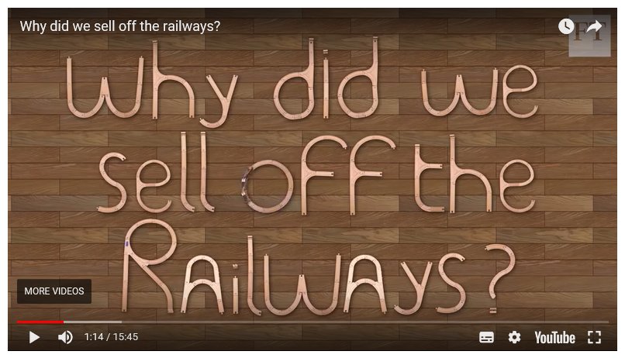
The Transport Secretary Chris Grayling announced that the East Coast main line was to be taken back into public ownership. The FT have released a fantastic video that asks the question; "Why did we sell off the railways?“
https://www.youtube.com/watch?v=U6V-HDbX9A8

Slide 19
The Public and Private sector
Activity
Past exam question : Anger over rising gas prices, questions a & b (on GOL)

Slide 20
Anger over rising gas prices
Nationalisation is when the Government takes over the ownership of a whole industry, this may be to supply services which were unprofitable or to save jobs when closure is threatened.
Privatisation is the transfer of public sector resources into the private sector
Arguments in favour:
Generation income for government
Nationalised industries were inefficient (high costs, losses)
Improve service
Share ownership

Slide 21
The Public and Private sector
Evaluation:
“With a thriving and competitive private sector, the UK has no need of a public sector.”
Discuss

