Slide 1
LEGAL STRUCTURES RECAP
True or false
Sole traders cannot employ staff members
When one partner in a partnership dies, the partnership agreement ends
Private Limited Companies (LTDs) can sell shares on the stock market
When the owners and the business are separate legal entities the owners will have limited liability
It is easy for sole traders to access finance
Unlimited liability means if the business gets into financial trouble the owners may lose their personal assets to repay the debt
Partnerships can be made up of between 2 and 50 people
Only Public Limited Companies (PLCs) need to file annual report and accounts at Companies House

Slide 2
BUSINESS STRUCTURES: NOT FOR PROFIT SECTOR Starter activity
Can you name a type of ‘Not for Profit’ Organisation?
Can you come up with examples of ‘Not for Profit’ Organisations e.g. Oxfam
Notes:
Charities are established with the aim of collecting money from individuals and spending it on a cause. They do not earn profits but they can earn surpluses.
Social enterprises trade to help solve social problems, improve the communities they operate in and to improve the environment. Many aim to make a profit but instead of paying dividends they reinvest the profits towards achieving their social objectives.

Slide 3
Learning Objectives
Explain the main features of not-for-profit organisations including:
social enterprises,
charities,
co-operative societies

Slide 4
Not for profit
The ‘third’ sector (not commercial or public)
They exist for a variety of reasons, but have common characteristics:
They are non-governmental organisations
They have a governing body (often trustees) responsible for managing their affairs
They are value driven (eg social, environmental, community or cultural aims)
Usually profits are reinvested to further the purpose of the organisation
Many use volunteer staff as well as paid employees

Slide 5
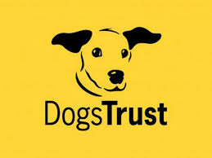
CHARITIES
Established with the aim of collecting money through donations and spending it on a cause e.g. Oxfam, Save the Children
Usually set up as a company limited by guarantee (a separate legal entity), owned by members (instead of shareholders)
Controlled and managed by the Board of Trustees
Includes rules that can’t distribute profits to members

Slide 6
Co-operative Societies
Organisation owned by its members. Two types:
Worker – the workers own the business – if you get a job in the company you become one of the owners – Suma Wholefoods
Workers are well motivated – they all get a share of the profits
Decision making can be difficult
Consumer – the users of the business own the business – Co-op Bank
Customers are loyal
Need a board of customers to run the business
Notes:
https://www.youtube.com/watch?v=TUPDL3vs-sM
https://www.youtube.com/watch?v=Qkx1UqCeKT4

Slide 7
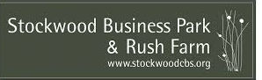
Other Societies
Community Benefit Societies (BenCom)
Owned by members (like a co-operative) but set up to benefit the community, whether that community are members or not (a co-operative focuses on benefitting members).
Run by members and raises funds by issuing community shares / from donations.
Friendly Societies
Mutual organisations owned by their members.
Offer members a range of affordable savings, investments, insurances, pensions (historically focused on insurance pre-welfare state)
Building societies
Building societies are owned by their savers and borrowers (members), not by external shareholders
Offer banking and financial services (historically focused on buying houses)
Notes:
http://stockwoodcbs.org/about/

Slide 8
SOCIAL ENTERPRISE
Social enterprises are defined as:
"Businesses with primarily social objectives whose surpluses are principally reinvested for that purpose in the business or community, rather than being driven by the need to maximise profit for shareholders and owners'.
In other words, a social enterprise is a proper business that makes its money in a socially responsible way.
These ventures are not necessarily formed to reinvest all profits into the communities. Social entrepreneurs can make a good profit themselves. However, their business model is also designed to benefit others.

Slide 9
Social Enterprises
Social enterprises complete alongside other businesses in the same marketplace, but use business principles to achieve social aims.
A few things all social enterprises have in common are:
They are directly involved in producing goods or providing services
They have social aims and ethical values
They are self-sustaining, and do not rely on donations to survive (i.e. they are not charities)
Examples included: 15, Eden Project, Divine Chocolate, Big Issue, Cafedirect
Notes:
Divine Chocolate, the Eden Project and fair-trade coffee company Cafedirect.

Slide 10
Social Enterprises
Notes:
https://www.youtube.com/watch?v=fSDL1reAvd4

Slide 11
Important to note…
An ethical business is NOT the same as a social enterprise. An ethical business tries to achieve its financial goals while minimising any negative impact on society or the environment.
Whereas a social enterprise main purpose is to fulfil its social AND or/environmental goals

Slide 12
Note taking and Research Task
Note taking: Read through pages 8 – 11 of the Business Structures notes and summarise the following:
What does not for profit mean?
What is a charity? What is their purpose / how do they work?
What is a co-operative? What is their purpose / how do they work?
What is a social enterprise? What is their purpose / how do they work?
Research a charity or a social enterprise. Create an information sheet on each of your chosen not for profit firms which includes an explanation of:
What is its purpose? (social or charitable goal)
How does it raise / make money?
What does it do with the money it generates?
Who owns it?
Who runs/manages it?
How is it staffed?
Identify 2-3 aims it has
Identify 2-3 objectives it has
Use the social enterprises link on Godalming Online to help you

Slide 13
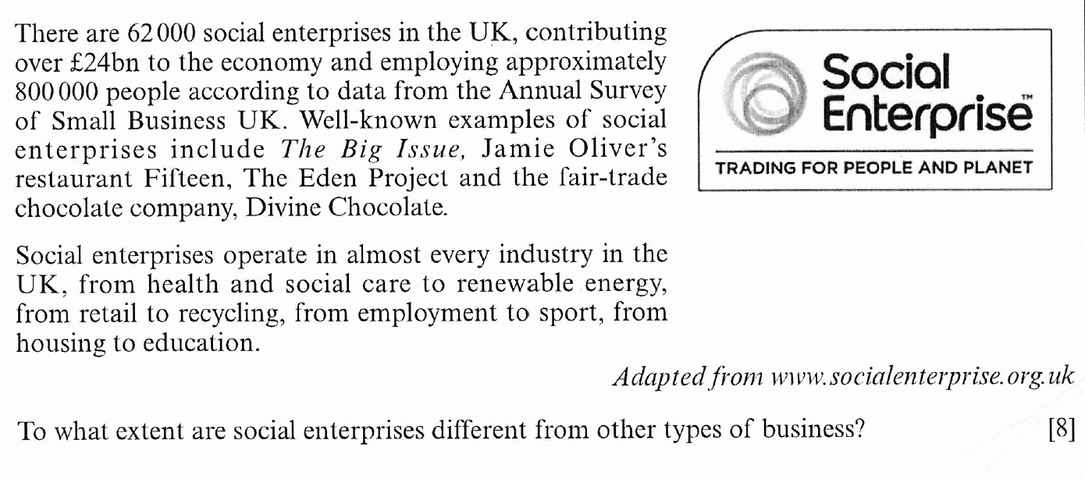
Discussion point
Use examples from your research task to support your arguments

Slide 14
50/50
Consolidate your Business Structures learning:
Complete ‘Business Structures’ end of topic quiz (on Gol)
And at least two of the “Test Yourself” activities on Godalming Online.
On going
Revise topics studied so far
Enterprise
Business Plans
Business Structures
It is a good idea to set up a 50/50 book or folder to record your 50/50 activities, these can include summaries of dragon’s den programmes (including key terms used), case studies of businesses, news articles etc.

