Slide 1
ArcGIS Introduction and pre-work
Aims
To explore how ArcGIS can be used to collect data in the field and create maps and other forms of data presentation
To introduce further ideas for possible investigations and data collection techniques

Slide 2
You will be receiving an important email from ArcGIS (Esri for schools) inviting you to join the Godalming College ArcGIS account. Please make sure that your inboxes are not full and that you do not accidently delete it.
You will be given a user name and be asked to change your password. Please do so as soon as possible as you will need to access the account in the preparation lessons for the Guildford fieldtrip.

Slide 3
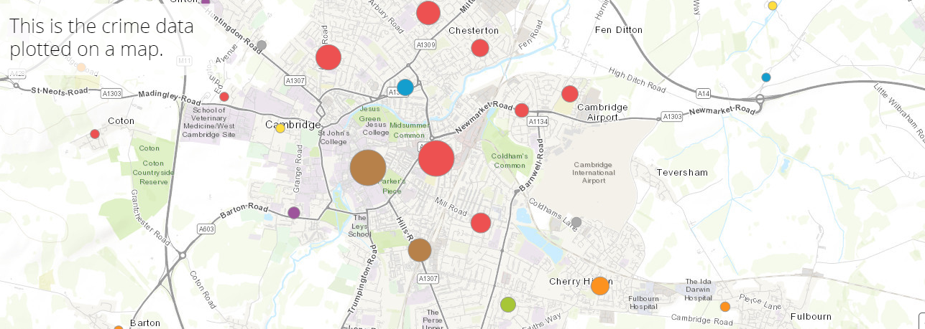
How can you use ArcGIS for your NEA?
https://esriukeducation.maps.arcgis.com/apps/Cascade/index.html?appid=40de01dad0344ead98d1a306e5240d95
All sorts of information could be mapped in this way e.g. pedestrian/traffic counts, environmental quality scores, housing decay surveys

Slide 5
https://sway.office.com/f3VGrkM4HIX6M0qN

Slide 6
Survey 123 form
You will be creating surveys like this one that you will then try out in Guildford

Slide 7
How to draw on top of basemaps (create a new feature layer)
Click on the image to access the video tutorial
This video covers:
Creating a layer in ArcGIS Online for RICEPOTS land use mapping
Drawing land use polygons on a map
https://schools.esriuk.com/teaching-resources/#-
Use the above link to learn how to create land use map https://services.arcgis.com/XSeYKQzfXnEgju9o/arcgis/rest/services/Landuse_New_Masters/FeatureServerTh

Slide 8
Pre-work to be completed for your second human lesson week beginning 9th March
https://schools.esriuk.com/teaching-resources/#/c=get-started Digital land use survey
1) Look through the powerpoint and watch the video tutorials. Write out the instructions on how to create the land use map so that you can complete the task below. These instructions will be put in your fieldwork folder so that you can refer to them again.
2) Try out the techniques shown using a base map of Guildford. It does not matter which categories you use as it is just an opportunity to play around with the software. Print out a copy of the map you have created. You will need to sign into your ArcGIS account to do this.
3) Use the measure tool in maps to measure the area of a place and also the distance from the centre of Guildford (High Street) to Pewley Hill
https://learn.arcgis.com/en/paths/developing-knowledge-skills-and-confidence-with-survey123/
4) Watch each of the video clips and write down step by step instructions that you can use later when you create your own survey forms.

