Slide 1
Guildford Fieldtrip Preparatory Work
Aims
To explore the data presentation and analysis tools in ArcGIS using microclimate data collected around college
To create survey forms to be used on the Guildford Fieldtrip
To choose suitable sampling points
To consider the risk assessments and ethical considerations needed for an urban study

Slide 2
To explore the data presentation and analysis tools in ArcGIS using microclimate data collected around college
Access the microclimate survey form that has been shared with you through the ArcGIS phone app. It will be the one with your class name e.g. A1, E1 etc (your teacher will tell you)
Your class are collectively going to record temperature, humidity and wind speed recordings around college. You are also going to record the surface type where the recordings have been taken, what time the recordings have been taken, whether the location is in the sun or in shade and also photographs at each location.
Equipment required – hygro-thermometer, anemometer and mobile devices (phones)

Slide 3
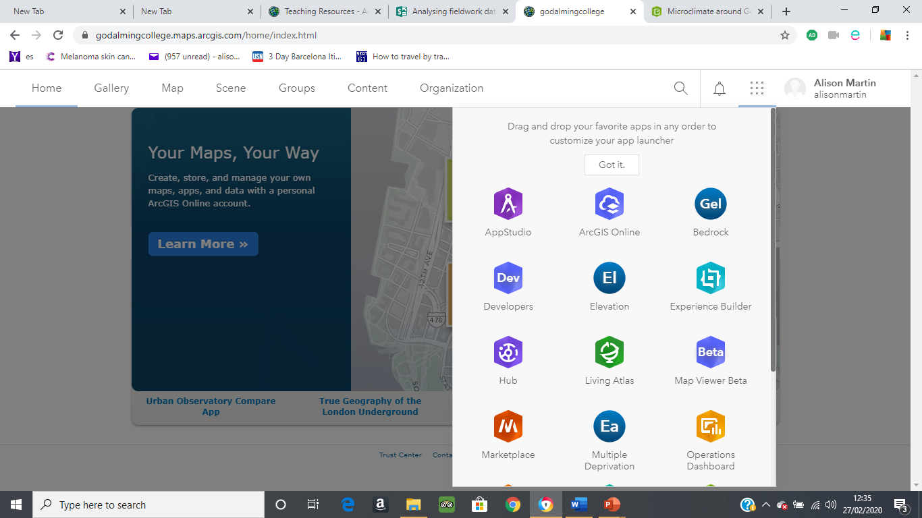
On return to the classroom you are then going to explore the various ways in which data can be presented and analysed. Work collaboratively and share with those around you the things you discover that can be done with the data.
To do this:-
Log in to your ArcGIS account
From the Home Page select the icon shown on the following powerpoint and follow the instructions provided to see how the data can be presented and analysed.
The following video clip will help you if you get stuck……..
https://sway.office.com/LRDBGx8FyvgqyFrp

Slide 4
From the Home Page –
Click here and then select Survey123
Click on the microclimate around Godalming College icon and explore the analyse and data functions for the data that has been collected.

Slide 5
ArcGIS has many functions that you can use for your NEA and the Esri for Schools website has a wide range of teaching resources, including videos that can guide you through the different functions. (You have already explored some of these functions when completing the pre-work)
We do not have time in class to go through all of them – it is up to you as to whether or not you choose to use the resources available, and to do some further research on the ArcGIS capabilities.
ArcGIS is a new tool for us too and so if you find some useful functions please do share these with your teacher!

Slide 6
Guildford Fieldtrip – to investigate
How does central Guildford vary in land use, quality of the environment, footfall and/or characteristics of cultural quarters.
How does land use change from the centre of Guildford to the outskirts?
How has gentrification impacted the area to the north of York Road, Guildford
How does the urban land use in central Guildford vary and is regeneration required in some areas?

Slide 7
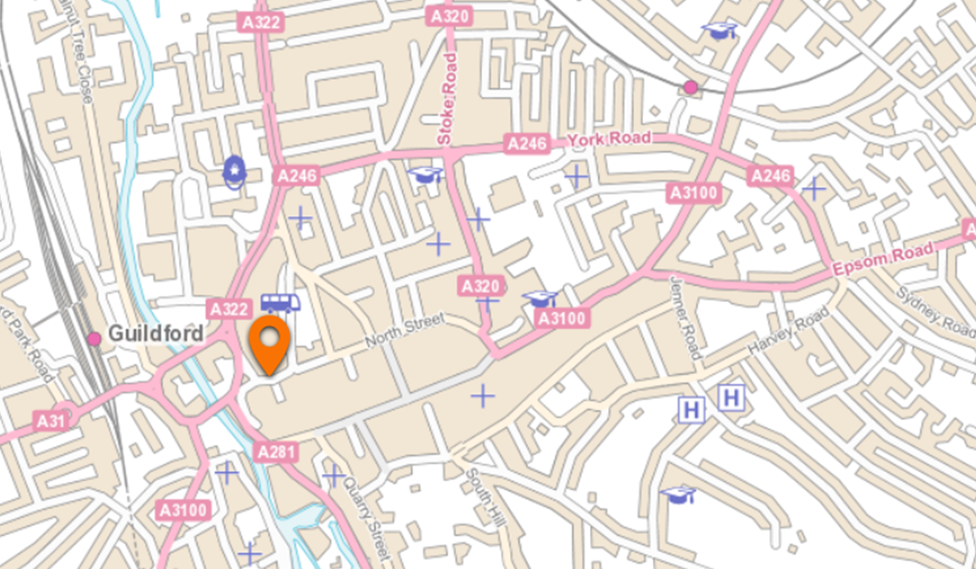
Meeting Point – Priory Centre
10am
High Street

Slide 8
Data collection methods to be used in Guildford
Environmental quality surveys
Land use surveys
Pedestrian counts
Housing decay surveys
Retail value assessments
Photographs
You will be working in groups of 3-4 people to complete the required survey forms for this fieldtrip. You will need to discuss how things should be done and allocate tasks to individual members of your group. It is important that you discuss what needs to go into the forms and where your sampling points will be before doing any individual work.
The survey forms will then need to be shared with team members.

Slide 9
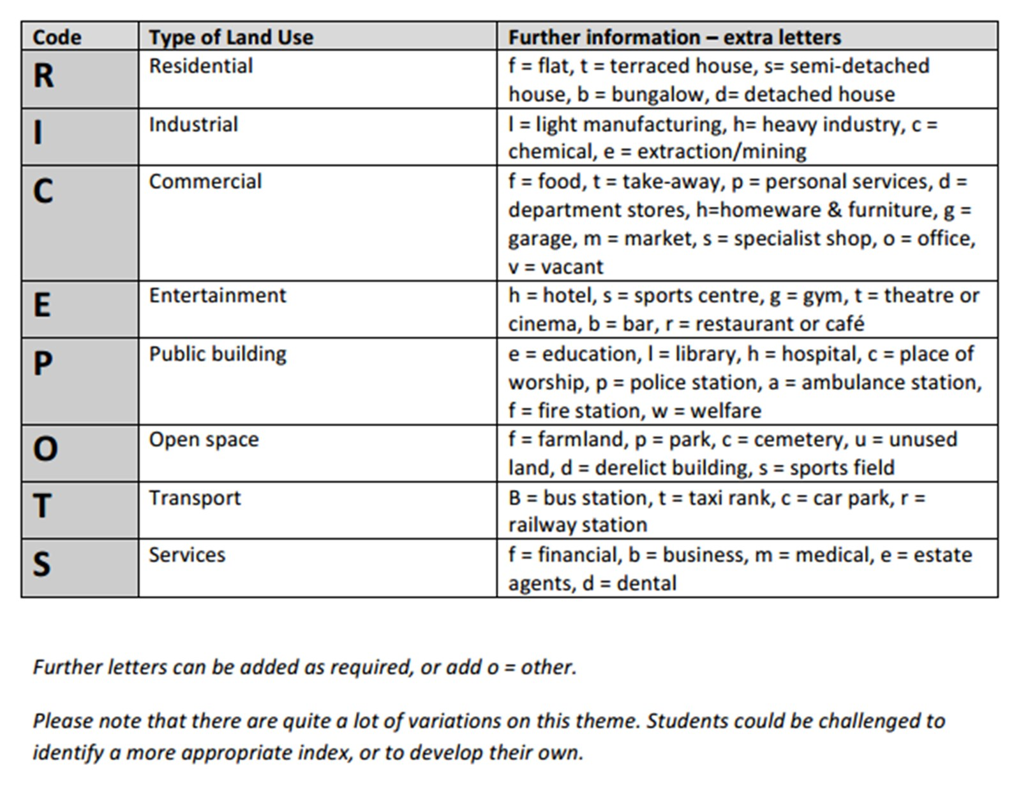
Measuring land use function
You are going to complete 2 land use surveys in Guildford.
One comparing land use between the High Street and North Street.
The other a 1km transect coming outwards from the city centre towards the suburbs.

Slide 10
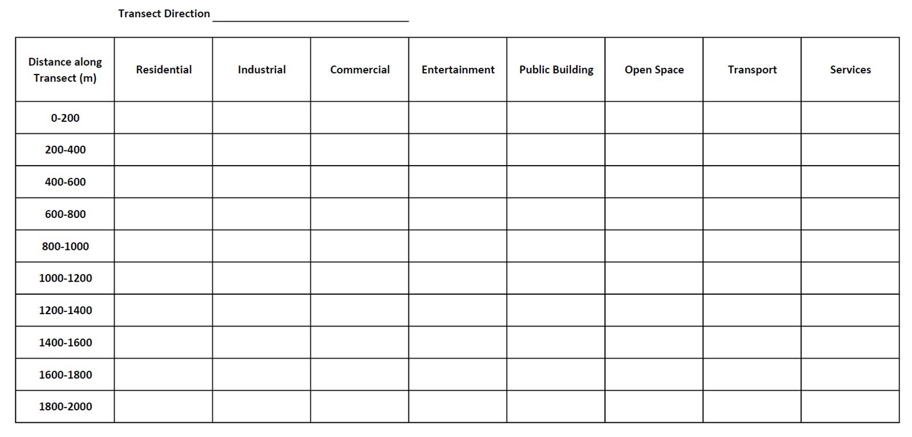
You could collect the land use data systematically like in this table. This would work well along your 1km land use transect.
For the city centre you will collect your data at every land use change. This is more suitable for smaller areas like the two streets being compared, where land use changes frequently.
You will need to use the map function in ArcGIS to identify a suitable 1km transect that has a variety of land use changes (follow a road so that it is accessible). Use the measure tool that you practiced in the pre-work to identify locations every 100m. Create a map and mark on those sampling points.
Create a survey form on ArcGIS which will enable you to collect land use data along the 1km transect.
Create another survey form that can then be used to record land use change along the High Street and North Street.

Slide 11
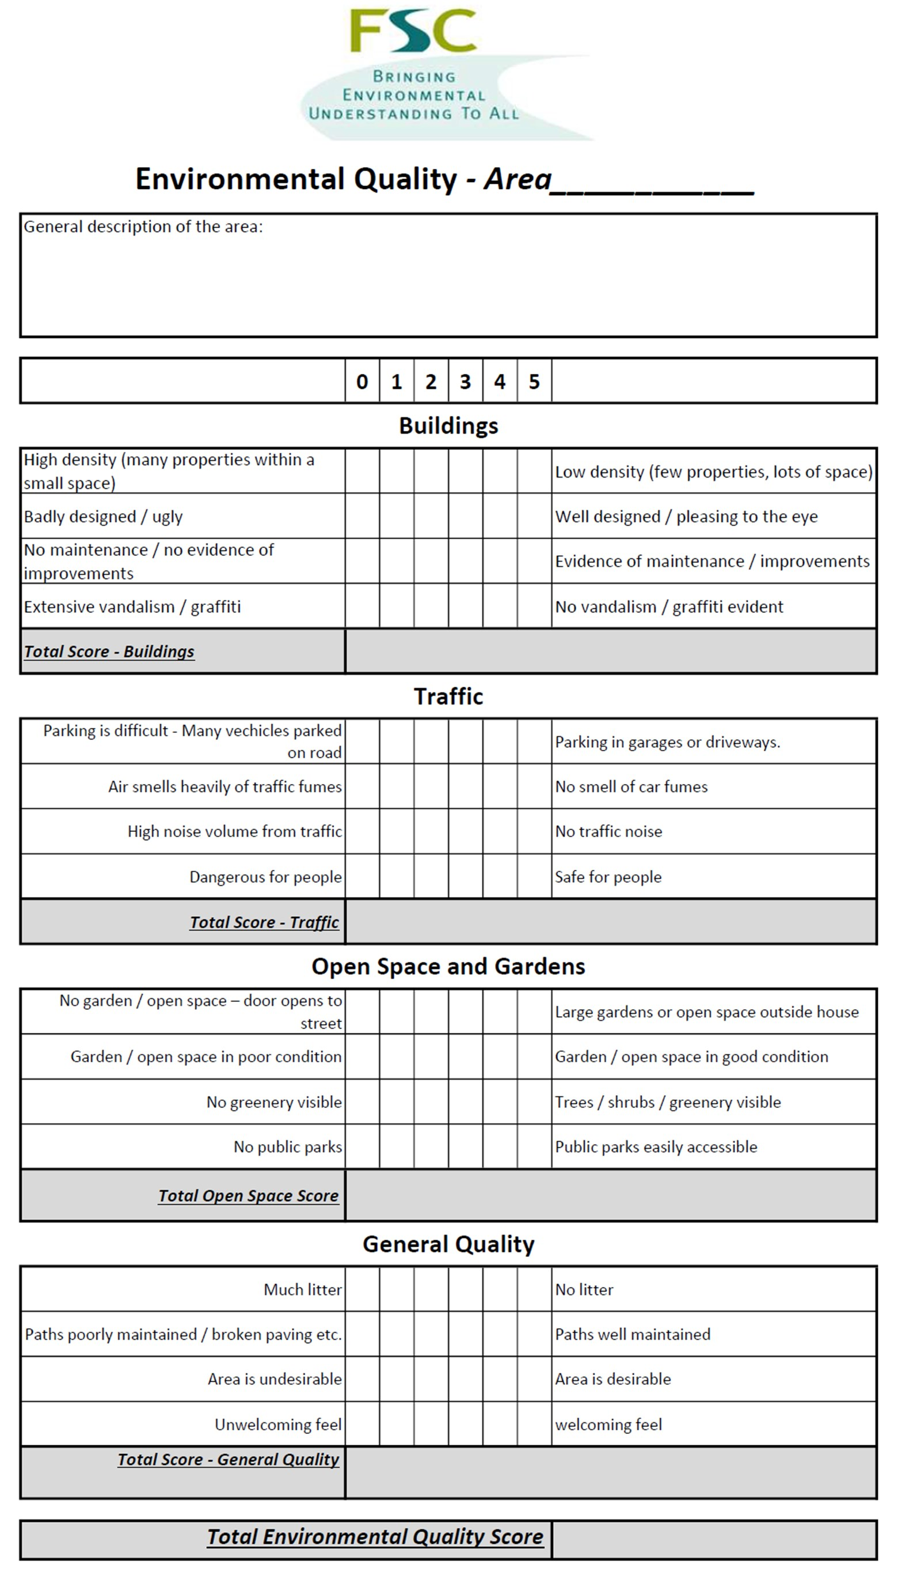
Environmental quality survey
An environmental quality survey uses an observer’s judgements to assess environmental quality against a range of indicators. Often they work on a sliding scale of quality (like 1 to 5) to represent less good to good. Alternatively you can use a Bi-polar scale (like -5 to +5) to indicate a negative assessment through to a positive assessment, with 0 representing neither good or bad.
As it is based on personal judgements the data collected using environmental quality surveys is subjective. Benchmarking the scoring between different observers will help reduce this subjectivity.
Sampling for environmental quality surveys within a study:
Either an overall judgement of an area – walk around the whole area and then complete the survey as a summary or at a number of points within the area – which may be selected using a random, systematic or stratified sample
Create a survey form to collect information to examine the environmental quality of two contrasting areas. You could choose to do it between two areas of the town centre or two different streets north of York Road. You have examples of two different environmental quality surveys in your handout – think about which questions will be most relevant for your chosen areas. Include the ability to record photographs in your surveys.

Slide 12
Pedestrian surveys - advice from Field Studies Council (FSC)
Think about the which day of the week to count pedestrians. Pedestrian numbers are likely to be higher on a Saturday or Sunday then during the week, during school holidays, during dry weather and if there is a popular event happening in the city centre
Time of day is also important. Pedestrian numbers are likely to be higher during "rush hours" (like 8am-9am) or shift changes and during office lunchtime. Around 11am and 2.30pm are often good times to choose.
You need at least 20-25 survey points. Choose survey points across the city centre. If you are working in groups, each group can walk different routes across the city centre.
This is up to you, but make sure that you survey in the same way each time. Think about how long to count pedestrians for - 2 minutes is enough. If your survey points are close together (perhaps every 100 metres), you might be able to do 3 or 4 pedestrian counts in 10 minutes. Whether to count people on one side of the road or both sides of the road - if you are working in groups, different members of the group could count different sides of the road, with someone else holding a stopwatch.
Decide where you are going to do your pedestrian surveys. This is a learning exercise and so you do not need to do the number of survey points recommended above. Instead choose four locations (You may wish to choose locations in the two study areas used for the retail survey) and create a survey form to collect this data.

Slide 13
Retail Value
An indicator that regeneration might be required in an area is to look at the retail value. This might also be a useful form of data collection for investigations linked to clone town surveys and sense of place or whether an area would benefit from regeneration. There are likely to be areas of higher and lower retail quality in Guildford City Centre. One way in which this can be done is to choose a study area, then score each shop within the area as follows:-
Shop type Score
Department store 5
High street chain 4
Independent specialist shop 3
Convenience store 2
Charity shop 1
Vacant retail premises 0
Identify two areas of Guildford City Centre where comparisons of retail value can be made.
Create a survey form on ArcGIS that you can use to collect this data.

Slide 14
Housing decay survey
You can also measure the condition of housing. Make sure that you sample houses fairly. You might, for example, choose to sample two streets picked at random, and then sample house numbers 5, 15 and 25 on each street. (Guidance from the FSC) Alternatively you could sample every 5th house. Whatever you choose to do you will need to be able to justify it.
Study a map of the area north of York Road and select two streets that you can survey. You may wish to use Google maps and street view to select suitable streets.
Decide what sampling strategy are you going to use (systematic, stratified or random) and create a survey form on ArcGIS to collect this data. Include the ability to include a photographic image of sample sites.

Slide 15
Think about the different data collection methods that you will be piloting on the Guildford Fieldtrip. Which of the methods could help you to answer each of these questions?
How does central Guildford vary in land use, quality of the environment, footfall and/or characteristics of cultural quarters.
How does land use change from the centre of Guildford to the outskirts?
How has gentrification impacted the area to the north of York Road, Guildford
How does the urban land use in central Guildford vary and is regeneration required in some areas?

Slide 16
Ethical issues
There are ethical issues that need to be addressed for all fieldwork trips e.g. not asking sensitive personal information when completing questionnaires and ensuring that all responses are confidential.
What ethical considerations might we need to take when completing housing decay surveys and taking photographs in busy areas?

Slide 17
Risk assessment
Use the same table as for the Witterings

