Slide 1
WATER AID (2016) Charity Advert
Component 1: Media Products, Industries and Audiences

Slide 2
COMPONENT 1: INVESTIGATING THE MEDIA
EXAM 35%
Section | A | A & B | A | A & B
Sector | Marketing | Advertising | Music Video | Newspaper
Text | Kiss of the Vampire | Tide | Formation | The Times
 |  | WaterAid | Riptide | Daily Mirror
Media Language | Y | Y | Y | Y
Representation | Y | Y | Y | Y
Industries |  |  |  | Y
Audiences |  | Y |  | Y
Contexts | Y | Y | Y | Y

Slide 3
Aims
For this part of Component 1 we shall be studying a TV Charity Advertisement for Water Aid. The areas we will be covering include;
Media Contexts –historical, political and social
Media Language – cinematography, lighting, mise-en-scene, sound, editing, signs and signifiers
Representation – gender, culture, ethnicity
Audience – targeting, reception theory and cultivation theory

Slide 4
Charity adverts
Codes | Conventions
Tragic and upsetting images | Sad, orchestral music
Poverty/suffering | Solemn voice over
Black and white images | Direct appeal for money
Facts and Statistics | Personalised story
Contact details
The Water Aid advert reinforces charity advertisement conventions by including key information about the concern; a personalised narrative to which this information is relevant, and a direct appeal to the audience for money.
However, the fact it lacks a non-diegetic voiceover, melancholic audio codes and black and white visual codes could all be seen as unconventional of this advertising sub-genre.

Slide 5
TASK 1:
Viewing 2:
Use the ‘Analysing WaterAid’ handout identify the cinematography techniques used
Viewing 3:
Use the ‘Analysing WaterAid’ handout analyse the connotations of the cinematography techniques used

Slide 6
Cinematography
Denotation | Connotation

Slide 7
Cinematography
Denotation | Connotation
Long shot Close up on the people drinking from the tap Wide shot Arid landscape Tracking camera movement Close up of walking feet with shoes

Slide 8
Cinematography
Denotation | Connotation
Long shot Close up on the people drinking from the tap Wide shot Arid landscape Tracking camera movement Close up of walking feet with shoes | This signifies how far her journey is to get water Connotes the positive effect the tap has on the people Connotes her thirst/how dehydrated she would be without water Following her on her journey, so we can sympathise with her. Challenges generic convention of Water Aid adverts with bare feet which connotes poverty, the presence of the shoes symbolises a positive change that clean water has brought into their lives

Slide 9
TASK 3:
Viewing 3:
Use the ‘Analysing WaterAid’ handout identify the lighting/colour techniques used
Viewing 4:
Use the ‘Analysing WaterAid’ handout analyse the connotations of the lighting/colour techniques used

Slide 10
LIGHTING/COLOUR
Denotation | Connotation
Desaturated blues/grey of UK Warm yellow/orange tones of Zambia Browns of earth Cast and Attached shadows Hard lighting Soft lighting Lens flare | Connotes the coldness of home and the excess of water juxtaposed…. Signifies a warm, friendly and happy place Signifies a need for water Connotes the heat of the sun and the need for water Reinforces the heat of the sun and the need for water Reinforces a warm, friendly and happy place Connotes a happy, summery day

Slide 11
TASK 4:
Viewing 5:
Use the ‘Analysing WaterAid’ handout identify the mise-en-scene techniques used
Viewing 6:
Use the ‘Analysing WaterAid’ handout analyse the connotations of the mise-en-scene techniques used

Slide 12
MISE-EN-SCENE
Denotation | Connotation
Set design and props of UK home The bright colours used for example in their tops and water containers Open area with bland colours Their facial expressions are all happy as well constantly smiling Body Language , swing/tap Traditional Zambian patterns on clothing Crowd of people around the tap | Emphasises the contrast and juxtaposition Connotes happiness and brightness brought into their lives due to the clean water Signifies little evidence of modern society in the area. Connoting how happy water can make them Signifies the energetic and positive nature of people Connotes a proudness of their heritage Signifies a happy, bustling community around water

Slide 13
TASK 5:
Viewing 5:
Use the ‘Analysing WaterAid’ handout identify the sound techniques used
Viewing 6:
Use the ‘Analysing WaterAid’ handout analyse the connotations of the sound techniques used

Slide 14
SOUND
Denotation | Connotation
There is a sound bridge from the radio in a house into the girl singing Diegetic singing Footsteps and other diegetic sounds Sound bridge – Child in the swing Parallel sound – All singing | connotes that although they are different in many ways, Britain and Zambia are linked through their basic need for water. They are happening at the same time. Connotes naturalism because there is no artificial sad music. Happy and contrasts usual Charity ads music Peaceful place / Happy Life in the community Happiness – “you could make people this happy too if you donate”

Slide 15
TASK 5:
Viewing 5:
Use the ‘Analysing WaterAid’ handout identify the editing techniques used
Viewing 6:
Use the ‘Analysing WaterAid’ handout analyse the connotations of the editing techniques used

Slide 16
EDITING
Denotation | Connotation
The edits in the advert are cuts, they are short takes. Parallel editing Slow motion Medium takes Editing mirrors song | Connotes that the girls’ movements and actions are fast paced, energetic and happy. Signifies the contrasts between UK/Africa Connotes the importance and purity of water Walking pace / climate Linked to Pace

Slide 17
Structure reminders….
Turn your notes into analytical sentences that include terminology and analysis
Pick 1 point (connotation) and analyse how the different areas work together:
Cinematography
Lighting/colour
Mise-en-scene
Editing
Sound
WaterAid Example | Start by choosing an element of the advert to analyse, then you’ll use lots of terminology to describe as you go. When analysing your example you’ll use lots of terminology. This will include the more general; connotes, signifies etc... Along with specific e.g. tracking shot, high key lighting, desaturated etc… Applying theorist should fall naturally, dont force it in for the sake of it. You need to apply and evaluate.
Terminology
Analysis/ Arguments/ Conclusions
Media Language Theorists

Slide 18
Framework | Theorist | Prompts | Component 1: Section A: Language and Representation
 |  |  | Marketing | Advertising | Music Video | Newspaper
 |  |  | Kiss of the Vampire | Tide | Formation | The Times
 |  |  |  | WaterAid | Riptide | Daily Mirror
Media Language | Roland Barthes | The 5 Codes (SEARS) | Y | Y | Y | Y
 | Tzvetan Todorov | Equilibrium
 | Levi Strauss | Binary | Y | Y | Y | Y
 | Steve Neale | Genre
 | Baudrillard | Post-Modernism
Representation | Stuart Hall | Stereotyping and inequality | Y | Y | Y | Y
 | David Gauntlett | Pick ‘n’ Mix | Y | Y | Y
 | Butler | Performative
 | Liesbet van Zoonen | Gender is constructed | Y | Y | Y
 | Bell hooks | Patriarchal oppression
 | Gilroy | Ethnicity |  | Y | Y
Industries | Curran and Seaton | Power and Industries |  |  |  | Y
 | Livingstone and Lunt | UK regulation |  |  |  | Y
 | Hesmondhalgh | Cultural industries |  |  |  | Y
Audience | Albert Bandura | Media Effects
 | George Gerbner | Cultivation |  | Y |  | Y
 | Stuart Hall | Reception x 3 |  | Y |  | Y
 | Jenkins | Fandom
 | Shirky | End of Audience |  |  |  | Y

Slide 19
Code (SEARS) | Description | WaterAid Analysis
Semantic Code | Refers to the connotations found within the text that gives additional meaning over the basic denotative meaning. These additional meanings are usually dependent on how the audience read the image. Semantic codes can be tightly connected to genre and the audience’s association with generic signifiers.
Enigma Code | Refers to the mystery within a text, where clues are dropped but there are no clear answers given to the audience. Enigmas within the narrative make the audiences want to know more, but unanswered enigmas tend to frustrate audiences as most audiences prefer closed endings
Action Code | Contains sequential elements of action in the text to add suspense and tension. The enigma and action codes work as a pair to develop the story's tensions and keep the reader interested.
Referential Code | Refers to anything in the text which may refer to an external body of knowledge such as scientific, historical, cultural knowledge. The referential code makes the audience understand or expect stories from what we already know…because we are smart, informed spectators!
Symbolic Code | Refers to symbolism within the text which emphasises opposites to show contrast and create greater meaning creating tension, drama and character development. So it could be the symbolism of two opposing character types.

Slide 20
Code (SEARS) | Description | WaterAid Analysis
Semantic Code | Refers to the connotations found within the text that gives additional meaning over the basic denotative meaning. These additional meanings are usually dependent on how the audience read the image. Semantic codes can be tightly connected to genre and the audience’s association with generic signifiers. | The lines from the song used from 00.34 diegetically and then as a sound bridge over the medium shot of a group of women carrying water buckets on their heads: “make me feel, make me feel like I belong… don’t leave me, won’t leave me here”. The connotation here being that the text’s audience can help Claudia “feel like she belongs” and “won’t leave” her there / in that situation if they donate to Water Aid.
Enigma Code | Refers to the mystery within a text, where clues are dropped but there are no clear answers given to the audience. Enigmas within the narrative make the audiences want to know more, but unanswered enigmas tend to frustrate audiences as most audiences prefer closed endings | Suspense is created through the enigmatic use of the slow-motion, medium close-up, low-angle tracking shot of Claudia’s feet and the swinging bucket…
Action Code | Contains sequential elements of action in the text to add suspense and tension. The enigma and action codes work as a pair to develop the story's tensions and keep the reader interested. | … emphasised by the crescendo of the song in the scene at the water pump over which the informative on-screen graphic appears
Referential Code | Refers to anything in the text which may refer to an external body of knowledge such as scientific, historical, cultural knowledge. The referential code makes the audience understand or expect stories from what we already know…because we are smart, informed spectators!
Symbolic Code | Refers to symbolism within the text which emphasises opposites to show contrast and create greater meaning creating tension, drama and character development. So it could be the symbolism of two opposing character types. | The drought-ridden African countries are reinforced both visually and through the advert’s audio codes up until about 00.47.

Slide 21
Structuralism - Claude Lévi-Strauss
Theory
The idea that texts can best be understood through an examination of their underlying structure
The idea that meaning is dependent upon (and produced through) pairs of oppositions
The idea that the way in which these binary oppositions are resolved can have particular ideological significance.
Application
What binary opposites do you see?
The song’s title line “sunshine on a rainy day”
is used over shots of children running,
playing, laughing and the more positive
connotations of this section of the advert are
emphasised by the high key lighting used.
Arid, washed-out, primarily beige
and brown colour palette of the advert’s first
third and the more vibrant colours
The on-screen graphic (“650 million people
still don’t have access to clean drinking water”)
creates a conceptual binary opposition
between Claudia’s positive story and that of
other, less fortunate people. It’s this opposition
that the audience is encouraged to be part
of the solution to by giving “£3 today”.

Slide 22
representation
How is Claudia Represented?

Slide 23
COMPONENT 1: INVESTIGATING THE MEDIA
EXAM 35%
Section | A | A & B | A | A & B
Sector | Marketing | Advertising | Music Video | Newspaper
Text | Kiss of the Vampire | Tide | Formation | The Times
 |  | WaterAid | Riptide | Daily Mirror
Media Language | Y | Y | Y | Y
Representation | Y | Y | Y | Y
Industries |  |  |  | Y
Audiences |  | Y |  | Y
Contexts | Y | Y | Y | Y

Slide 24
Framework | Theorist | Prompts | Component 1: Section A: Language and Representation
 |  |  | Marketing | Advertising | Music Video | Newspaper
 |  |  | Kiss of the Vampire | Tide | Formation | The Times
 |  |  |  | WaterAid | Riptide | Daily Mirror
Media Language | Roland Barthes | The 5 Codes (SEARS) | Y | Y | Y | Y
 | Tzvetan Todorov | Equilibrium
 | Levi Strauss | Binary | Y | Y | Y | Y
 | Steve Neale | Genre
 | Baudrillard | Post-Modernism
Representation | Stuart Hall | Stereotyping and inequality | Y | Y | Y | Y
 | David Gauntlett | Pick ‘n’ Mix | Y | Y | Y
 | Butler | Performative
 | Liesbet van Zoonen | Gender is constructed | Y | Y | Y
 | Bell hooks | Patriarchal oppression
 | Gilroy | Ethnicity |  | Y | Y
Industries | Curran and Seaton | Power and Industries |  |  |  | Y
 | Livingstone and Lunt | UK regulation |  |  |  | Y
 | Hesmondhalgh | Cultural industries |  |  |  | Y
Audience | Albert Bandura | Media Effects
 | George Gerbner | Cultivation |  | Y |  | Y
 | Stuart Hall | Reception x 3 |  | Y |  | Y
 | Jenkins | Fandom
 | Shirky | End of Audience |  |  |  | Y

Slide 25
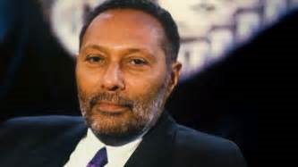
Stuart Hall
The idea that representation is the production of meaning through signs
The idea that stereotyping, as a form of representation, reduces people to a few simple characteristics or traits
The idea that stereotyping tends to occur where there are inequalities of power, a subordinate or excluded groups are constructed as different or ‘other’
Consider
Have stereotypes been followed/subverted?
Is anyone portrayed as different or ‘other’?

Slide 26
David Gauntlett
He suggests that representations offer an opportunity for audiences to think about their own identity and role in society.
The idea that the media provide us with ‘tools’ or resources that we use to construct our identities
The idea that whilst in the past the media tended to convey singular, straightforward
messages about ideal types of male and female identities, the media today offer us a more diverse range of stars, icons and characters from whom we may pick and mix different ideas.
Gauntlett also pointed out that whilst media role models hold some influence on audiences, we are more likely to be shaped by parents, friends, colleagues, teachers etc.
Consider
How could the representation of Claudia affect the identities of black girls, particularly those with relatives from Africa?
How could the representation of Claudia affect the understanding of those outside the black ethnicity?

Slide 27
Liesbet Van Zoonen: Representation/Feminist theory
Was inspired my Laura Mulvey and her work on ‘The Male Gaze’ to consider how men and women are represented differently as a result of western culture.
The idea that gender is constructed through discourse, and that its meaning varies according to cultural and historical context
The idea that the display of women’s bodies as objects to be looked at is a core element of western patriarchal culture
The idea that in mainstream culture the visual and narrative codes that are used to construct the male body as spectacle differ from those used to objectify the female body.
Consider
How has the cultural context affected our understanding of gender?

Slide 28
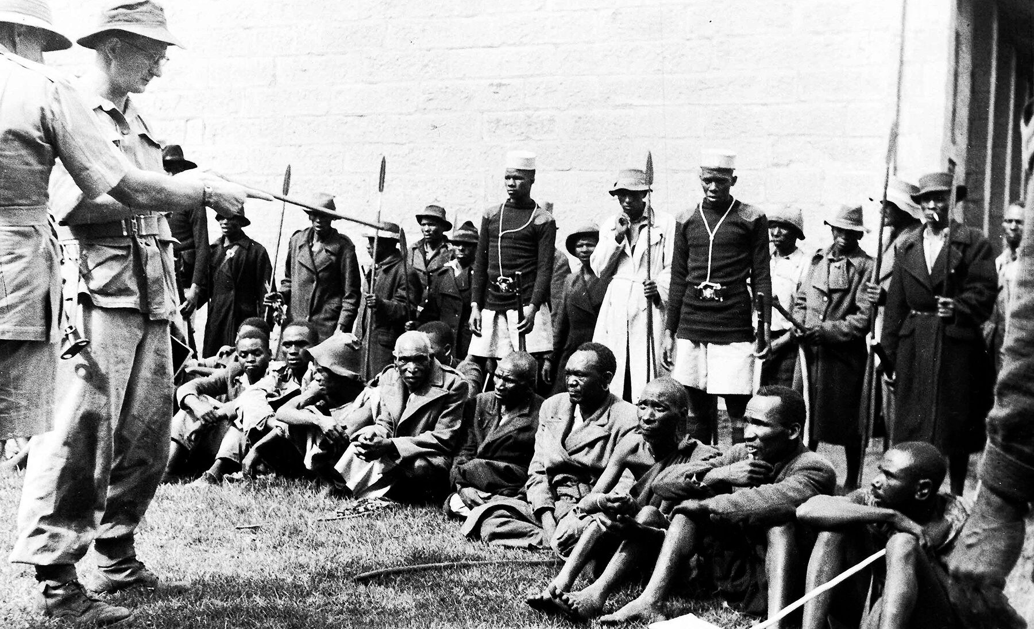
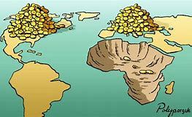
Paul Gilroy: Theories around ethnicity and postcolonial theory
Colonial ideas continue to inform contemporary attitudes to race and ethnicity in the postcolonial era
The idea that civilisationism constructs racial hierarchies and sets up binary oppositions based on notions of ‘otherness. ‘
Consider
How representations within the advert create a dominant relationship between UK audiences and developing countries.
Is it a positive relationship?
Is it one based on power?

Slide 29
AUDIENCE

Slide 30
Framework | Theorist | Prompts | Component 1: Section A: Language and Representation
 |  |  | Marketing | Advertising | Music Video | Newspaper
 |  |  | Kiss of the Vampire | Tide | Formation | The Times
 |  |  |  | WaterAid | Riptide | Daily Mirror
Media Language | Roland Barthes | The 5 Codes (SEARS) | Y | Y | Y | Y
 | Tzvetan Todorov | Equilibrium
 | Levi Strauss | Binary | Y | Y | Y | Y
 | Steve Neale | Genre
 | Baudrillard | Post-Modernism
Representation | Stuart Hall | Stereotyping and inequality | Y | Y | Y | Y
 | David Gauntlett | Pick ‘n’ Mix | Y | Y | Y
 | Butler | Performative
 | Liesbet van Zoonen | Gender is constructed | Y | Y | Y
 | Bell hooks | Patriarchal oppression
 | Gilroy | Ethnicity |  | Y | Y
Industries | Curran and Seaton | Power and Industries |  |  |  | Y
 | Livingstone and Lunt | UK regulation |  |  |  | Y
 | Hesmondhalgh | Cultural industries |  |  |  | Y
Audience | Albert Bandura | Media Effects
 | George Gerbner | Cultivation |  | Y |  | Y
 | Stuart Hall | Reception x 3 |  | Y |  | Y
 | Jenkins | Fandom
 | Shirky | End of Audience |  |  |  | Y

Slide 31
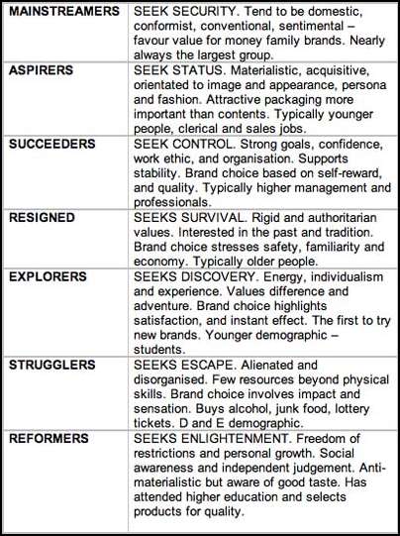
Demographics | Category | Answer | What evidence from the advert is there to support your answer on audience? How have your specified group been targeted?
 | Gender
 | Ethnicity
 | Age
 | Socio-economic segmentation
Psychographic | Cross Cultural Consumer Characteristics (4C’s)
Typical age ranges used to categorise people below:
15 and under
15-24
25-35
36-55
56 and over
A
B
C1
C2
D
E
Mainstreamers, Aspirers, Suceeders, Resigned, Explorers, Strugglers Reformers,

Slide 32
What evidence from the advert is there to support your answer on audience? How have your specified group been targeted?
Use of a young woman with whom they might personally identify
Parents might identify with the wish to make a ‘better life’ that Water Aid’s clean water provides for the children represented in the advert.
Water Aid acts as an Opinion Leader for the target audience who would assume the “650 million people…” statistic (01.14) is true and reliable.
The unconventionally positive visual codes, audio codes and representations would, the producers hope, give the advert unique selling points compared to other charity appeals and therefore make the audience more likely to donate.

Slide 33
Framework | Theorist | Prompts | Component 1: Section A: Language and Representation
 |  |  | Marketing | Advertising | Music Video | Newspaper
 |  |  | Kiss of the Vampire | Tide | Formation | The Times
 |  |  |  | WaterAid | Riptide | Daily Mirror
Media Language | Roland Barthes | The 5 Codes (SEARS) | Y | Y | Y | Y
 | Tzvetan Todorov | Equilibrium
 | Levi Strauss | Binary | Y | Y | Y | Y
 | Steve Neale | Genre
 | Baudrillard | Post-Modernism
Representation | Stuart Hall | Stereotyping and inequality | Y | Y | Y | Y
 | David Gauntlett | Pick ‘n’ Mix | Y | Y | Y
 | Butler | Performative
 | Liesbet van Zoonen | Gender is constructed | Y | Y | Y
 | Bell hooks | Patriarchal oppression
 | Paul Gilroy | Ethnicity |  | Y | Y
Industries | Curran and Seaton | Power and Industries |  |  |  | Y
 | Livingstone and Lunt | UK regulation |  |  |  | Y
 | Hesmondhalgh | Cultural industries |  |  |  | Y
Audience | Albert Bandura | Media Effects
 | George Gerbner | Cultivation |  | Y |  | Y
 | Stuart Hall | Reception x 3 |  | Y |  | Y
 | Jenkins | Fandom
 | Shirky | End of Audience |  |  |  | Y

Slide 34
TASK 2
Create a poster either hand drawn, on Publisher or at www.visme.co/ (Chrome) applying audience theories
George Gerbner: Cultivation Theory | Stuart Hall: Reception Analysis
What messages/ideas are WaterAid trying to cultivate within this advert? How is that different to the majority of charity adverts? What impact do conventional charity adverts have on our understanding of the world? How is WaterAid try to change this? Can it be successful in doing considering the repetition of the message we have had from previous charity adverts going back as far as the 1980s? | What is the dominant/preferred reading of the advert? What techniques have been used to encourage a dominant reading? What might a negotiated reading be? Why might an audience have this response? What might an oppositional reading be? Why might an audience have this response?

Slide 35
Benchmark feedback- TASK 1: MEDIA LANGUAGE
SOME good analysis on lighting, camera, editing, sound and mise-en-scene and how they worked together to create meaning. Very few students separated these elements out.
Add more detailed analysis focused on connotations
Use phrases such as: ‘The establishing shot includes the dry landscape and a woman walking slowly, connoting…
Adding theorists in this case Barthes and Levi Strauss (Media Language)
Adding accurate terminology (revise sheets)
Use more formal language
Some students drifted in to discussing how the audience would interpret the use of the Media Language. This is not required. Any discussion of how the audience responds or how the audience was targeted should have been included in your points for Task 2.
DO | DON’T
this connotes | this shows the audience
this signifies | this suggests
this symbolises | We

Slide 36
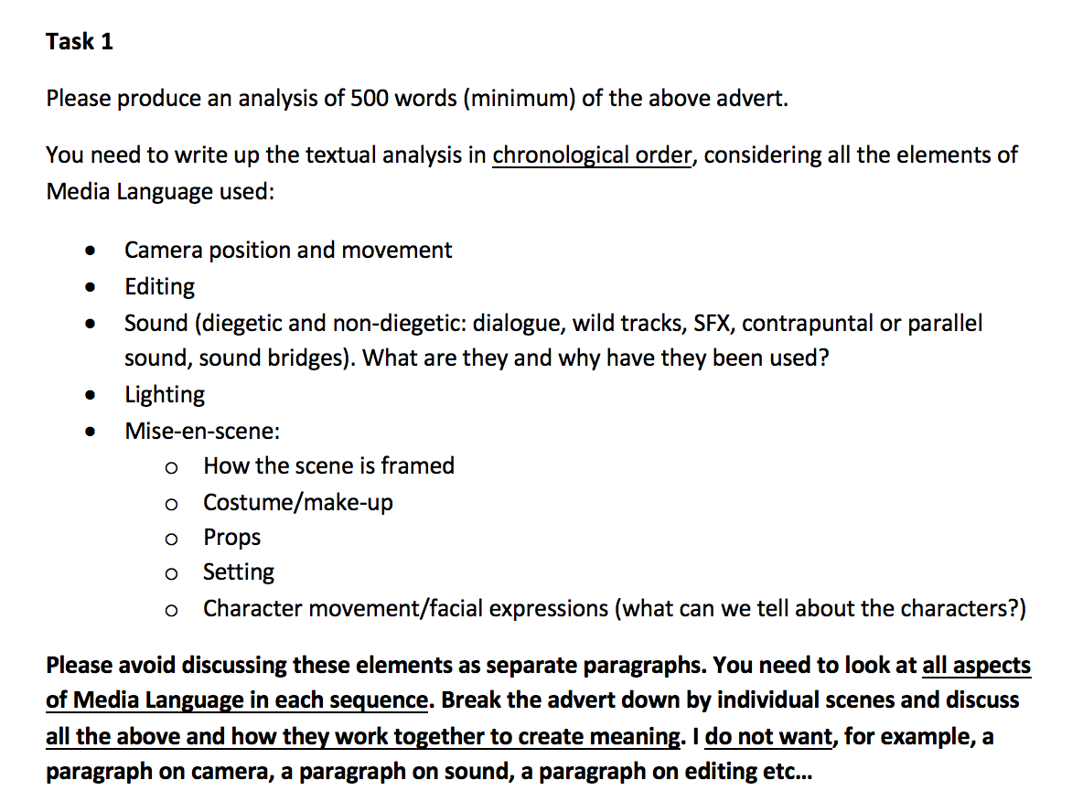
BENCHMARK FEEDBACK

Slide 37
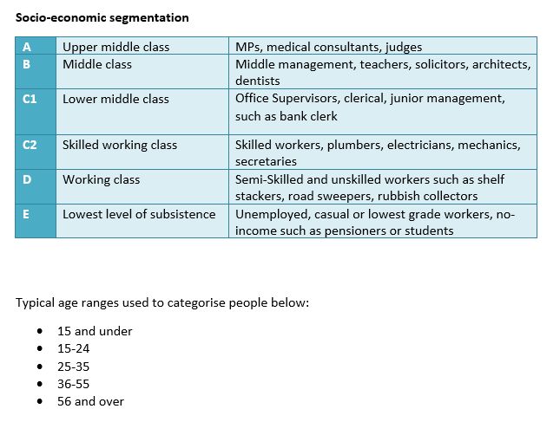
Benchmark feedback - TASK 2: AUDIENCE
This is where you needed to discuss who the target audience is:
Primary age group
Secondary age group
Gender
Class – e.g. ABC1
Psychographics
Use brackets and categories from booklet
Some sweeping assumptions made about audiences - e.g. C2,D,E drink much more booze!
You need to outline how the audience had been targeted/appealed to, e.g. through the use of emotive imagery; enigmas; star power; statistics/written codes…

Slide 38
BENCHMARK and ASSESSMENT tracking
Complete Essay Title: Charity Advert Benchmark
Your Grade:
What I need to improve:
Adding theorists essays, in this case Barthes and Levi-Strauss (Media Language)
Adding terminology
Add more analysis (signifies/connotes)
Use more formal language

Slide 39
WaterAid and the A Level Exam…2021!
Component 1 Section A: Investigating Media Language and Representation
This section assesses media language and representation in relation to two of the following media forms: Advertising (WaterAid and Tide) Marketing (Kiss of the Vampire) Music Video (Formation and Riptide) Newspapers (Daily Mirror, The Times) There are two questions in this section: One question assessing MEDIA LANGUAGE in relation to an UNSEEN, i.e. (NOT A SET TEXT) One extended response comparison question assessing REPRESENTATION in ONE SET TEXT and an UNSEEN

Slide 40
Practising your analytical skills…
Component 1 Section A: Investigating Media Language and Representation
This section assesses media language and representation in relation to two of the following media forms: Advertising (WaterAid and Tide) One extended response comparison question assessing representation in ONE SET TEXT and an UNSEEN

Slide 41
Practising your exam analytical skills…
GoL (WaterAid) and download ‘UNICEF Advert Analysis’
Complete the table taking notes as you watch the advert
NOTE TAKING TIPS:
Take notes in chronological order, across all elements of media language
Make sure you have notes on all areas:
Camera position and movement
Editing
Sound
Lighting
Mise-en-scene
Pick 1 scene and turn it into a focused and analytical sentence…

Slide 42
APPLYING THEORY
WATCH THE UNICEF 2015 ADVERT
Apply Barthes 5 codes
Apply Levi-Strauss (Structuralist)
What ______ _________ can you see? How important are they to the narrative of the advert?
BARTHES CODES | ANALYSIS OF UNICEF
S
E
A
R
S

Slide 43
APPLYING THEORY
WATCH THE UNICEF 2015 ADVERT
Apply Barthes 5 codes
Apply Levi-Strauss (Structuralist)
What binary oppositions can you see? How important are they to the narrative of the advert?
BARTHES CODES | ANALYSIS OF UNICEF
SEMANTIC
ENIGMA
ACTION
REFERENTIAL
SYMBOLIC

Slide 44
Structure reminders…. Know what criteria you are marked against…
Grade Descriptor | Excellent | Good | Satisfactory | Basic | Minimal
Band | 5 | 4 | 3 | 2 | 1
Rough Grade Indication | A | B | C/D | D/E | U
Question answered throughout
Appropriate terminology used
Application of academic theories
Points illustrated with set text examples
Analysis/Arguments/ Conclusions
Writing style; including essay structure and SPAG
Therefore ensure your essays are structured to meet all of these areas

Slide 45
Structure reminders…. Know what criteria you are marked against…
Question answered throughout | Use words from the question in the introduction, conclusion and importantly throughout the essay at the end of each point linking it back to the question, using words or phrases from the question can be helpful.
Appropriate terminology used | Start by choosing an element of the poster to analyse, then you’ll use lots of terminology to describe as you go. When analysing your example you’ll use lots of terminology. This will include the more general; connotes, signifies etc... Along with specific e.g. main image, technical codes, anchorage etc…
Application of academic theories | Applying media language theorist should fall naturally, don’t force it in for the sake of it, you need to apply and evaluate. “….would suggest that…” “…when considering…[theorist name]…”
Points illustrated with set text examples | Each point you make should start from an example, be specific, the more detail the better you demonstrate your knowledge of the set texts.
Analysis/Arguments/ Conclusions | This is crucial and is where you develop your arguments and points you want to make, in this case analysing representation
Writing style; including essay structure and SPAG | This includes the introduction and conclusion as well as how your essays is structured and flows coherently from 1 point to the next.

Slide 46
for this UNICEF task focus only on analysing media language
UNICEF Example | Start by choosing an element of the advert to analyse, then you’ll use lots of terminology to describe as you go. When analysing your example you’ll use lots of terminology. This will include the more general; connotes, signifies etc... Along with specific e.g. tracking shot, high key lighting, desaturated etc… Applying media language theorist should fall naturally, don’t force it in for the sake of it, you need to apply and evaluate. | The juxtaposition of happy ambient diegetic sounds in the park along side the melancholic diegetic soundtrack make for a chilling and disturbing start to the charity advert. Levi Strauss considered that texts can be understood through the underlying structure of binary opposites, this is exemplified throughout the whole advert, and in this case with the sound track
Terminology
Analysis/ Arguments/ Conclusions
Theorists

Slide 47
Your turn…
UNICEF Example | Start by choosing an element of the advert to analyse, then you’ll use lots of terminology to describe as you go. When analysing your example you’ll use lots of terminology. This will include the more general; connotes, signifies etc... Along with specific e.g. tracking shot, high key lighting, desaturated etc… Applying media language theorist should fall naturally, don’t force it in for the sake of it, you need to apply and evaluate.. | .
Terminology
Analysis/ Arguments/ Conclusions
Media Language Theorists

Slide 48
knowledge organiser to Be COMPLETED for homework
There are sections on:
Context
Media Language
Representation
Audience
That you need to complete as revision for this text

