Slide 1
Coasts
20 Mark Questions – exam technique

Slide 2
Improving performance at A Level
Practice essays so that they become the norm rather than the exception. Build up to unseen essays carried out in a limited time period (about 30 minutes) – and handwritten ones
Peer assessment of essays helps candidates to see where the requirements of the question have, and have not, been met. Make full use of the generic mark scheme for college-based essays.
Create a glossary of command words
Use case studies and examples, making sure that you know which topic is illustrated by which case study… but, use only that part of the case study that is relevant to the question set
Where asked to ‘evaluate’, it is important to provide evidence upon which judgmental statements can be based. If asked to state “to what extent”- either fully, mostly, generally, partially, not at all (supported by evidence)

Slide 3
20 Mark Question
One way students could structure their response:
10% – introduction
80–90% – main body
10% – conclusion
Students should:
ensure, where appropriate, that there is a balance of discussion and use of evidence. Utilising data will potentially allow students to demonstrate detailed knowledge and understanding of concepts, processes and interactions, in particular case study data, which should underpin the response throughout
engage with the command word, e.g. responses that ask ‘to what extent’ should have a clear decision on what extent the student agrees/disagrees with the point of view presented in their response
write concisely to answer questions

Slide 4
Writing extended responses
Breadth
Make a broad range of relevant points in a coherently argued fashion.
Depth
Each point should offer appropriate detail, knowledge of content concept and process where appropriate. Offer analysis, evaluation and interpretation as appropriate.
Support
Use case studies to embed the knowledge concepts and processes in real world situations.
Synopticity
Make the links which are required by the question.

Slide 5
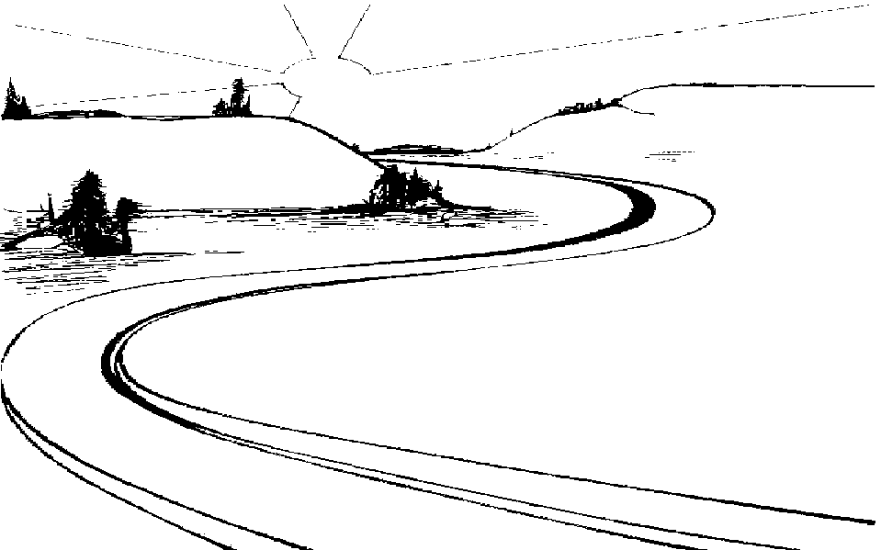
Writing extended answers at A Level
A good geographer will:
(where possible)
Remember your T & Cs and keep to the PAF
Complexities
Scale
Time
Future uncertainties
Attitudes
Players

Slide 6
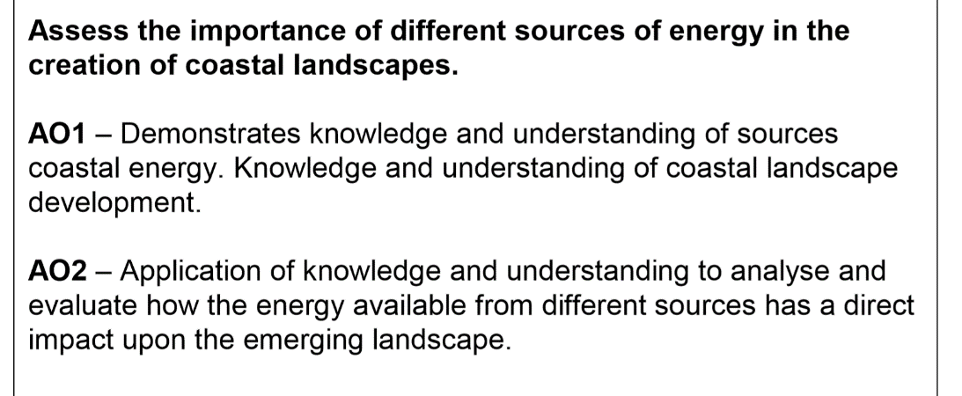
Coasts
AO1 is used to assess students’ knowledge and understanding.
AO2 assesses a student’s ability to apply their understanding to unfamiliar situations and/ or make their own links between aspects of subject content.
Notes:
This is taken from the SAM AS Level paper, 9 mark question and has been adapted for the purposes of preparing students for the 20 mark question in the B” Dec 2019.

Slide 7
EXAM PRACTISE: Breaking down an Essay title
1. Highlight terms you want to define
2. Annotate with key words
3. Think about your view point
‘Assess the importance of different sources of energy in the creation of coastal landscapes.’ (20)
Define key terms:
Acknowledge that along most coastlines, various sources of energy (define inputs into the coastal system - wind, waves, currents and tides) are acting upon the coastline to shape and develop the landscape features. Define high and low energy coastlines, define the coastal system.
Think of view point and give evidence to support that view. Assessment may consider any energy source as important. Wind should be a strong feature as this is the major driver. Need terms like “to some extent” or “to a large extent”.
Sources of energy:
Knowledge of wind, waves, currents and tides and how these shape the coastline. The key is that responses assess the importance of the energy in the development of the coastal landscape of choice.
Coastal landscapes:
Examples of different coastal landscapes to illustrate the importance of energy inputs, e.g. Holderness, Dorset (Jurassic coastline). Name high and low energy coastlines to assess the importance of energy in shaping their landforms and landscapes.

Slide 8
Main Body – your evidence must support your view point.
Point - Make a point
Explain – then go on to explain how your point addresses the question – what type of energy and how it is shaping the landforms at the coast
Evidence – then provide accurate evidence from relevant case studies
Link to Question – At the end of every paragraph you MUST link back to the question – i.e. is this type of energy important in shaping coastal landscapes?

Slide 9
‘Assess the importance of different sources of energy in the creation of coastal landscapes.’ (20)
Introduction: Key definitions and introduce potential coastal landscapes you have studied
Arguments to show the importance of the energy available from different sources of energy in has a direct impact upon the emerging landscape. | Arguments might suggest other factors that impact upon the emerging landscape, e.g. the role of geology
P E E L P E E L | P E E L
Conclusion – Remember your T&Cs and keep to the PAF where possible

Slide 10
Conclusion
Don’t just rewrite what you’ve already said.
Must answer Question – Assess the importance….is one input of the coastal system more significant than the other in creating landscapes?
Often worth thinking about the FUTURE – make a comment about how climate change is going to impact on both processes.

Slide 12
Peer Assessment
Assess the importance of different sources of energy in the creation of coastal landscapes. [20 marks]

Slide 13
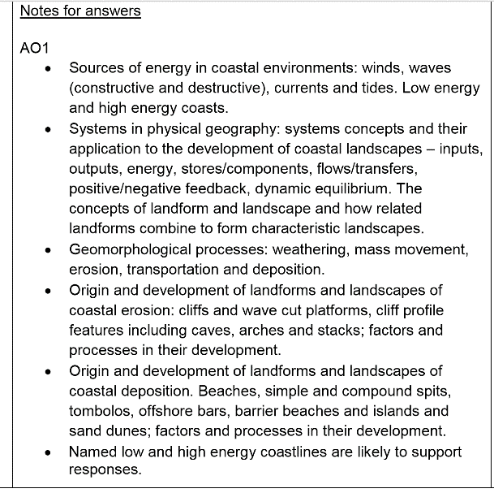

Slide 14
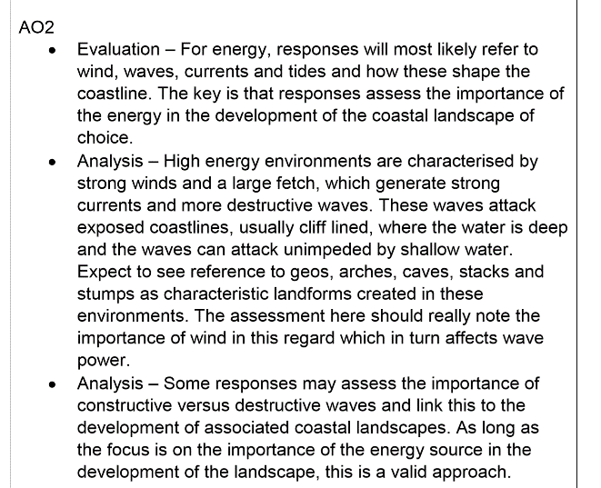
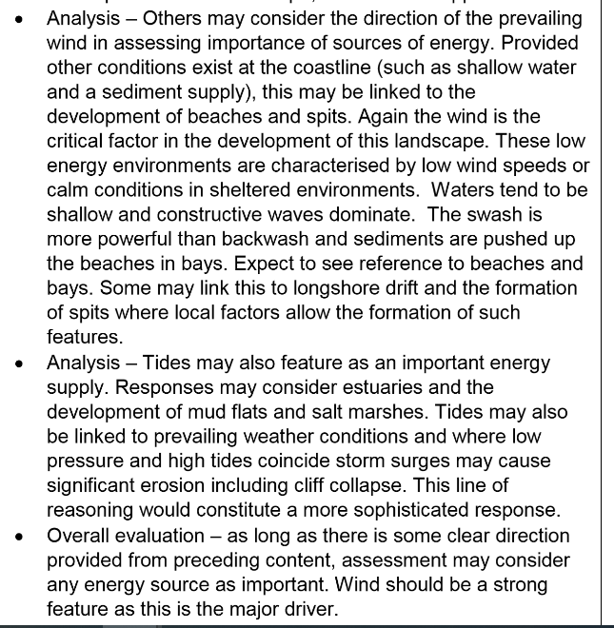

Slide 15
Assessment
When reading the 20-mark answer, use the following key in the margin or highlight parts of the text in different colours
AO1
K & U knowledge and understanding of place(s) and environments
C & P knowledge and understanding of key concepts and processes
S & T awareness of scale and temporal change
AO2
A & E analysis and evaluation in the application of knowledge and understanding
Links – links between knowledge and understanding to the application of knowledge and understanding in different contexts
Concl – evaluative conclusion that is applied to the context of the question
The distinction between ‘analysis and evaluation’ and ‘evaluative conclusion’ is that the conclusion should come to an overall judgement related to the steer of the question, e.g. as prompted by the command words ‘to what extent…’ and ‘assess the extent to which…’ etc.

Slide 16
Level 1 (1-5) |  | Level 2 (6-10) | Level 3 (11-15) | Level 4 (16-20)
Isolated knowledge and understanding of key concepts and processes. |  | Some knowledge and understanding of key concepts, processes and interactions and change (AO1). | Generally clear and accurate knowledge and understanding of key concepts and processes (AO1). | Full and accurate knowledge and understanding of key concepts and processes throughout (AO1).
Very limited awareness of scale and temporal change, which is rarely integrated where appropriate. There may be a number of inaccuracies. (AO1). |  | Some awareness of scale and temporal change which is sometimes integrated where appropriate. There may be a few inaccuracies (AO1). | Generally clear awareness of scale and temporal change which is integrated where appropriate (AO1). | Detailed awareness of scale and temporal change, which is well integrated where, appropriate (AO1).
Very limited relevant knowledge and understanding of place(s) and environments (AO1). |  | Some relevant knowledge and understanding of place(s) and environments which is partially relevant (AO1). | Generally clear and relevant knowledge and understanding of place(s) and environments (AO1). | Detailed, highly relevant and appropriate knowledge and understanding of place(s) and environments used throughout (AO1).
Very limited and rarely logical evidence of links between knowledge and understanding to the application of knowledge and understanding in different contexts (AO2). |  | Some evidence of links between knowledge and understanding to the application of knowledge and understanding in different contexts (AO2). | Generally clear evidence of links between knowledge and understanding to the application of knowledge and understanding in different contexts (AO2). | Full evidence of links between knowledge and understanding to the application of knowledge and understanding in different contexts (AO2)
Very limited analysis and evaluation in the application of knowledge and understanding. This lacks clarity and coherence (AO2). |  | Some partially relevant analysis and evaluation in the application of knowledge and understanding (AO2). | Generally clear, coherent and relevant analysis and evaluation in the application of knowledge and understanding (AO2). | Detailed, coherent and relevant analysis and evaluation in the application of knowledge and understanding throughout (AO2).
Very limited and/or unsupported evaluative conclusion that is loosely based upon knowledge and understanding which is applied to the context of the question (AO2). |  | Some sense of an evaluative conclusion partially based upon knowledge and understanding which is applied to the context of the question (AO2). | Clear evaluative conclusion that is based on knowledge and understanding which is applied to the context of the question (AO2). | Detailed evaluative conclusion that is rational and firmly based on knowledge and understanding which is applied to the context of the question. (AO2)
Overall comment
Target 1
Target 2
C&P
Definitions
S&T
K&U Places
Links
Examples & other views
A&E
Arguments & opinions
Concl

