Slide 1
Benchmark: out on your desks for me to collect if not, then printed on my desk in office (907) before 4:15 today ☺

Slide 2
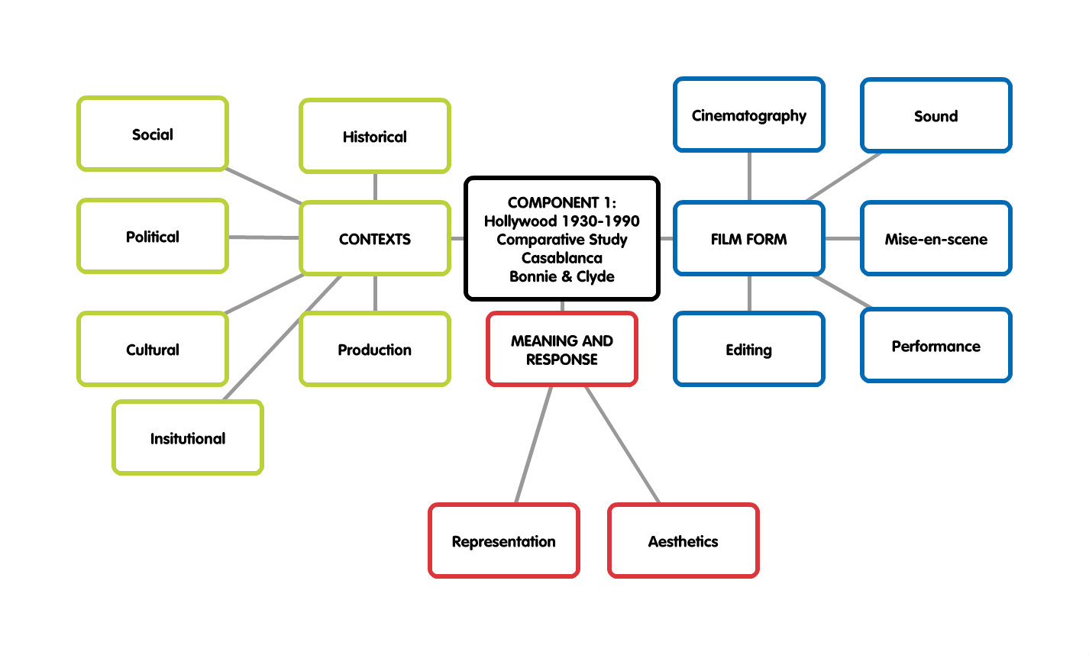

Slide 3
Representation buzzwords
ILSA | RICK

Slide 4
Representation buzzwords
ILSA | RICK
Beautiful | Strong
Young | Old
Compliant | Mysterious
Passive | Respected
Stereotypical 1940s woman | Representative of US foreign policy
Demure | Isolationist
Indecisive | Sentimentalist
Feminine | Interventionist
A function of the narrative | Self-sacrificing
Damsel in distress | Hollywood tough-guy

Slide 5
Representation
The term representation refers to the ways in which characters, situations, images and sounds in a film stand for, or depict, aspects of the real world.
Everything we see or hear in film is created and constructed for our viewing
Therefore the characters have been created and constructed deliberately, our task is to analyse how people have been portrayed/represented
THE ‘HOW’ IS FILM FORM

Slide 6
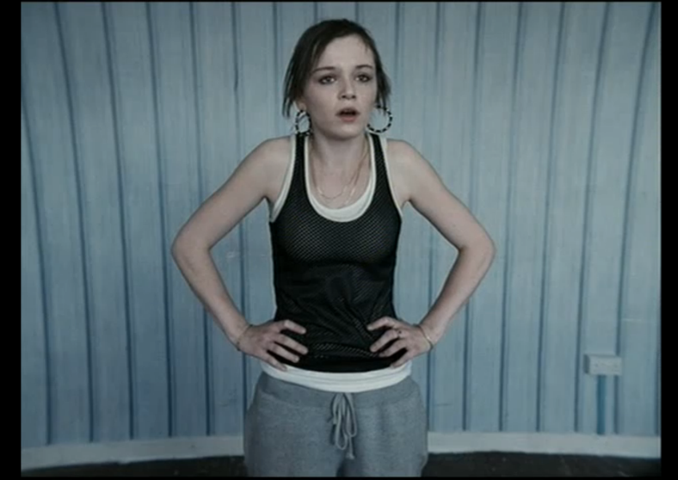
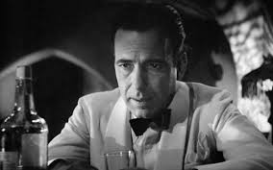
CATEGORISING
The representation of groups usually refers to categorising people by their:
Gender
Nationality
Sexuality
Region
Age
Ethnicity
Social Class

Slide 7
STEREOTYPE definition
Stereotype
A way of classifying people which is over-simplified, based on a narrow set of attributes and assumptions.

Slide 8
What were the stereotypes of the time?
Propaganda posters depict the ideal woman of American femininity and domesticity as a young, pretty, white, heterosexual, middle-class woman.
This representation maintained traditional femininity and domesticity, suggesting that when men return home from the war they will be returning to a normal life where women raise children and tend to the house while men earn money.

Slide 9
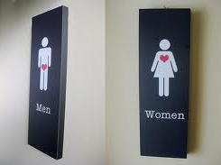
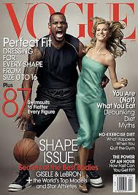
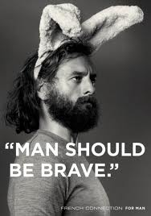
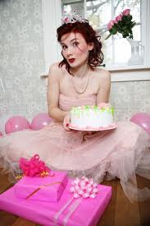
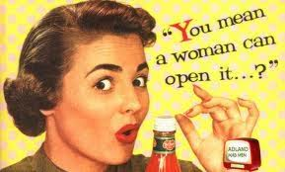
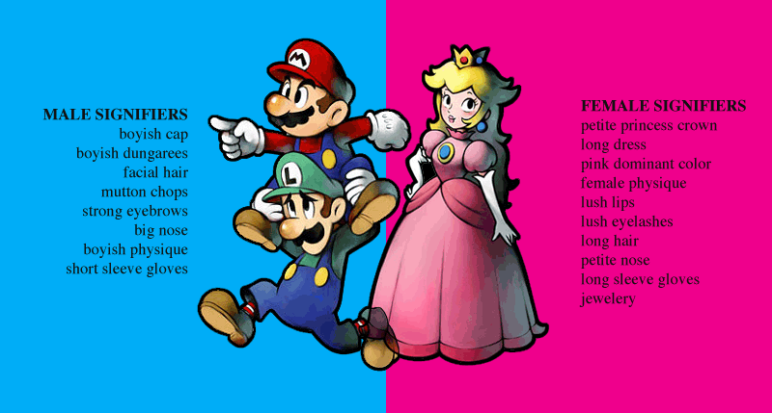
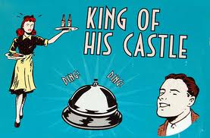
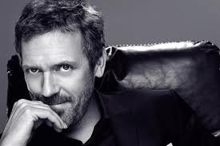
Male & Female stereotypes
Male | Female
Which gender stereotypes do we see in Casablanca?

Slide 10
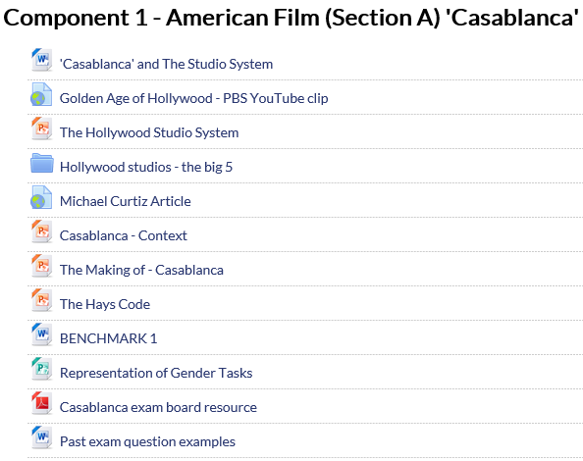
Analyse the characteristics of the main characters from Casablanca and consider why the gender/character is stereotypical of this era and how this representations reflects society at the time the film was made.

Slide 11
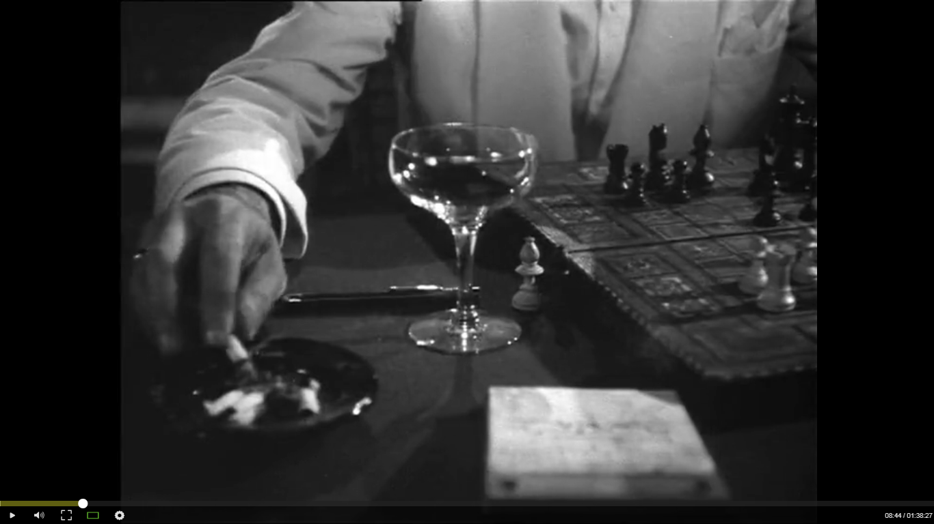
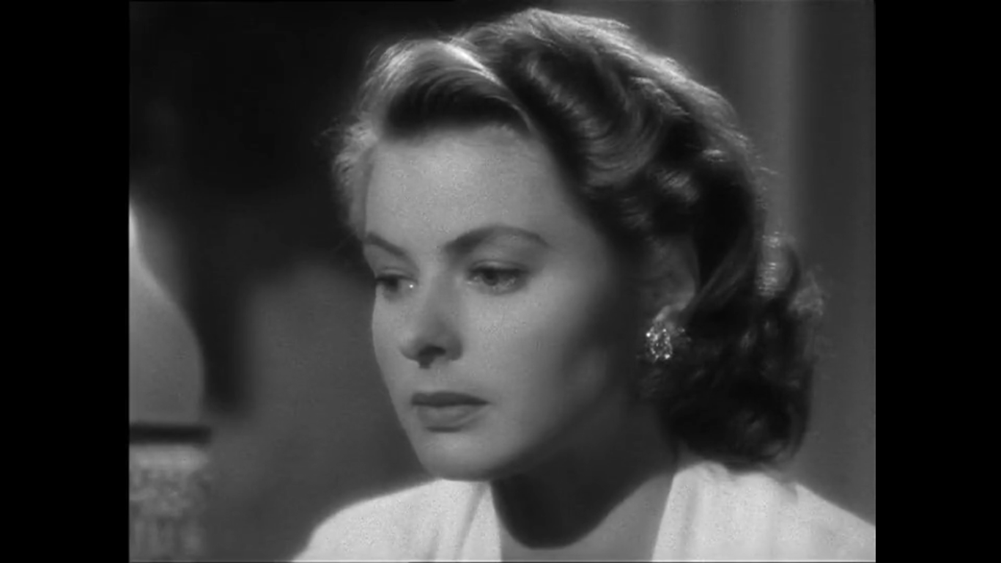
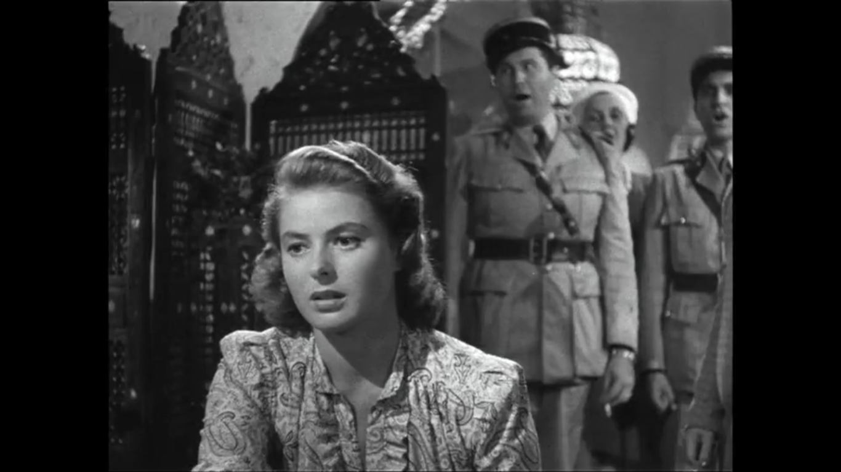
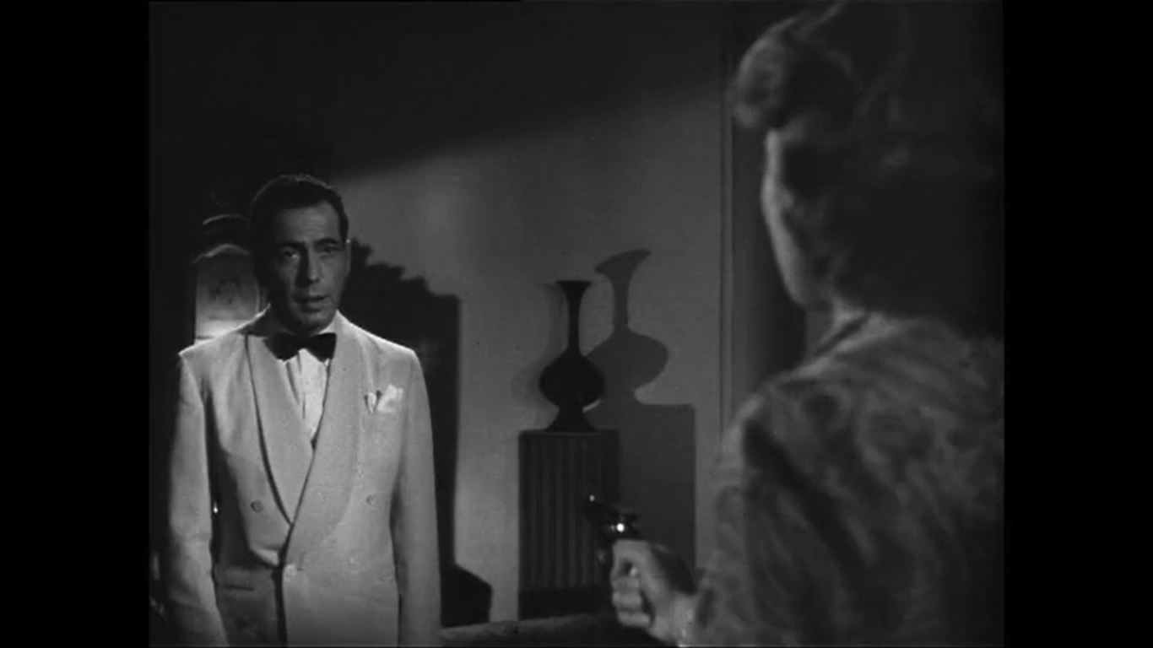
Representations of gender key scenes to consider
Introduction of Rick
Introduction of Ilsa (‘As Time Goes By’)
The La Marseillaise scene
Ilsa points a gun at Rick
Closing sequence

Slide 12
AS Film Studies – example question

Slide 13
Compare how gender is represented in ONE sequence from each of your chosen films. REFER TO ONE CHARACTER FROM EACH FILM [20]
Consider the task you have just completed and make a little essay plan, include the following:
What will be your one sequence?
Who will be your one character?
What film form will you use to analyse representation?
What context will you bring in to explain the representation?

Slide 14
Example response
In the closing sequence of the Classical Hollywood film Casablanca (Michael Curtiz, 1942) the character of Rick (Humphrey Bogart) is represented in an interesting way. Rick is caught up in a love triangle with former lover Ilsa and her husband Victor Laszlo. The closing sequence resolves the film’s narrative and represents Rick as changing from an isolationist to a sentimental interventionalist.
As Rick, Ilsa, Laszlo and Captain Renault arrive at the airport for the Lisbon bound plane, at this point it is not entirely clear if Rick will be the hero or the villain. For much of the film he has been more of an anti-hero, keeping his cards close to his chest: “I stick my neck out for nobody” he is heard saying twice in the opening 20 minutes. However, he surprises the audience and all characters involved in the closing sequence, when he announces, rather matter of factly, that the two people getting on the plane will be Ilsa and Laszlo, rather than himself.

Slide 15
This is a key transitional moment for Rick as he shows his true colours for the first time and lets the audience see that he is still very much an idealist, which we’ve had only a glimpse of during the Paris flashback and the La Marseillaise scene. The sequence is shot and edited in the traditional classical Hollywood style, with continuity editing and adhering to the 180 degree rule. The camera does however, have some stylish dolly-in shots, which gives the moment a certain melodramatic flourish and helps to represent Rick as the rightfully heroic character that he is.
When the moment comes for Rick and Ilsa to part, the pair are framed in intimate, separate close ups. Rick talks with purpose in hurried dialogue, explaining his reasoning for their separation. The non diegetic leitmotif of ‘As Time Goes By’ rises to emote the moment further, as we realise (at the same time as Ilsa) that Rick has chosen the greater-good, over his love for her. This sentiment was particularly potent for the time, as the character of Rick is said to be the embodiment of America during the early 1940s. Rick the cynical isolationist, eventually realising through the rekindling of true love that he is a sentimentalist and ready to intervene for the good of the world. This was representative of how many Americans felt after the bombing of Pearl Harbour, instigating America’s intervention into WWII.

