Slide 1
Mise en Scene
Sometimes written Mise-en-Scène
Notes:
1

Slide 2
Mise en Scene
Mise en Scene
(pronounced meez ahn sen)
‘Mise en Scene’ is a French term that originates from the theatre.
It literally means everything that is ‘put into the scene’, ‘or the staging of a scene’.
Think about all the elements that have been placed in front of the camera.

Slide 3
Mise-en-scene
Setting/ Location
Props/Iconography
Costume & Make up
Lighting & Colour
Facial expression/ Body Language

Slide 4
Mise en Scene
Think about all the planning that has gone
into the arrangement of this still image?

Slide 5
Settings/Location
Settings within a film can evoke many responses.
They can mirror the emotions of a character, establish place and time, and offer information about themes within a film.

Slide 6
Settings/Location ‘The Graduate’ (Mike Nichols, 1967)

Slide 7
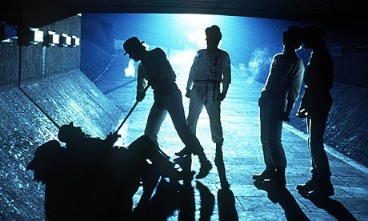
A Clockwork Orange – Dir. Stanley Kubrick (1971)
Location/Setting
Lighting & Colour
Costume & Make-up
Body Language
Props

Slide 8
Settings/Location
The setting of a scene is crucial to our understanding of time and place. We can locate ourselves in a certain place, town, country, planet or even galaxy.
Present day or historic
Urban or rural
Isolation or claustrophobic
Wealth or poverty (or class)

Slide 9
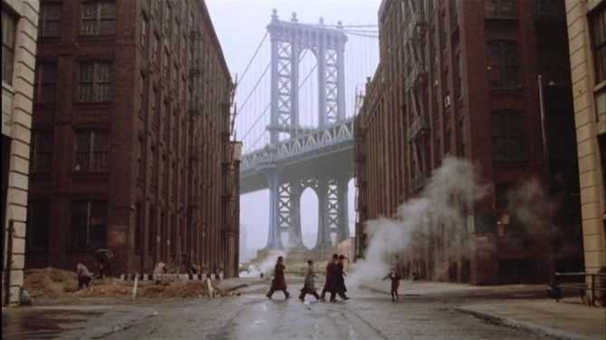
Settings/Location Once Upon a Time in America (Sergio Leone 1984)

Slide 10
Settings/Location For Edward Scissorhands

Slide 11
Decor
The way a set/location is decorated can also add meaning to an event, and can mirror a character’s psychological state.

Slide 12
Decor Good Will Hunting (Gus Van Sant, 1998)

Slide 13
Lighting
Lighting is essential in conveying mood and atmosphere.
There are a variety of lighting styles used in cinematography:

Slide 14
Lighting
Key light- Usually brightest light
Back light- Lit behind characters
Filler Light- Helps to soften harsh shadows
Naturalist lighting- Location shooting using natural sunlight.
Lighting from different angles can produces a range of effects
Underlighting, Toplighting & Backlighting
.

Slide 15
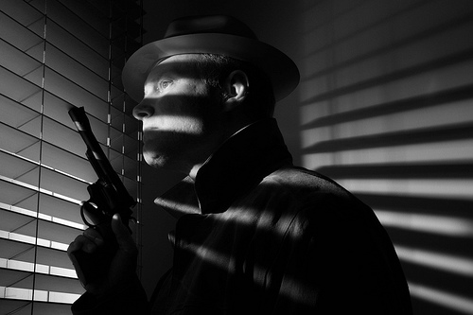
Lighting Film Noir

Slide 16
Props
Objects included in a scene are essential in the generation of meaning, historical period and character.
If a prop is regularly used or shown, it can become a symbolic motif.
One way to identify the genre of a film is through props used.

Slide 17
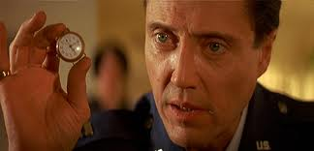
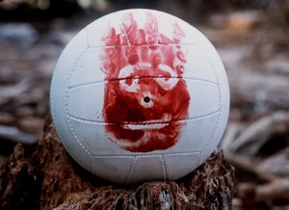
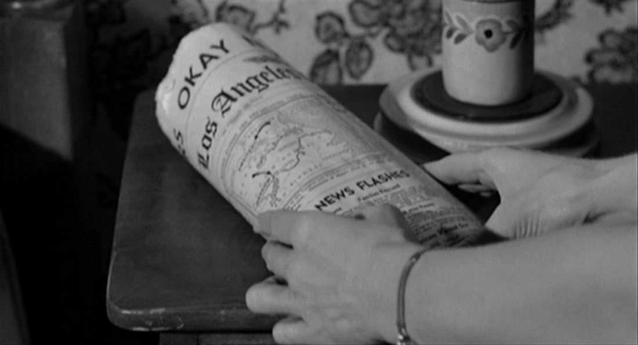
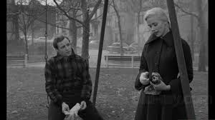
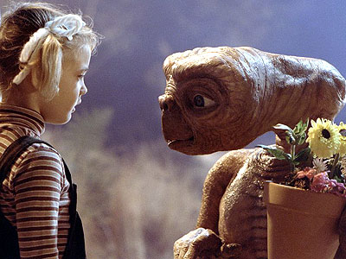
Props

Slide 18
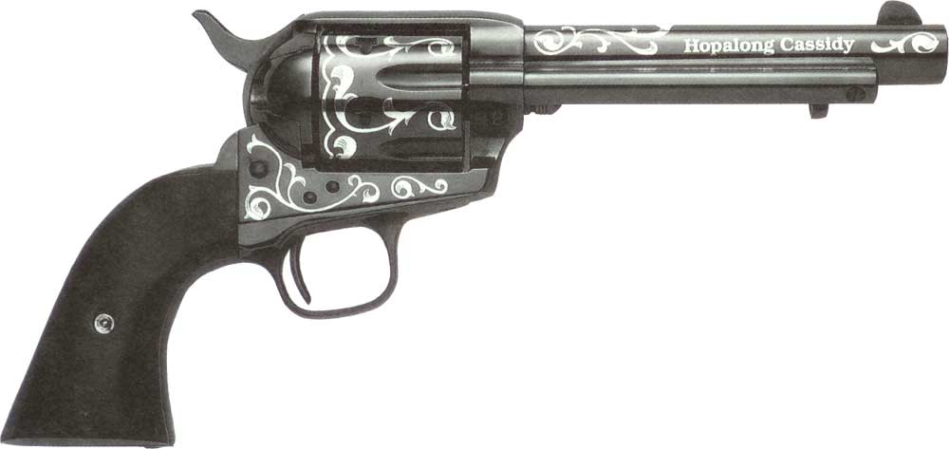
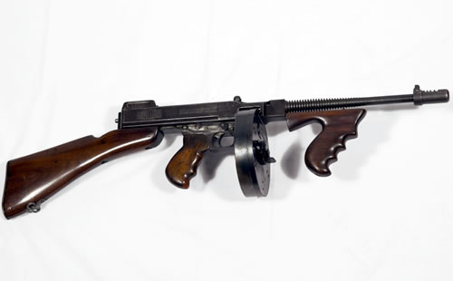
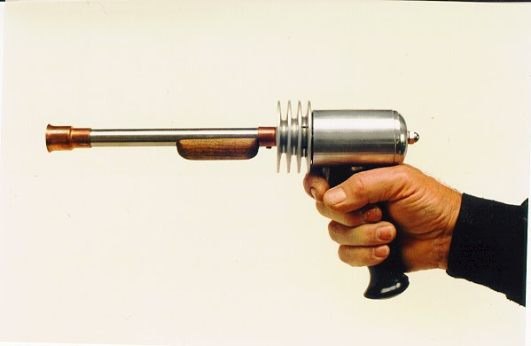
Props
What type of films do these guns belong to?

Slide 19
Costume
Costumes are important in the creation of characters’ status, psyche, and historical time (setting).
A change in costume can signal a change in fortune, a change of heart or perhaps a political stance.

Slide 20
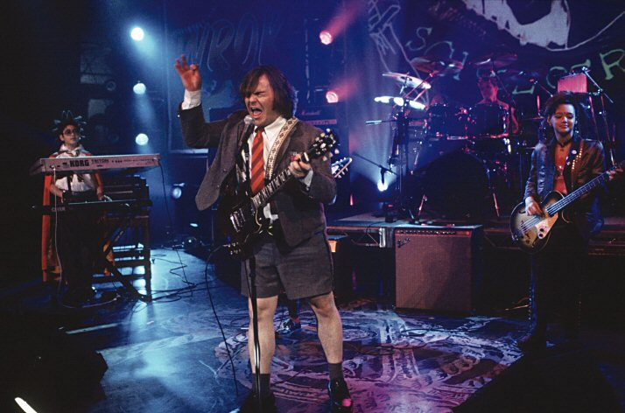
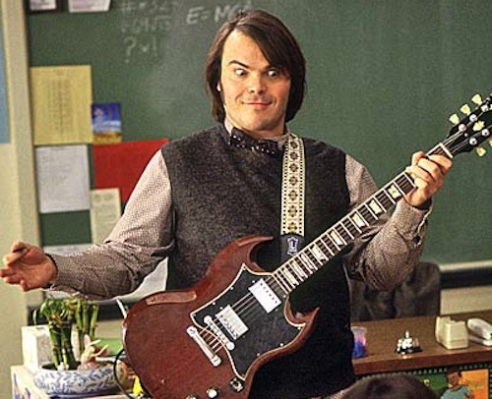
Costume School of Rock (Richard Linklater, 2002)

Slide 21
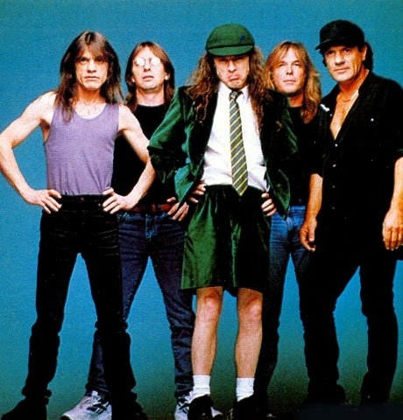
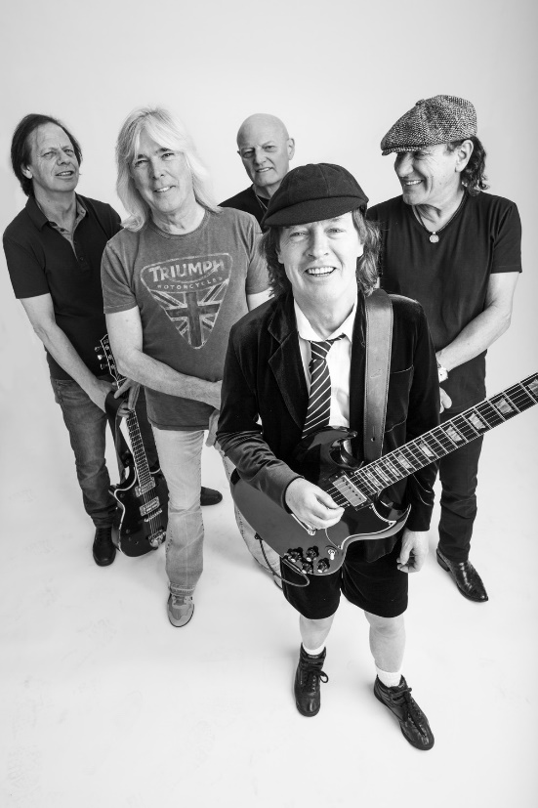
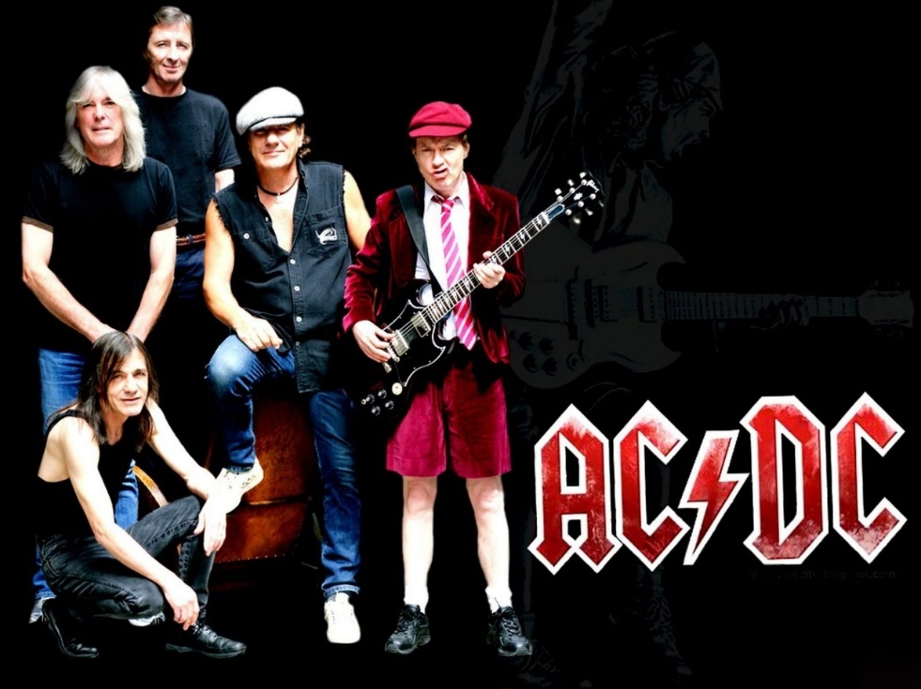
Intertextuality…

Slide 22
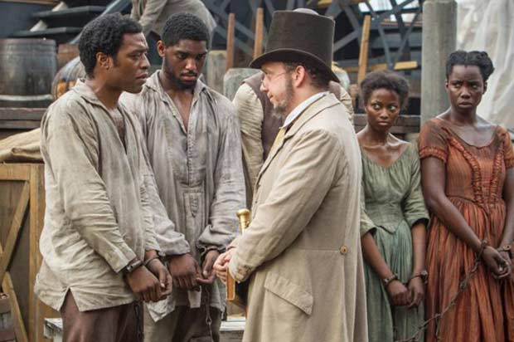
12 Years a Slave (2013)
What can we say about: Setting/Location, Lighting & Colour, Costume & Make-Up, Body Language, Props?

Slide 23
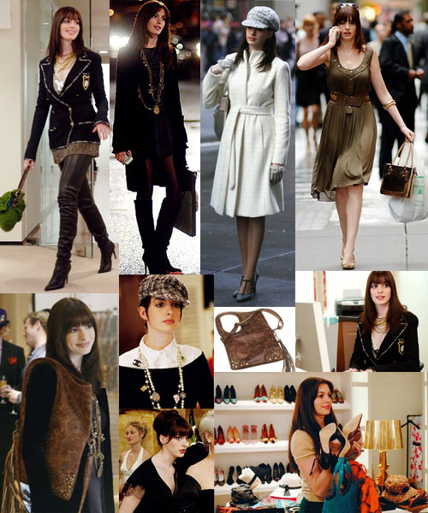
Costume The Devil Wears Prada (David Frankel, 2006)

Slide 24
Make-up
Make-up is an essential tool for all actors, but can also be used to generate particular meanings. Prosthetics can vastly change the appearance of an actor.

Slide 25
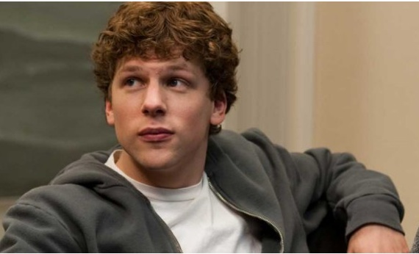
Make Up

Slide 26
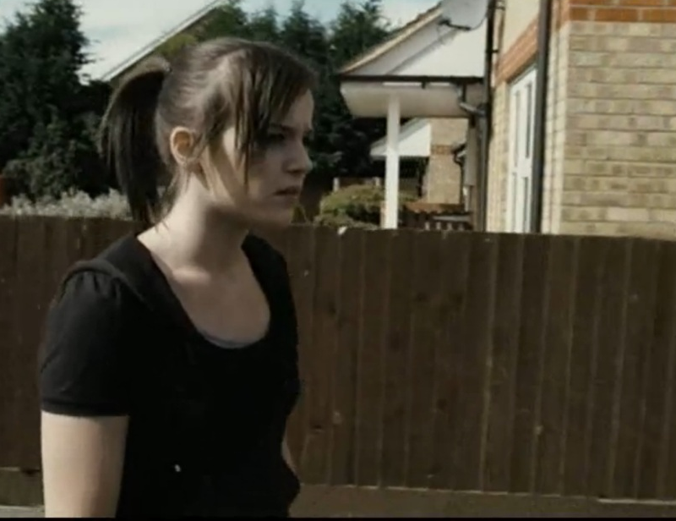
Make Up
Like most elements of filmmaking, what is not there, is sometimes of equal importance. The decision to use minimal / to no make up is a brave decision, which can add a sense of realism to a character or performance.

Slide 27
Performance
Performance (body language and movement) can transmit information about attitudes and feelings.
The way an actor walks, talks, sits, or stands can be symptomatic of his or her state of mind. A good performance can add additional meaning to the audience.

Slide 28
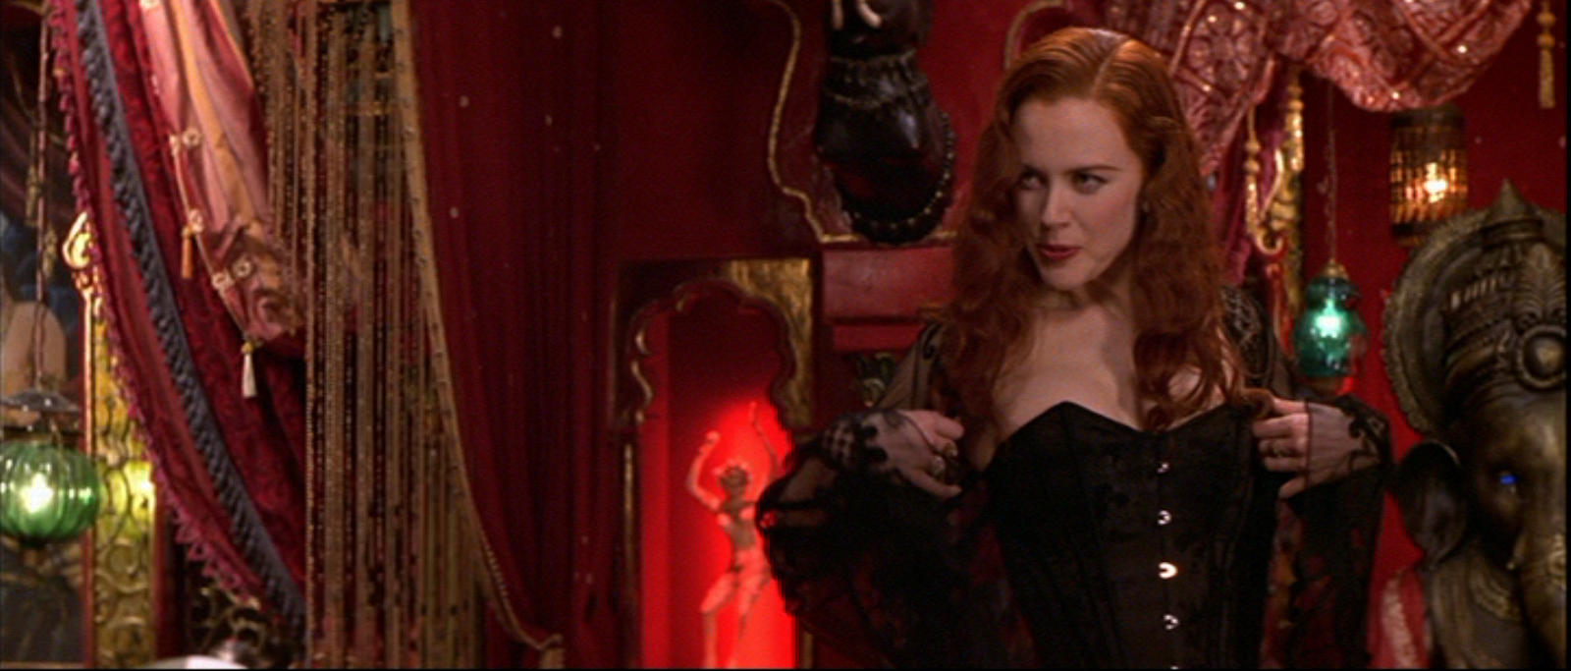
Moulin Rouge
What can we say about: Setting/Location, Lighting & Colour, Costume & Make-Up, Body Language, Props?

Slide 29
Secrets & Lies, (Mike Leigh, 1996)
What can we say about: Setting/Decor, Lighting, Props, Costume, Make-Up and Performance?

Slide 30
As a reminder jot down in your key terms section in the back of your exercise books:
Mise en Scene (pronounced meez ahn sen)
Setting/location/Décor
Lighting
Props
Costume
Make-up
Performance (body language, movement)

