Slide 1
+Explore
Teaching English as a foreign language
PRAGMATICS, PROSODICS & PHONOLOGY

Slide 2
What is pragmatics?
Implied meaning
Pragmatic Acts:
Locutionary act: the act of saying something e.g. ‘There’s a fly in my soup.’
Illocutionary act: what is implied or meant beyond that statement e.g. ‘Please get me another soup and apologise.’
Perlocutionary act: an effect is brought on by the locutionary act e.g. The waiter removes the soup.
Why is this useful with TEFL?
Write down 4 additional contexts as a group using the following structure:
Speaker 1: Locutionary act which has pragmatic meaning
Illocutionary act which is what is meant (not spoken)
Speaker 2: Perlocutionary act accompanied by an action

Slide 3
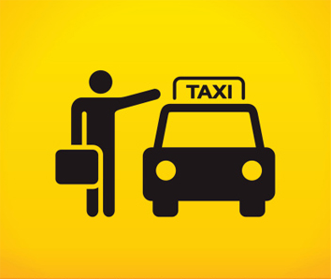
Pragmatics and Tone:
Try to come up with 5 different contexts that you would use the sentence: ‘There’s a taxi’. Think about how you can vary your tone including rising and falling intonation for each one as well as volume, speed of delivery and pauses.

Slide 4
Prosodics:
Sounds that indicate pragmatic meaning
Intonation: the rise and fall of the voice in speaking
Tone: vocal sound with reference to pitch, quality, strength
Stress: relative emphasis/prominence given to a certain syllable/s in a word
Rhythm: a movement marked by the regulated succession of strong and weak elements
Volume: how loudly/softly a speaker is
Why is this useful with TEFL?

Slide 5
Syllable-timed vs. stress-timed languages:
Syllable-timed language: a language whose syllables take approximately equal amounts of time to pronounce e.g. Spanish, French, Japanese, Cantonese
Stress-timed language: a language where there is approximately the same amount of time between stressed syllables e.g. English, Arabic, German
Activity:
Underline the stress in each of the following words:
a) potato b) about c) apartment d) present e) controversy) f) aluminium

Slide 6
Different intonation patterns: Yes/No Example
Falling: Regarded as neutral, fall gives an impression of finality
Rising: Different pragmatic meanings could be behind this tone:
Gives an impression that something is to follow (A: Excuse me B: Yes?)
Could be seen as acknowledging something (A: You start off on the ring road B: Yes)
Could be used to elicit information (A: Have you seen Ann? B: No)
Fall-Rise: Used for limited agreement/response with reservations (A: I’ve heard it’s a good school B: Yes)
Rise-Fall: Used to communicate rather strong feelings of approval, disapproval, surprise (A: You wouldn’t do an awful thing like that, would you? B: No.
Level: Used to convey something that’s routine/uninteresting/boring (A: Have you packed this bag yourself? B. Yes)
Activity:
Purely through intonation and without using any words, make your partner guess the word you’re saying in your head and the meaning associated with it

Slide 7
Teaching preparation TASK:
If you had to teach pragmatics and prosodics to learners of English as another language, what strategies would you use (including activities) to make them understand these concepts.

Slide 8
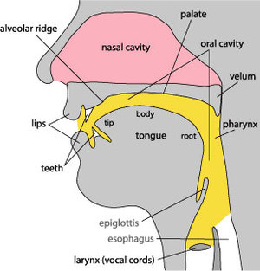
Phonology: sounds of language
Phoneme – smallest unit of sound
45 phonemes in Standard English pronunciation
We analyse sound through using the International Phonetic Alphabet

Slide 9
Consonants: Plosives
Created when the airflow is blocked for a brief time
Voiced:
/b/ - big, crab
/d/ - dog, cod
/g/ - garden, dagger, log
Unvoiced:
/p/ - pet, sport, cap
/t/ - tap, story, cot
/k/ - caravan, kick, sky, queasy

Slide 10
Consonants: Fricatives
Created when the airflow is only partially blocked and air moves through the mouth in a steady stream
Voiced:
/v/ - vein, give
/ð/ - this, smooth
/z/ - zero, hose, rows
/ʒ/ - leisure, beige
Unvoiced:
/f/ - fit, cough, phone, beef
/θ/ - thimble, fourth
/s/ - sauce, hiss, cinema
/ʃ/ - shop, lotion, mash, sugar
/h/ - hair

Slide 11
Consonants: Affricatives
Created by putting plosives and fricatives together
Voiced:
/ʤ/ - germ, jet, judge
Unvoiced:
/ʧ/ - champion, feature, catch

Slide 12
Consonants: Approximants
Created by a continuous, relatively unrestricted airflow
Voiced:
/w/ - wall
/r/ - ready, corrupt
/j/ - yawn

Slide 13
Consonants: Nasals
Created by air moving through the nose
Voiced:
/m/ - mould, numb, jam
/n/ - night, loan
/ŋ/ - singer, cling

Slide 14
Consonants: Laterals
Created by placing the tongue on the ridge of the teeth and then air moving down the side of your mouth
Voiced:
/l/ - laugh, below

Slide 15
Regional Consonants
Cockney:
/ɫ/ - milk, tell
/ʔ/ - butter, bottle
Scottish:
/ʍ/ - which
/x/ - loch

Slide 16
Long Vowels
Vowels are sounds made without closure or audible friction
/ɑ:/ -
/i:/ -
/ɜ:/ -
/ɔ:/ -
/u:/ -
bar, father
feet, speak
heard, bird
taught, port, saw, moor
moon, true, through, grew

Slide 17
Short Vowels
/I/ -
/ɛ/ -
/ə/ (schwa) –
/i/ -
/ʌ/ -
/ʊ/ -
/æ/ -
/ɒ/ -
quick
friend, said, bed
water, above
party
drunk, tough
full, put
spat
watch, hot

Slide 18
Diphthongs
A vowel in which there is a perceptible change in quality during a syllable
/eI/ -
/aI/ -
/əʊ/ -
/Iə/ -
/ɛə/ -
/aʊ/ -
/ɔI/ -
/ʊə/ -
pray, sleigh, grey, fade
fry, high, spider
go, bow, toe
hear, pier, beer
care, bear, flair, where
cow, bough
boy, noise
tour, poor

