Slide 1
Changing places 3.2.2.1: relationships and connections
The Dynamics of Change
Learning Objectives
Examine the concept that all places are changing and are socially constructed
To identify the different forces of change both current and historic
Key words:
Social construction
Forces of change
Concept Checker:
All places are dynamic and not static
All places are socially constructed.

Slide 2
A group of geographers dubbed the ‘social constructionists’ (that includes David Harvey and Doreen Massey) has suggested that all places must be understood as:
  Dynamic and not static
  Socially constructed
Example of this are Milton/Milton Abbas in Dorset and Poundbury in Dorset

Slide 3
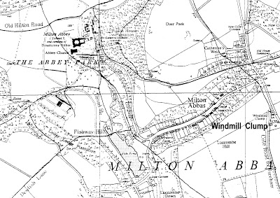
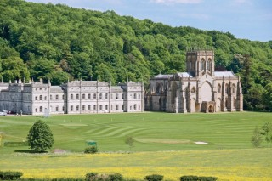
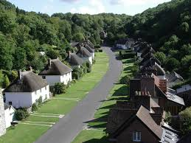
Milton, Dorset
Original site of village
New site of village
In 1752 the estate of Milton was sold to Joseph Damer.
Read through p81 in the Oxford textbook.
Q Why did he want to destroy the village of Milton and build it elsewhere, renaming it Milton Abbas?
Q Do you think that it would be allowed to happen today?

Slide 4
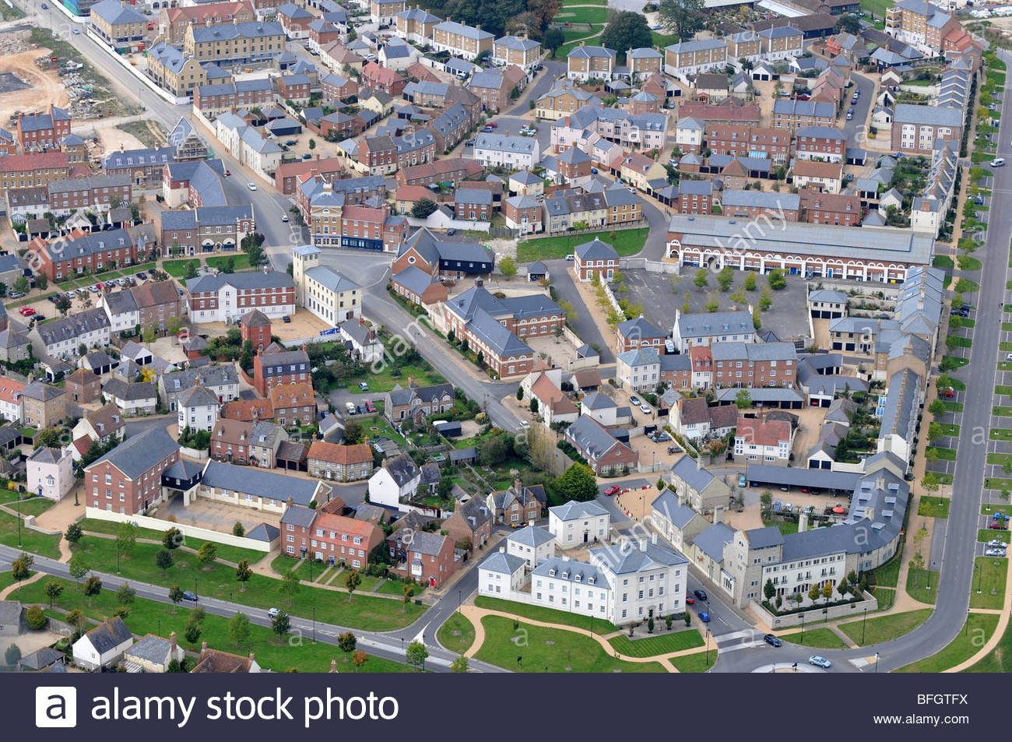
Many places/ land uses were created by the economic power of the aristocracy and Milton Abbas is an historical example
In Poundbury (also in Dorset) another, more recent, aristocratic project has been created
Watch the following clips and complete the question and table in the handout.
http://estream.godalming.ac.uk/View.aspx?id=16045~5d~uPTFHGgELS 26.15 mins to 33.15 mins
Why was Poundbury built?
What do you think are the positives and negatives of the scheme?
How much say do the local community have in the place-making?

Slide 5
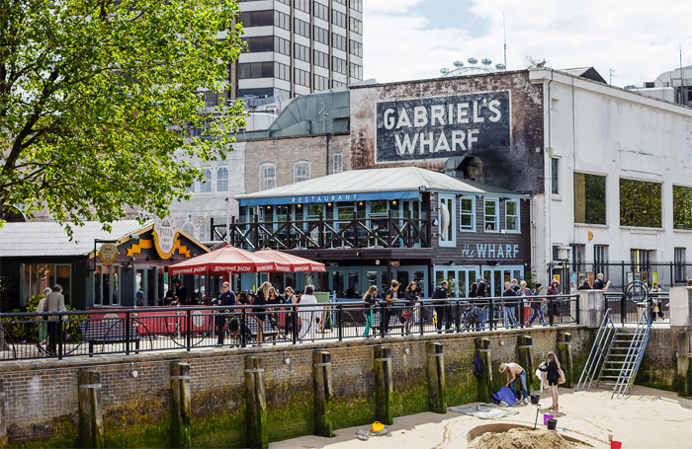
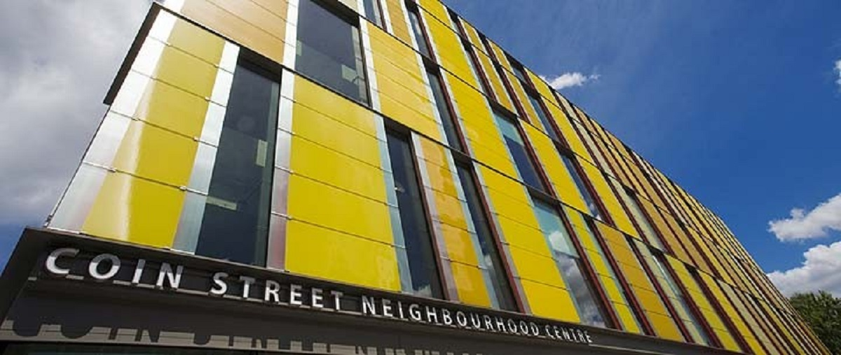
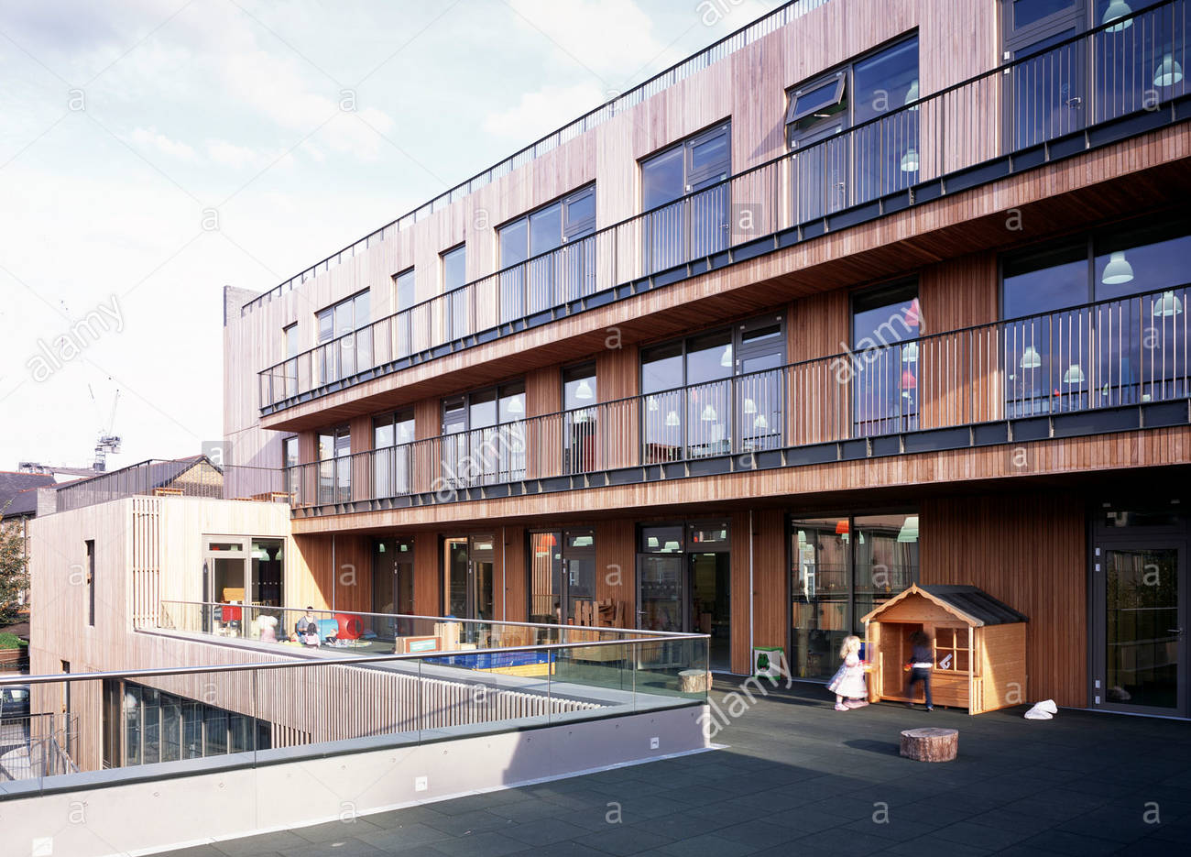
Coin Street – A community led scheme
https://www.youtube.com/watch?v=QYMZvybWIUI

Slide 6
Local community groups
e.g. Coin Street residents
National government
International institutions
e.g. European Union
Forces of change in the place-making process
Transnational corporations (TNCs)
e.g. Westfield Corporation
Global institutions
e.g. World Trade Organization
Local
government
National Institutions
e.g. National Trust
Individuals
e.g. activists, aristocrats, celebrities
There are many players involved in the social process of place making, including community groups. During the course of this topic you will study a number of examples of how local and national government in shape place making. Research each of the players in blue and suggest how they may influence or change a place.

Slide 7
Possible ideas…..
Tescos – opening of a store may result in the closing of shops in the town centre
National Trust may restore and open a new property. Boost in economy due to tourism and changing the places identity
EU – provides grants and funding to develop and regenerate places e.g. Cornwall
Global institutions – World Trade Organisation – trade involves business. Places becoming more industrialised
Celebrities e.g. Beatles can change the identity of the place (Liverpool) and make the place known worldwide
New Era residents – an example of a local community group influencing housing policy

Slide 8
Extension task
Research Doreen Massey
  What were her writings on the ‘sense of place’?

