Slide 1
Casablanca Revision
Casablanca Analysis

Slide 2
A3 Mind Map
Fill the sheet with notes, to include:
Summaries of your notes in class
Scenes which would be appropriate for each of the core study areas
Include FFT in these scene notes

Slide 3
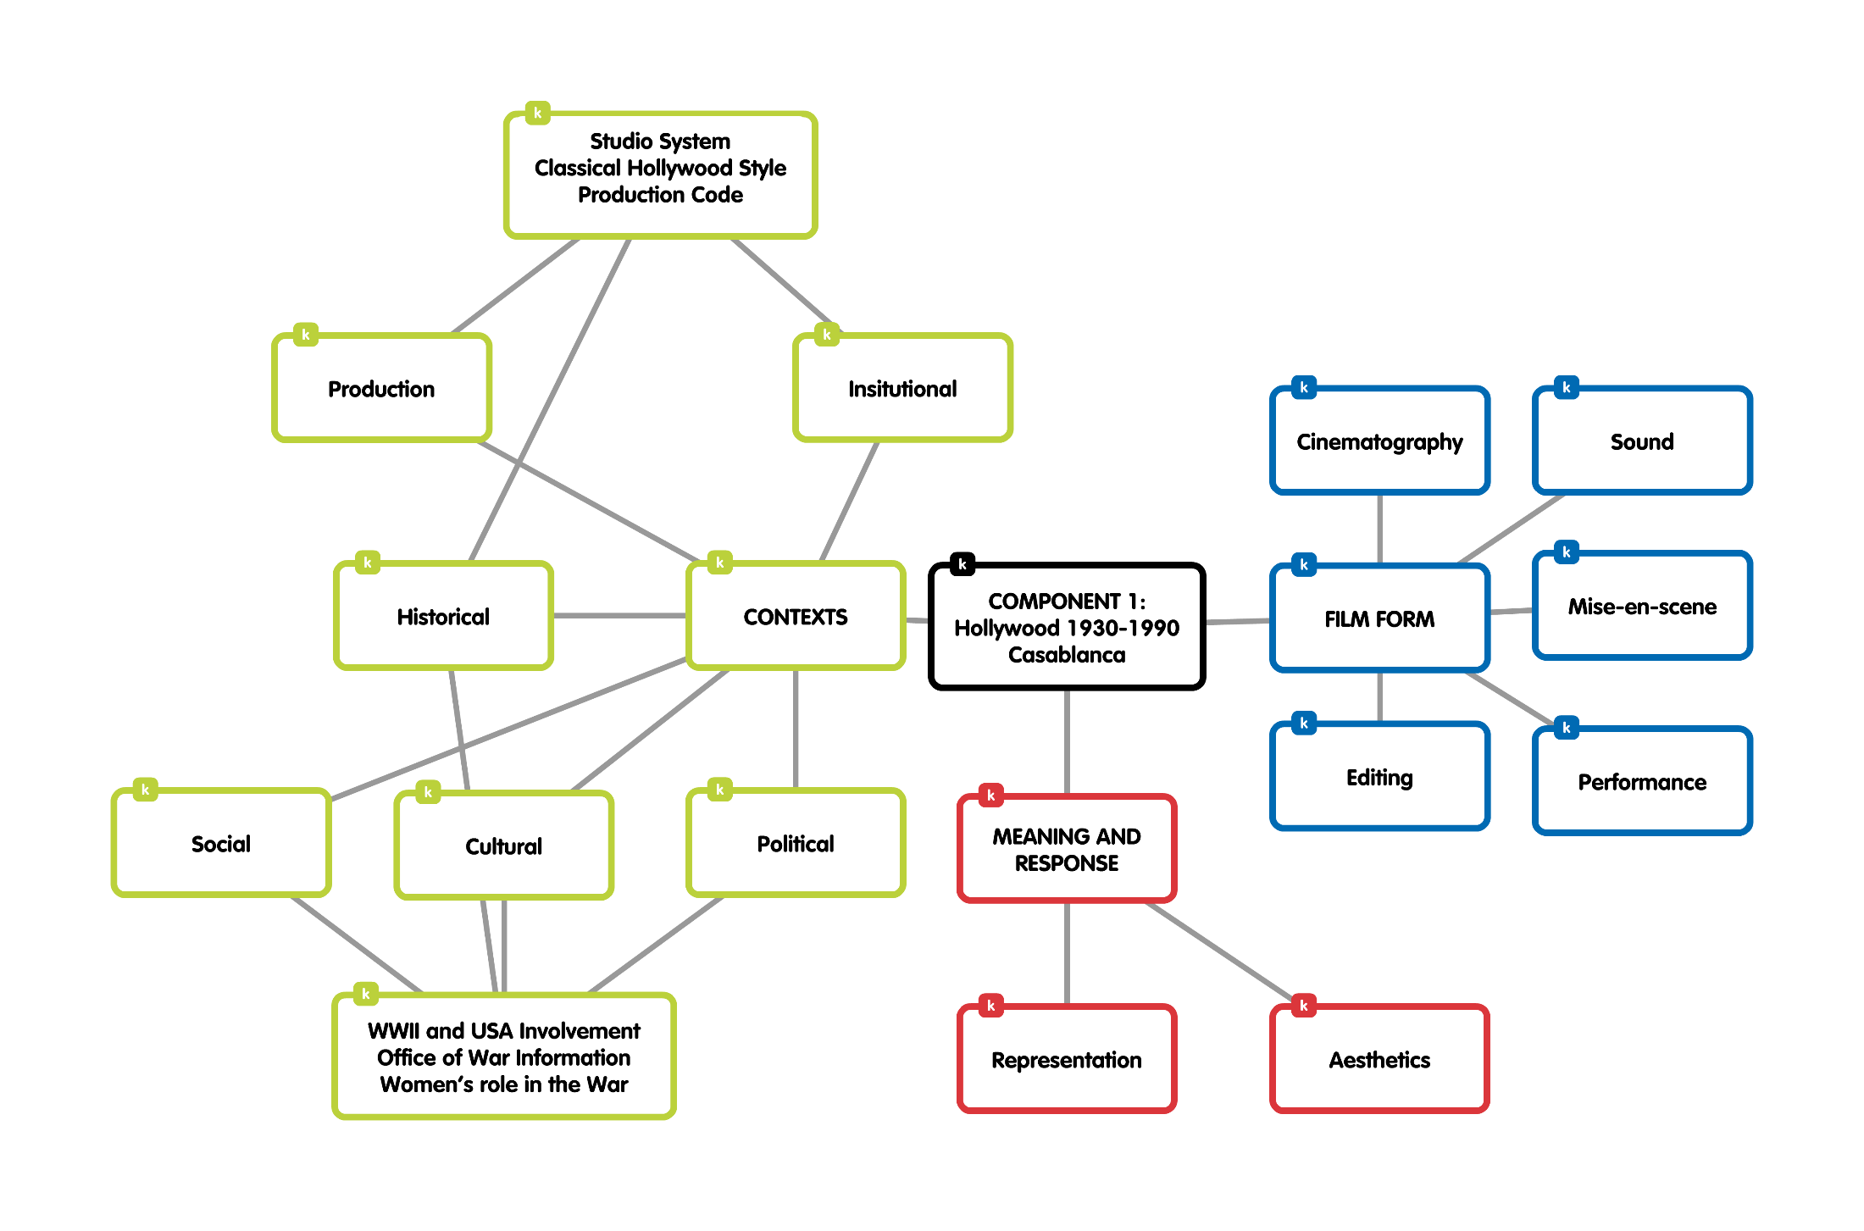

Slide 4
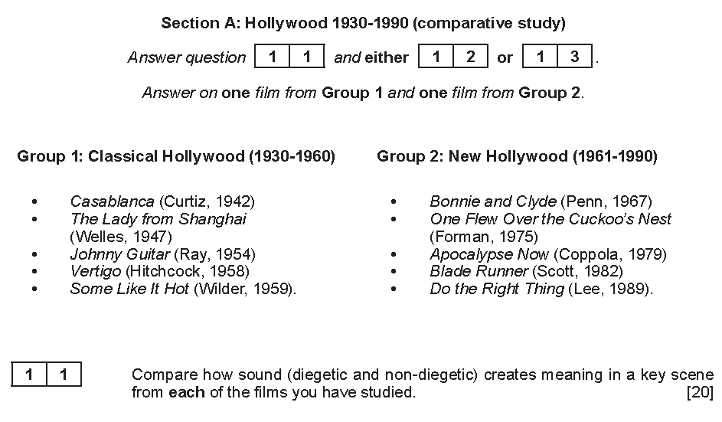

Slide 5
Aesthetics is concerned with beauty or the appreciation of beauty
Includes:
Look of the film
Elements of film form
Beauty and narrative

