Slide 1
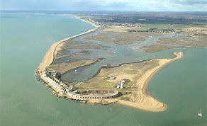
Spits
Spits are an elongated, narrow ridge of land that has one end joined to the mainland and projects out into the sea or across and estuary (1)
It is composed of sand or shingle, dependent on the material supplying it (1)
Material is transported along the coast via longshore drift in a zig zag motion (1)
Where the coastline changes direction there is a build up (deposition) of material in the more sheltered water creating a spit (1)
The end of the spit curves around due to wave refraction and the second most dominant wind direction may contribute to this (1)
Behind the spit salt marshes often form, particularly if the spit extends into a river estuary and silt is deposited in the sheltered water behind the spit (1)
Spits do not extend the whole way across a river estuary as river currents transport the sediment away (1)
Found along drift-aligned coasts (1)
E.g. Spurn Head, Holderness

Slide 2
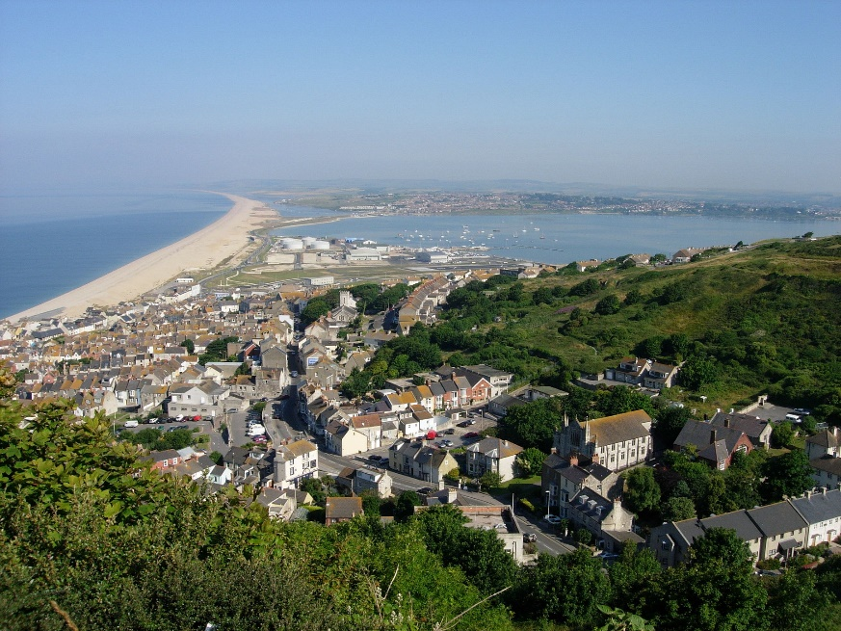
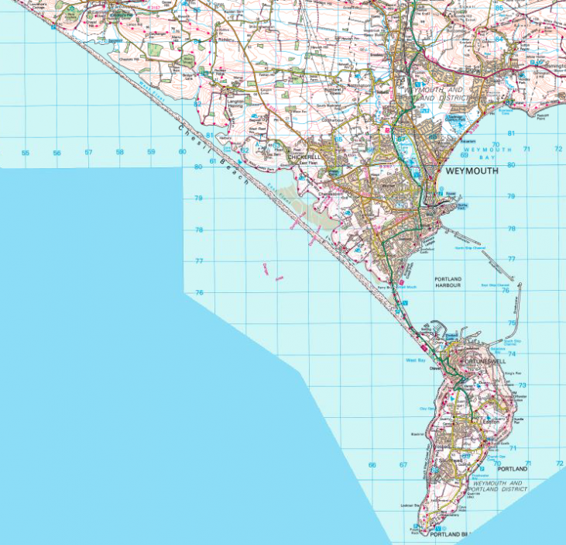
Tombolo
A tombolo is a spit which joins an island to the mainland (1)
It is composed of sand or shingle, dependent on the material supplying it (1)
Material is transported along the coast via longshore drift in a zig zag motion (1)
Where the coastline changes direction there is a build up (deposition) of material in the more sheltered water creating a spit. This continues to grow until it reaches an island (1)
E.g. Chesil Beach in Dorset

Slide 3
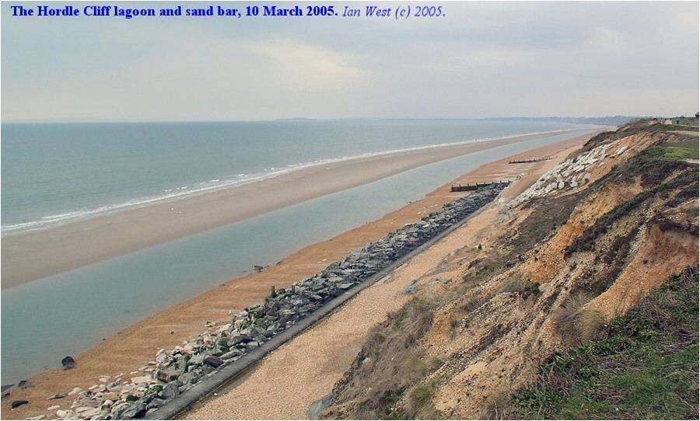
Offshore bar (sandbars)
Where a ridge of beach material that remains semi-submerged accumulates seawards of the breaker zone then it is known as an offshore bar (1)
Destructive waves erode sand from the beach with their strong backwash and deposit it offshore (1)
Offshore bars act as both sediment sinks and also potentially sediment input stores (1)
They can absorb wave energy thereby reducing the impacts of waves on the coast (1)

Slide 4
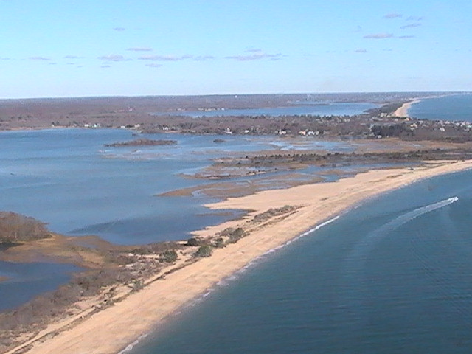
Barrier beach and barrier island
An elongated bank of sand or shingle lying parallel to the coastline (1)
It is created through deposition (1)
It is not submerged by incoming tides (1)
Where the bank is high enough to allow sand dunes to develop it is known as a barrier island (1)
Often the sheltered area between the barrier beach and the land becomes a lagoon or coastal marsh may develop (1)
They may be formed by the breaching of a spit or by constructive waves push a bar towards the land (1)
E.g. the Lido of Venice (1)

Slide 5
Characteristics of storm beaches
A ridge composed of the biggest boulders thrown up by the largest waves (1)
They are found above the usual high tide mark on the back shore (1)
They are most likely to form during the winter months when wave energy is greatest (1)

