Slide 1
Nature vs Nurture
To understand the debate of Nature vs Nurture
To outline Gesell’s Maturation Theory
To outline Bandura’s Social Learning Theory
To outline the stress-diathesis model

Slide 2
What is the nature/nurture debate?
This debate has been going on for many years
Nature refers to genetic inheritance
E.g. eye/hair/skin colour, biological sex
Nurture refers to the influences of external factors (from your environment)
E.g. friends, family, where you live
There is debate as to whether some characteristics are ‘wired in’ before the child is born
E.g. behaviour, intelligence and personality

Slide 3
Theories we have looked at…
Bowlby’s theory of attachment is on the side of nature
Chomsky’s theory of language acquisition is also nature
In contrast, Bandura’s SLT represents nurture.
Characteristics not observed at birth but later emerge is called maturation
The nature perspective believes we have an internal clock that tells us when things should develop

Slide 4
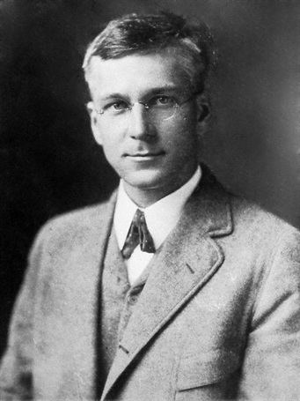
Gesell’s Maturation Theory
Arnold Gesell was a psychologist and paediatrician
He observed large numbers of children to see when they developed particular traits or skills
Using his results, he created what we know as milestones
He observed that each child moved at their own pace
Development is pre-determined and that environment has little effect
Delay in reaching milestones is a genetic issue

Slide 5
For the next task you will need an A3 page, split into three sections to make your notes on

Slide 6
However, critics think that Gesell’s theory doesn’t explain individual or cultural differences.
It also doesn’t explain children with learning difficulties

Slide 7
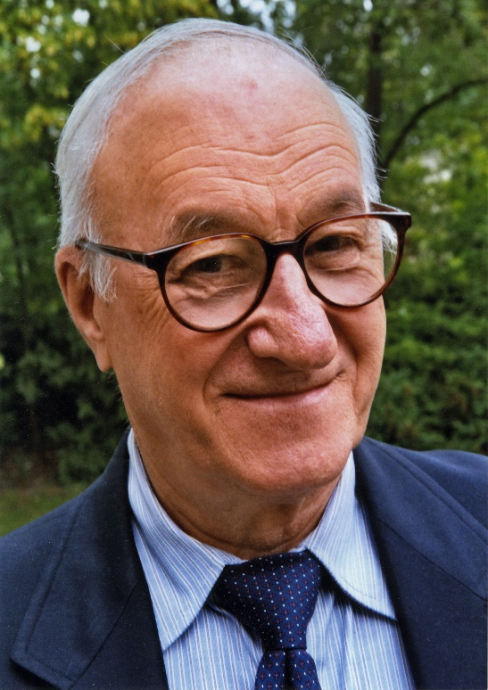
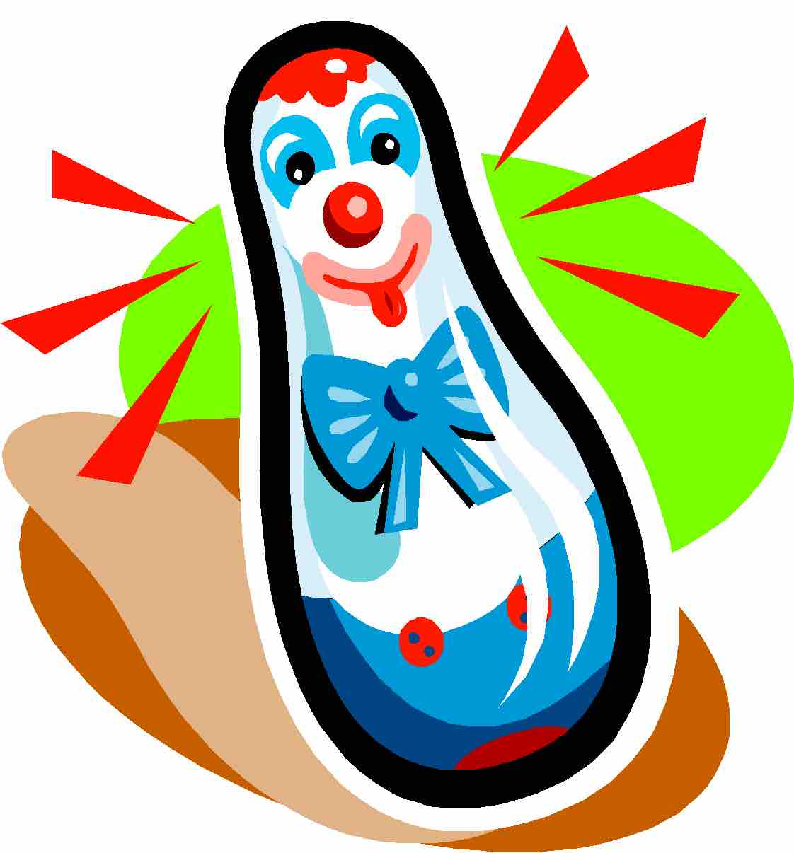
Bandura and Social Learning Theory
https://www.youtube.com/watch?v=dmBqwWlJg8U
While watching the video try to make notes on what is happening!
Bandura observed children with them watching other people
He suggested that children can pick up bad behaviours through copying others or ‘modelling’
He believed there were four steps to their learning.
https://www.youtube.com/watch?v=zerCK0lRjp8
https://www.youtube.com/watch?v=128Ts5r9NRE&t=113s

Slide 8
1st: Children notice the behaviour of someone they are close to or admire
2nd: The child ‘internalises’ or remembers what action they have seen
3rd: They reproduce the behaviour when there is opportunity to
4th: Children will either repeat the behaviour or stop depending on the outcome

Slide 9
Positive reinforcement is when behaviour is repeated because of personal satisfaction or rewards
Negative reinforcement is when the behaviour isn’t repeated to avoid an adverse experience
https://www.youtube.com/watch?v=PsTlJyox0Kg (role models)

Slide 10
Stress-diathesis model
This attempts to explain how stress caused by nurture can interact with a person’s nature
Some people are born with a genetic predisposition to a mental illness or diathesis
High levels of stress such as family conflict, trauma or abuse can trigger those with a predisposition

Slide 11
While these theories are useful guidance, they do not provide the answer as to whether development is nature or nurture

Slide 12
To what extent is nature a good explanation for development (12 marks)
This lesson we are going to debate instead of writing the essay
As we have seen, the theories we have looked at do not necessarily answer this question
Split into two teams and research material for the side of the debate I have given you

Slide 13
B2: Genetic Factors That Affect Development
To understand what genetic predisposition and susceptibility are
To outline some of the conditions that can be affected by genetic predisposition
To enhance our verbal literacy by presenting back to the class

Slide 14
Genetic predisposition
Genetic predisposition is the inheritance of genes that mean there is a possibility you may develop a certain condition
This does not mean that you definitely will!
We can sometimes alter environmental factors and offer treatment to ensure a person lives as healthily as possible
Some inherited conditions can have serious effects on a child’s development

Slide 15
Presentations
You have all been put into groups to research a genetic disorder
Use the information in your textbooks and the internet to create a PowerPoint that you will be delivering to the class
Ensure that your slides are easy to understand and without too much text

Slide 16
Use (pages 33- 35) and the internet to research
Disorder | Group
Colour blindness
Huntington’s disease
Cystic fibrosis
Phenylketonuria (PKU)
Duchenne muscular dystrophy
Down’s Syndrome
Brittle bone disease
Klinefelter syndrome

Slide 17
Homework
Summarise each of the disorders we have looked at into two sentences keeping the richness of information

Slide 18
Susceptibility and Biological Factors
To understand the key terms
To outline biological factors that affect development
To write a letter to pregnant mothers

Slide 19
Susceptibility to disease
Susceptibility is an increased likelihood of acquiring a disease because of your DNA
The World Health Organisation (WHO) believe that a mixture of nature and nurture can bring on a disease
But most diseases and disorders happen to those with a susceptibility to them e.g. particular cancers, diabetes or high cholesterol

Slide 20
What do we know already about cancer?

Slide 21
Cancer
There are over 200 types of cancer
Cancer affects your cells, making them abnormal and then dividing and spreading
Most cancers are linked to the environment- can you think of any examples?
Some cancers are however linked to genetics such as breast, bowel, womb and kidney

Slide 22
What do we already know about diabetes?

Slide 23
Diabetes
This is an increasingly common chronic disorder that affects millions
1 in 16 people have a type of diabetes
Environment and lifestyle can play a part but there is a genetic predisposition too
Risk of Type 1 if both parents have it
Risk of Type 2 is 90% if you have an identical twin who is diabetic

Slide 24
High blood cholesterol
Cholesterol is a fatty substance that can build up in your artery walls leading to heart disease
What lifestyle factors could cause this?
This can also be inherited
1 in 600 people have this condition
50% chance that a child of someone with high cholesterol will also suffer with it

Slide 25
Pregnancy and Disorders
Using your textbook, find the answers to these questions
What could be detrimental to a baby’s health?
What can drinking alcohol cause?
What is cytomegalovirus (CMV)?
What is rubella and how can it impact on a pregnant woman?
What is the best diet and lifestyle a woman can have while pregnant?

Slide 26
Foetal alcohol syndrome
Drinking alcohol causes a huge risk to foetuses in the womb
A baby suffering with foetal alcohol syndrome can be born smaller with a smaller heads because of poor brain development
This can cause long lasting effects on their physical and developmental health
They can have heart defects, learning difficulties and neurological problems

Slide 27
Maternal infections during pregnancy
Rubella is dangerous during the first month of pregnancy
This can cause a baby to have impaired hearing or eyesight or a damaged heart
Most women are vaccinated against this to avoid risk
Cytomegalovirus (CMV) is a common virus from the herpes family
If this passes to the foetus, it can cause congenital CMV with symptoms like deafness and learning difficulties
1-2 babies in 200 are born with this, 13% show the above symptoms and 14% will develop problems later in

Slide 28
Maternal infections during pregnancy
While not linked to an infection, diet and lifestyle can have as much of an effect on a foetus
This is both while pregnant and while breast feeding
Animal research suggests that a diet high in sugar and fat can lead to high cholesterol and heart disease for the child
Malnutrition can lead to a lifetime of poor health for the child
The FSA recommend that pregnant women eat plenty of fruit, vegetables, protein, starch, fibre and calcium
Pregnant women should avoid alcohol and caffeine

Slide 29
Environmental factors which affect development
Exposure to pollution
Respiratory disorders, cardiovascular problems, allergies
Poor housing conditions
Respiratory disorders, cardio vascular problems, hypothermia, anxiety and depression.
Access to health and social care services
Availability of transport, opening hours of services, ability to understand needs and requirements of particular services.
Why this might happen
What will it mean if it does happen?
How will it affect PIES?

Slide 31
B4: Social factors that affect development

Slide 32
How can families help us develop?

Slide 33
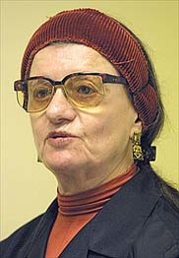
Parenting styles
Who is this woman?
What did she determine and what do they mean?

Slide 34
Parenting styles
Parenting styles are different ways that parents bring up their children
Baumrind identified three of these:
Authoritative- parents are not overly strict but children develop appropriate attitudes and boundaries. Children are resilient and conform to social norms
Authoritarian- parents have high expectations and are often overwhelmingly strict. Children are rebellious
Permissive- parents make few demands and are reluctant to implement rules. Children lack self-control as they have no boundaries
Uninvolved parenting is another style found in later research. This involves parent who do not involve themselves in their children's lives

Slide 35
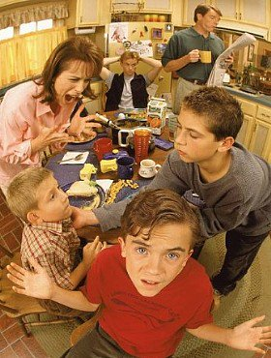
Family dysfunction:
Dysfunctional families are those that do not provide some or all of the functions we discussed earlier
Families can become dysfunctional due to many reasons…what could they be?
Stress
Health problems
Poor housing
Low income
Poor parenting skills
Manipulative family members
Neglect
Inconsistency in parenting
Coming from a dysfunctional family
Little experience of giving support
This can make it difficult to develop self-confidence

Slide 36
Parental divorce or separation
A recent increase in divorce and separation can have particular consequences for children's growth and development
Negative consequences can be:
an effect on self-esteem and self-confidence
Emotional distress
Moodiness
Depression
Influence by peers
Risky behaviours
Poverty
Underachievement

Slide 37
Sibling rivalry
As we have seen, Bandura explored the impact of role modelling
Constant exposure to family conflict can lead to aggression and bullying towards other children
Rosenthal and Doherty suggest that children exhibiting sibling rivalry have been bullied by their primary caregiver
They do this to try to gain a sense of control
Parents can also cause conflict through competition between siblings

Slide 38
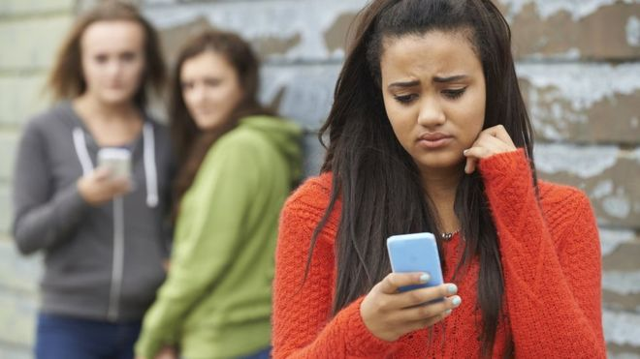
Bullying
There is no legal definition of bullying but it can be seen as repetitive behaviour with an intention to hurt someone emotionally or physically
This can be towards children or adults, undermining self-esteem leading to stress, depression and anxiety
People can be bullied for many reasons and it can take many forms
Non-physical
Threats
Physical violence
Cyber bullying
Bullying can have long-term effects on self-esteem
All schools and workplaces must have policies in place to report and deal with bullying

Slide 39
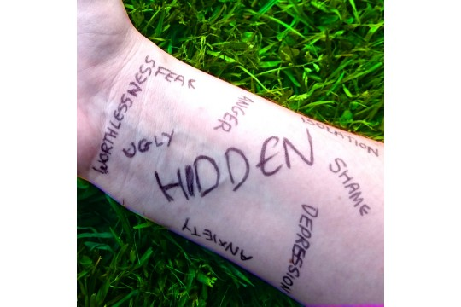
Self-harm
The effects of bullying can impact on a child's growth and development- especially emotionally
This can lead to feeling unsafe, lonely, self-critical and to believing the bullies
For some people, self-harm is a way of releasing these feelings
Hurting themselves makes them feel better
Self-harmers often hide their behaviour for example wearing long sleeves
If this gets worse, severe depression and anxiety can be felt including suicidal thoughts and even suicide

Slide 40
Culture, religion and beliefs
Some religious groups believe that some medical procedures should not be allowed
Jehovah's Witnesses believe that blood transfusions are wrong
In some cases, people have been taken to court to save a child’s life because of this
This can affect many areas of care such as pregnancy and childbirth
Some cultures do not believe in medical intervention and use their own remedies instead
There can be interactions with these remedies when using prescription medication
Culture can also have an effect on health and a balanced diet vegetarianism, halal and kosher diets can cause issues with health:
Nutritional deficiency with a lack of meat and fish
Calcium deficiency can cause weak bones and teeth
Iron and B12 deficiency can impact on the production of red blood cells
Protein deficiency can impact on muscle and organ function

Slide 41
B5: Economic Factors That Affect Development

Slide 42
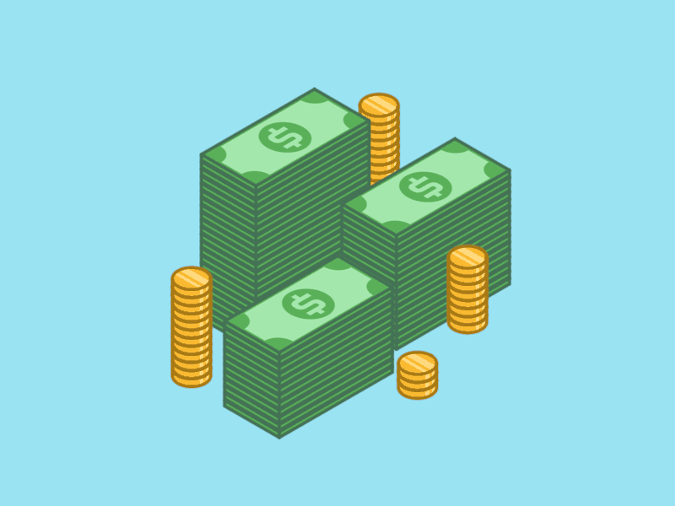
Income and Expenditure
Amount of money that is spent
Amount of money that is spent
What might a lack of income cause?
Housing?
Resources?
Fitting in?
Relative poverty is being poor in comparison to the rest of the people you live near
This can lead to being marginalised

Slide 43
Poverty
Child Poverty Action Group:
Higher risk of illness
Premature death
Lower life expectancy by 8 years on average
Weigh less at birth
Trussell Trust:
445 food banks in the UK
Year on year increase since 2009

Slide 44
Income and Quality of Life
Where can income come from?
This isn’t evenly distributed across the UK
Bottom 10% earn £8,500 a year leaving them in poverty
Top 10% earn £79,000
Who are more likely to be on low income?

Slide 45
The impact of low income:
Paxton and Dixon (2004)
Education?
Employment?
Crime?
Pollution?
Life expectancy?

Slide 46
Employment Status
Office for National Statistics
15.9% of households have no adults working
1.5% adults never worked
NE England 21.2.% not working
SE lowest 12.3%
Social Trends
22% of children living in poverty in England and Wales (2.9 million)
How would a low paid job make you feel?
What about a high paid job?

Slide 47
Education
DofE
By age 3, poorer children are 9 months behind in development than wealthier children
By age 14, nearly a year and a half behind
Do less well in GCSEs
This can lead to a lack of employment opportunities or low-pay work
This can lead to low self-image
‘High-flying’ jobs however can lead to stress

Slide 48
Peer groups
Independence increases the number of social relationships
Attitudes or assumptions that we use to make sense of our social experience and beliefs can be copied from others
Secondary socialisation takes place
This is the process of learning appropriate behaviour through education, friends, media, religion and the government

Slide 49
Values and attitudes
Primary and secondary socialisation effect our attitudes, beliefs and values
Values are principles that we use to guide our thoughts and decisions
They are also effected by our life experiences such as bullying and culture
Social networking and access to information are now easier than ever creating a huge impact

Slide 50
Lifestyle
Lifestyle describes how someone spends their time and money, their ‘style’ of living
Your choices are limited by money and influenced by culture

Slide 51
Nutrition
Alcohol
Lifestyle
Tobacco
Exercise
Drug use

Slide 52
B6: Major Life Events

Slide 53
Predictable and Unpredictable
Predictable events are expected to happen at a particular time. They can have a positive or negative effect on someone’s health and wellbeing
Unpredictable events are unexpected and can have serious physical and psychological effects on the individual- positive or negative

Slide 54
Life event | Predictable | Unpredictable
Starting school/nursery
Moving house
Marriage
Divorce
Starting a family
Beginning employment
Retirement
Death of a relative/partner/friend
Accident or injury
Changing employment
Leaving home
Promotion or redundancy
Serious illness

Slide 55
Predictable events
 | Positive Learning | Risk of Stress
Starting school
Beginning and changing employment
Leaving home/care
Leaving prison
Marriage
Parenthood
Retirement

Slide 56
Unpredictable events
 | Positive Learning | Risk of Stress
Birth of a sibling
Redundancy
Illness and serious injury
Divorce
Bereavement

Slide 58
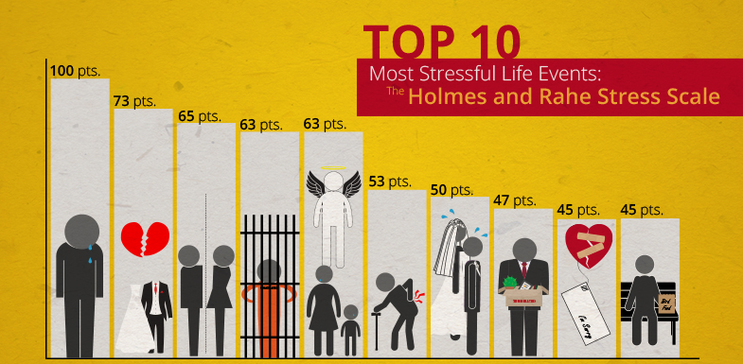
Holmes-Rahe Social readjustment rating scale (SRRS)
Psychologists use this scale to rate and measure stress scores
It identifies 43 life events that have been rated by stress score
They assumed that everyone would be affected by stress
Each participant is unique and deals with things in different ways
Critics stress this point as some may feel divorce is stressful while others find it a relief
‘Daily hassles’ are events that cause a small amount of stress in daily life

Slide 59
Stress levels Lazarus: when perceived demands exceed resources
Stress is an automatic response to dealing with challenges
When we stress, our bodies are flooded with hormones that raise heart rate, blood pressure, boost energy and prepare for ‘fight or flight’
Over time, stress can become a serious issue, making someone unwell
What are some examples of short-term stress?
What are some examples of long-term stress?

Slide 60
Stress and Health
Stress can cause irritability, tiredness, headaches, a lack of motivation and an inability to concentrate
This can lead to over/under eating, smoking or drinking alcohol
Chronic stress over a long period of time can cause anxiety attacks, depression and cardiovascular problems
This is difficult to recover from

Slide 61
High levels of stress hormones
Reseach what high levels of stress hormones can cause to the body and write it down in your booklets
Immunity: susceptible to infections especially if drinking
Cardiovascular: high BP, heart attacks, sudden death
Respiration: breathlessness, asthma
Digestion: loss of appetite, ulcers, IBS
Musculoskeletal: tension headaches, taut muscles
Endocrine- diabetes, low libido, absence of periods
Indecision, impaired judgment, inability to sleep, accident prone, low self-image

