Slide 1
Unicef UK goals as set out in annual report 2018
Source: Unicef UK annual report 2018

Slide 2
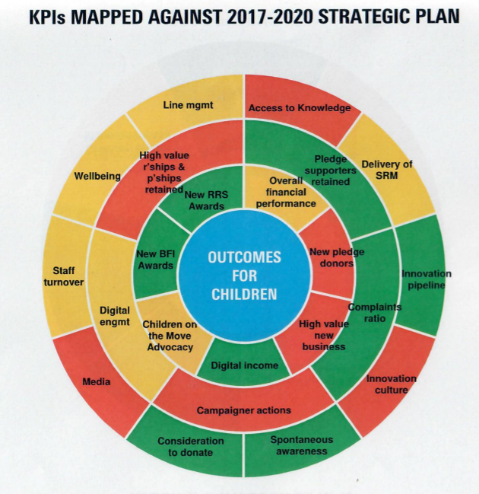
Unicef UK 2018 Performance against KPIs
Green = good
Amber = could improve
Red = needs improvement
Source: Unicef UK annual report 2018
of brand

