Slide 1
Punk Art Movement
The graphic design of the late 70s punk movement is as much part of what we consider ‘Punk’ to be as the music and fashion. Underpinned by the same snarling anti-establishment attitude and DIY ethos, punk art and graphics have a rawness that comes from both the artists and designers behind them and their means of production.
While the likes of artists such as Jamie Reid who went to art school, much of punk art and design was created by practitioners without formal training. A pen, camera and/or a pair of scissors – and a passion for the music – were all that was necessary to get involved, just like you only needed some cheap instruments and three chords to start a band. The end results were equally rough, with fanzines cranked out on grimy photocopiers in a similar fashion to bands self-pressing their own records.

Slide 2
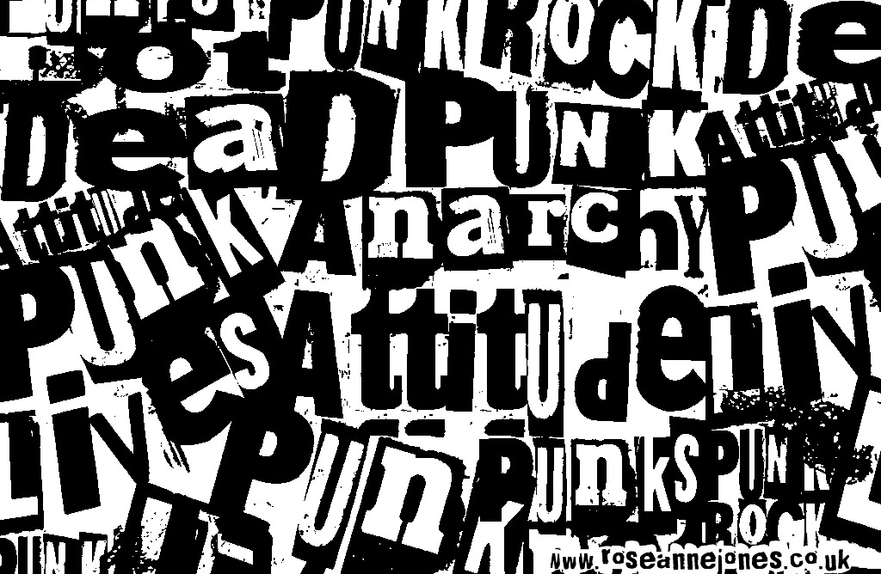
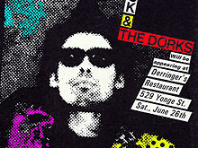
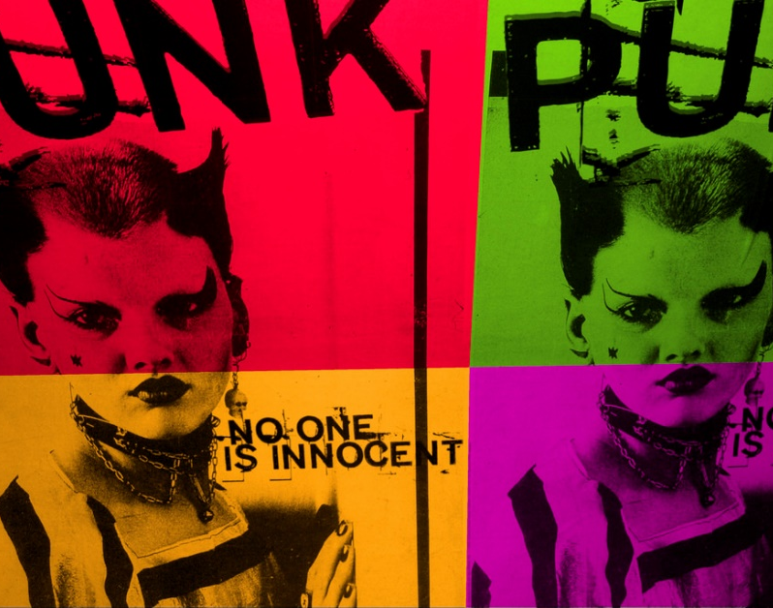

Slide 3
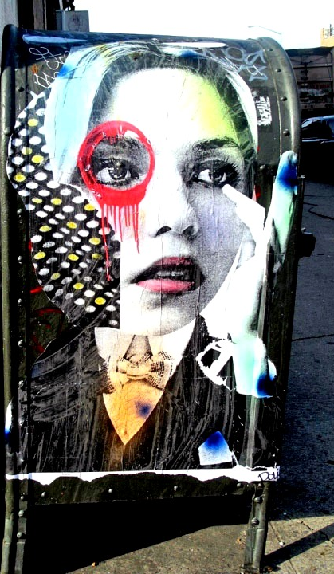
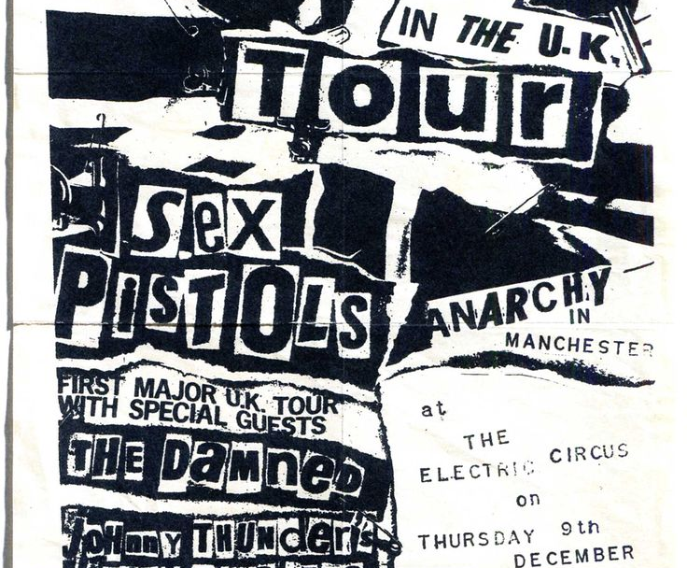
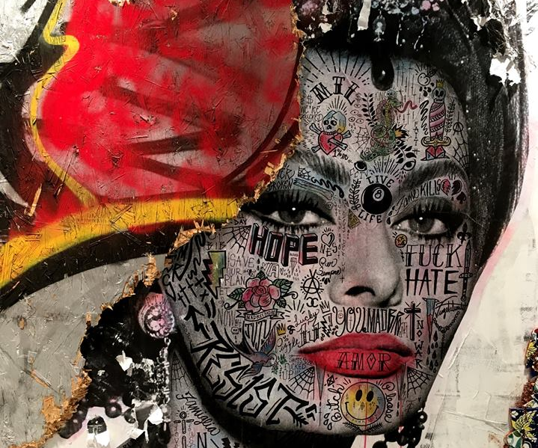

Slide 4
You are to create a double page spread to be mounted on undersized A3 cartridge paper.
Left side page - create 4 experimental off screen designs on undersized A5 paper inspired by the Punk movement.
Right side – Create a selection of digital designs inspired by the punk movement. Try experimenting with a range of digital techniques, explore different brushes, stencil style typography etc. Vary the size of your designs.

Slide 5
Things to consider
You want to create a rebellious element to your designs. Think about ripped edges, defacing imagery, layered collage etc.
Typography – this is crucial. Think about ransom style collaged typography and using spray painted stencils.
Think about the techniques you are using: paint splatters, ripped or burnt edges, spray painting, collage, scratching into surfaces such as photographic paper.
Be experimental, think about the message you are trying to portray to the audience.
Research artists like Jamie Reid, Stikki Peaches and Dain before you make a start.

Slide 6
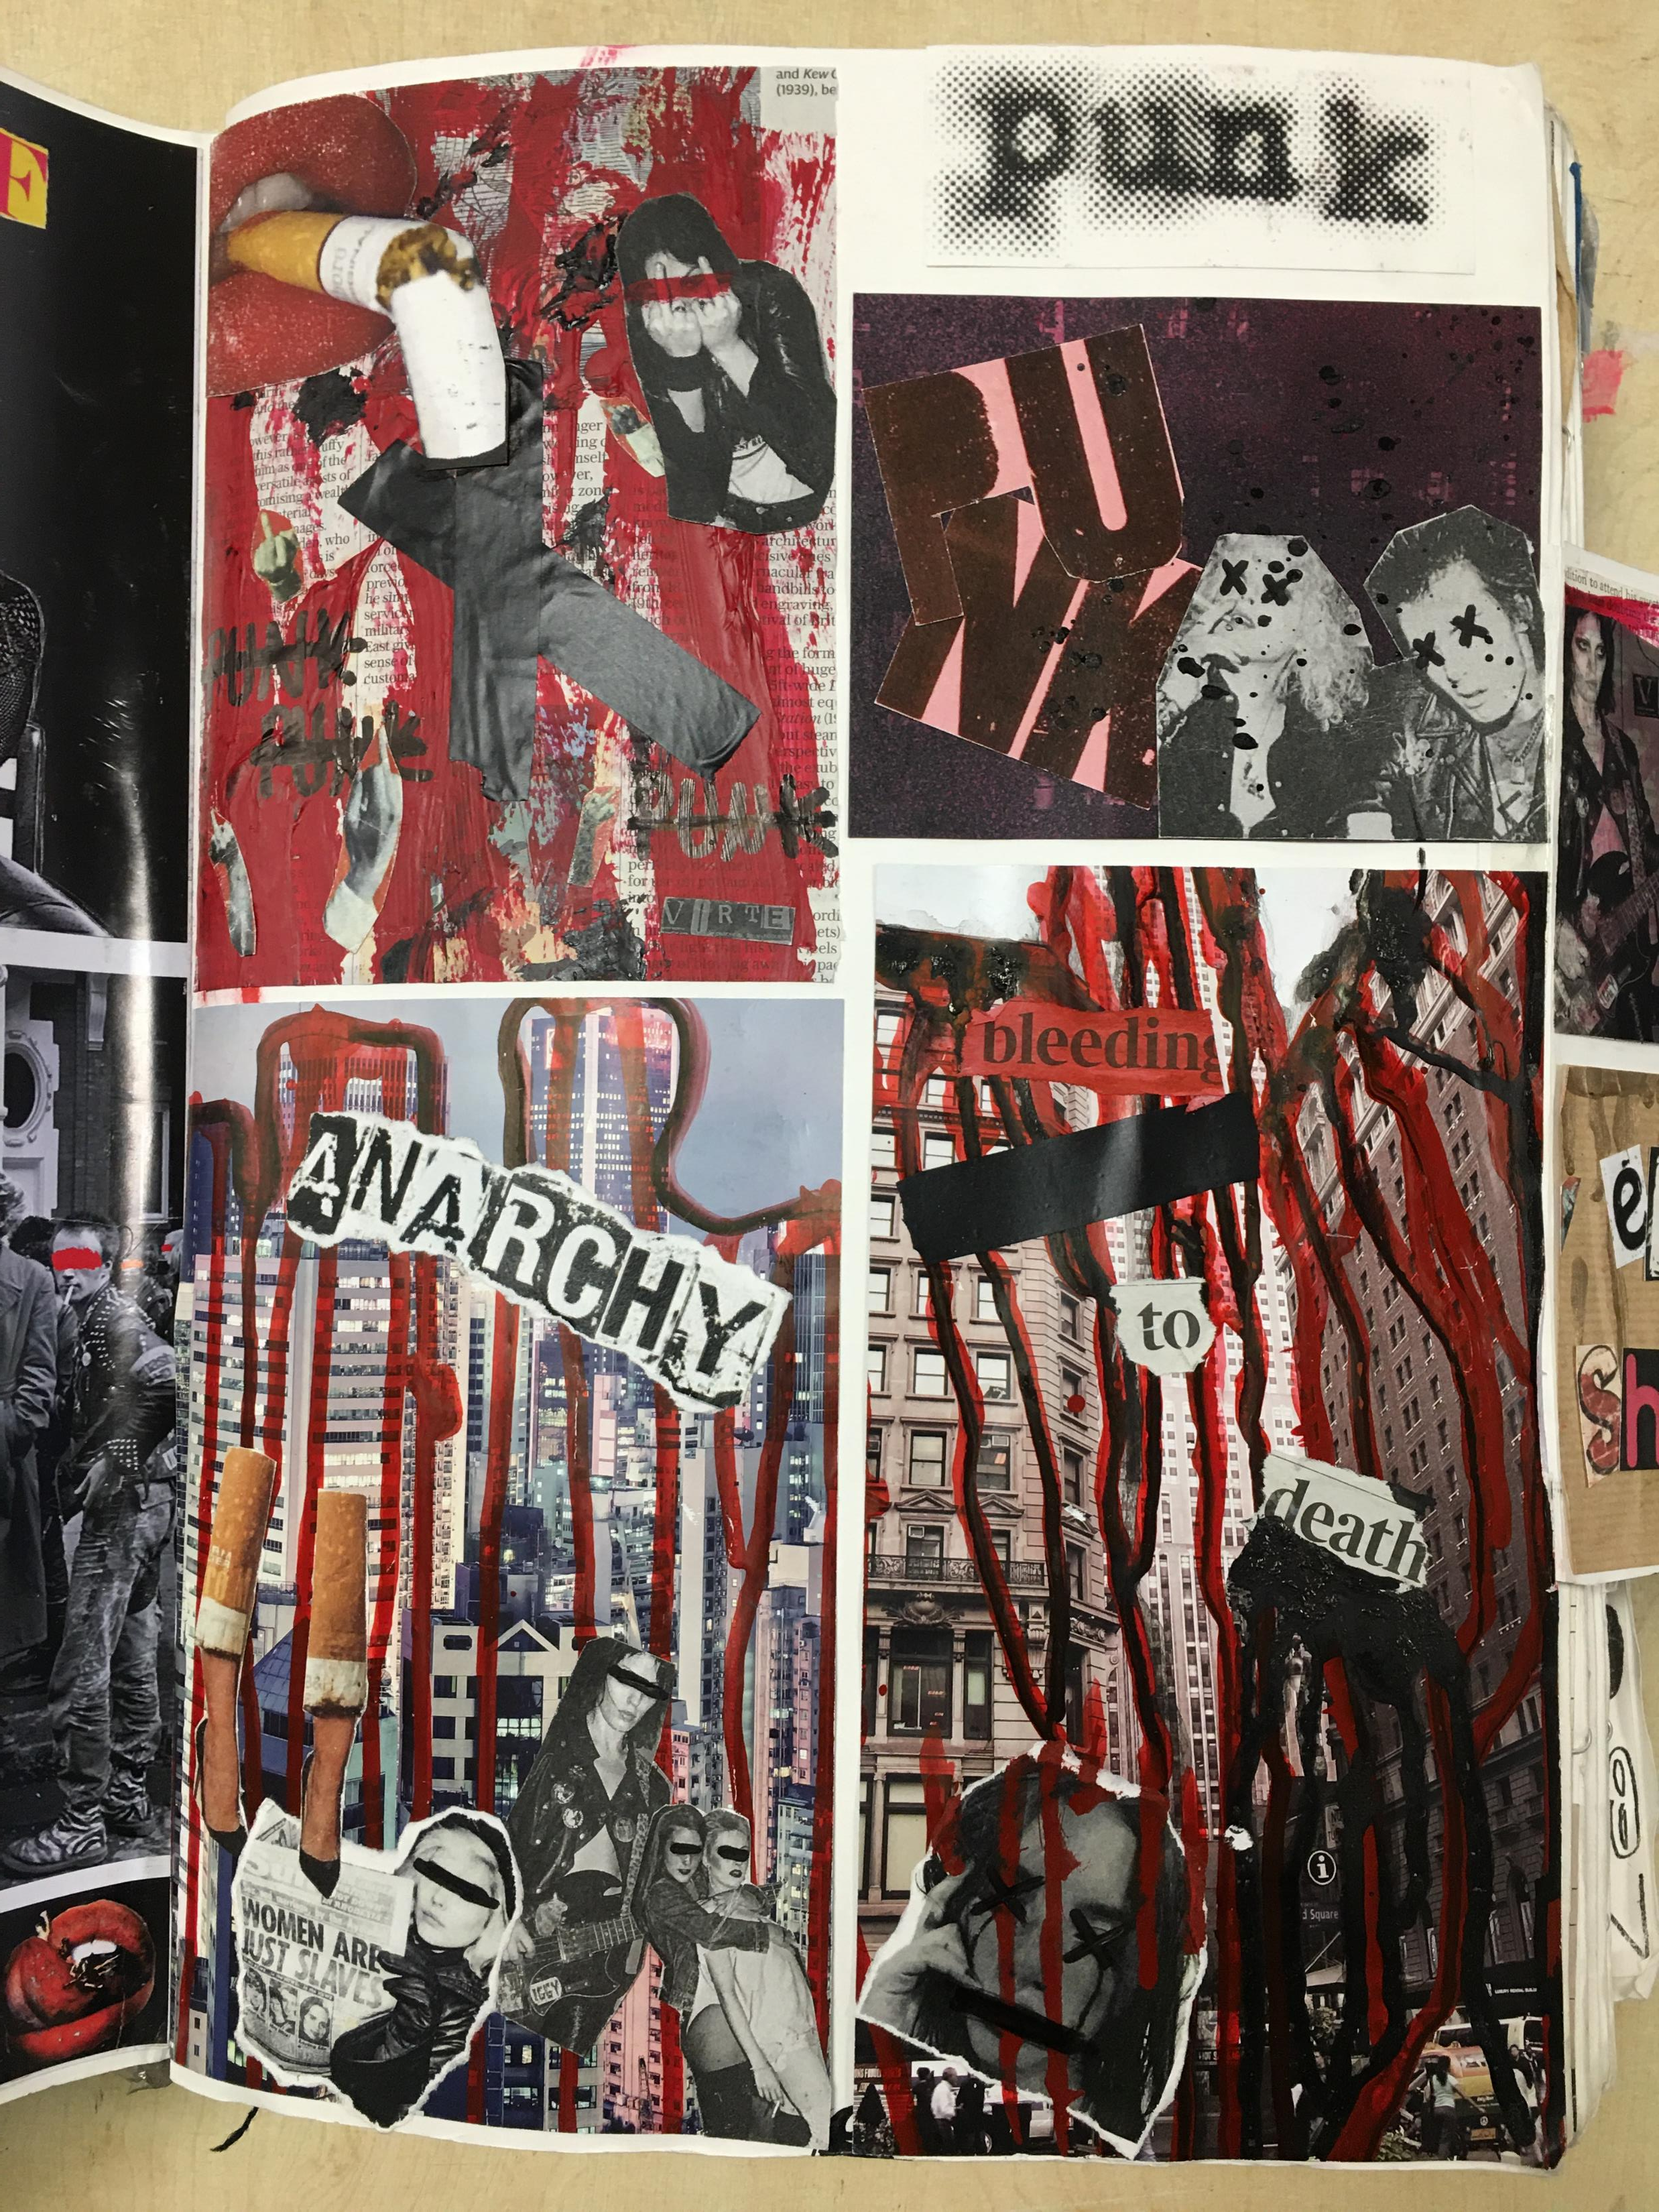
Examples of double page spread

