Slide 1
Spot the Errors
 | £ | £
Liabilities
Fixed Assets Van |  | 1, 500
Current Assets Stock Trade Receivables Cash | 3, 000 200 1, 000 | 2, 400
Total Assets |  | 5, 700
Assets
Current Liabilities Trade Payables Overdraft | 600 100 | 900
Working Stock |  | 3, 200
Total Assets more Total Liabilities |  | 5, 000
Shareholders Stuff Share Capital | 6, 000

Slide 2
Exam Skills
Unit 2 – Finance for Business

Slide 3
Overview
One hour
50 marks
Onscreen
Questions on all content covered
Answer in any order

Slide 4
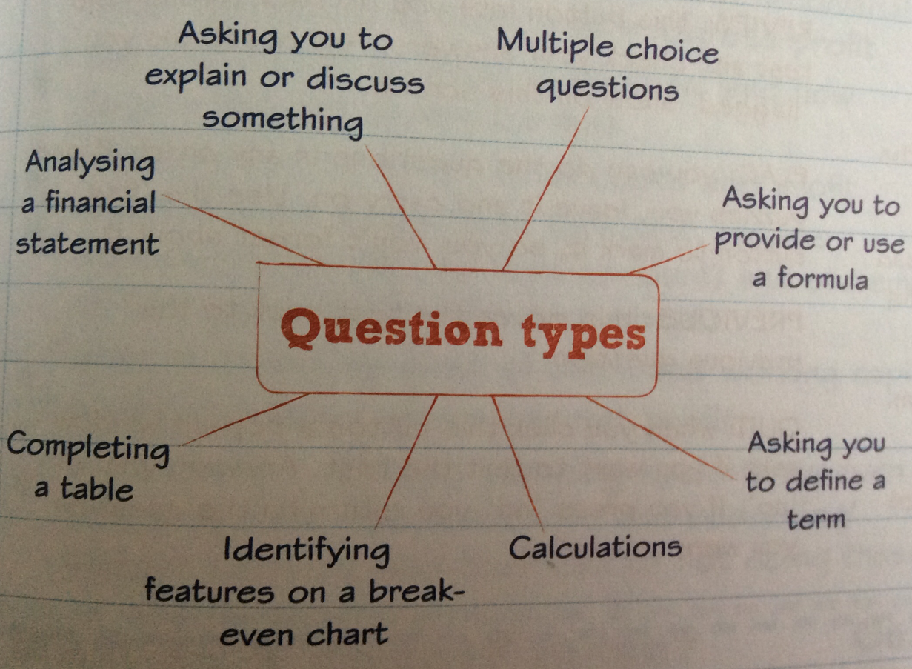

Slide 5
Understanding the Question
Read each question carefully and make sure you know exactly what you have to do.
Always check:-
How many items you have to select
You understand the term being used
How you must respond

Slide 7
Revision Topics
The difference between key terms
Features of a break even graph and how to use the break even formula
Formulae for revenue, total costs and profit
The items on a cash flow forecast, income statement and statement of financial position
What is meant by cost of sales and working capital
How to improve gross and net profit
The benefits of these planning tools: break even, cash flow forecasting and budgeting and the risks of not doing them.

Slide 8
Hints & Tips
Revise key terms and formulae
Arrive in good time
Read the questions carefully
You don't need a pen or paper
Must have your lanyard
Use the marks given for the question as a guide
If the answer has a large response box means you must provide detail

Slide 9
8 Markers
Practise

Slide 10
Discuss the use of breakeven analysis in helping Sandra plan for a successful business. (8 marks)
You need to explain what BE is and why its useful. The risks of not completing it. Finally link to how BE can help Sandra plan for success.

Slide 11
Mark Scheme
First Task – explain what break even is and why it is needed . . . .
It shows when the business is making enough money to cover their costs
It is necessary in order to fix an appropriate selling price for goods
It is needed to know how much to sell to enable the business to make a profit
It is needed to identify and track costs (both fixed and variable costs)
It can help businesses identify where they can change their costs, for example, buying cheaper materials or finding a cheaper supplier
It is needed to highlight the margin of safety

Slide 12
Mark Scheme
Explain the risks of not completing a breakeven analysis . . .
The business sets the wrong selling price for goods and ends up making a loss
The business costs are higher than the revenue generated
The business will not be aware of the margin of safety
The business will not be aware of how much they need to sell to make a profit
It can help businesses identify where they can change their costs, for example, buying cheaper materials or finding a cheaper supplier

Slide 13
Mark Scheme
Link to success
Planning costs and potential revenue should keep Sandra on track to make profit
Useful tool in gaining financial support from banks – essential for new businesses
BE can allow for ‘what if’ scenarios. Sandra can see what the impact of changing selling prices, going with an alternative supplier etc can have on her BE amount before actually doing it.

Slide 14
Why is it important for businesses to use financial planning tools such as cash flow forecasting and budgeting? (8 marks)
You need to explain what financial planning tools are i.e. cash flow forecasting and budgeting. Discuss the benefits of completing them and then detail the risks of not doing them.

Slide 15
Mark Scheme
Importance and benefits of planning tools
Shows when money is coming into the business (cash inflows)
Shows individual and total outflows and the dates/timings of those outflows
A new business would have no past records to use for planning
Risks of not completing a cash flow forecast or budget
Inaccurate or imprecise planning of finances particularly as a new business would have no past records
Payments to be made or received may be forgotten/ not accounted for
Inability to plan and organise overdrafts and loans in advance so that emergency funds could incur penalties

Slide 16
Discuss how preparing a trading account can benefit a business. (8 marks)
A trading account shows gross profit. A business can check that they are not spending too much money on cost of sales and that it is earning enough sales revenue.
Gross profit is important because this is needed to pay for expenses, including staff wages. If gross profit is too low to cover these then the business may be losing money and may not survive.
If the gross profit is too low it must try to increase sales income or lower the cost of sales. It could hold special events to attract more customers or try to find cheaper suppliers or negotiate savings and discounts on some items. It could increase prices but this could result in customers going elsewhere. It is better off trying not to spend more money if possible.

Slide 17
Explain what a statement of financial position shows
Identify the problems on Monisha’s statement
Suggest solutions to the problems

Slide 18
Explain what revenue and costs are
Discuss the impact of changing revenue for notebooks and diaries. Think about whether people would pay more. Link to BE too.
Discuss the impact of changing costs for notebooks and diaries. Think about the issue of going with a different paper supplier. Again link to BE.

