Slide 1
Calculating Costs, Revenues & Profits

Slide 2
Learning Objectives
What are the definitions of costs, revenue and profit?
How do you calculate costs, revenue and profit?
Can I calculate costs, revenue and profit?

Slide 3
Costs
Costs are the money paid out by a business for the items it needs.
There are six different types of costs that you will need to know:-
Start up costs
Operating (running) costs
Fixed costs
Variable costs
Direct costs
Indirect costs

Slide 4
Start Up Costs
Are the costs incurred by a business before they start trading.
For example a new sandwich shop will have to spend money on:-
New signage
A till
A fridge

Slide 5
Task
Jason is starting a gardening business. He and an assistant will travel to customers’ houses and mow their lawns and look after their gardens.
Give two examples of start-up costs Jason might have.

Slide 6
Task
Complete the start-up costs worksheet – easy version.
Notes:
Btec workbook

Slide 7
Operating (running) Costs
Are the expenses a business has in its day-to-day operations.
Also known as overheads.
For example a sandwich shop will have the operating costs of ingredients and electricity.

Slide 8
Task
Some of the costs for Jason’s gardening business are shown below. Decide whether each statement is a start-up cost or a running cost.
Buying a lawn mower
Purchasing a van
Paying wages to an assistant
Buying diesel for the van

Slide 9
Task
Sarah makes celebration cakes.
Give two examples of running costs she might have.

Slide 10
Task
Complete the operating costs worksheet – easy version.
Notes:
Btec Workbook

Slide 11
Operating (running) costs can be divided by fixed and variable costs.
Fixed costs are often indirect costs.
Variable costs are often direct costs.

Slide 12
Fixed Costs
Fixed costs are any costs that do not vary directly with the level of output produced.
Fixed costs exist even if a business is not producing any goods or services.
Examples:-
Rent
Salaries
Utility Bills
Insurance
Internet Access
Consultant & Advisor Costs

Slide 13
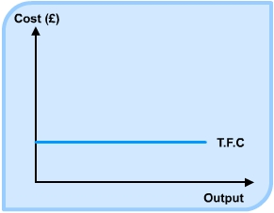
Fixed Costs

Slide 14
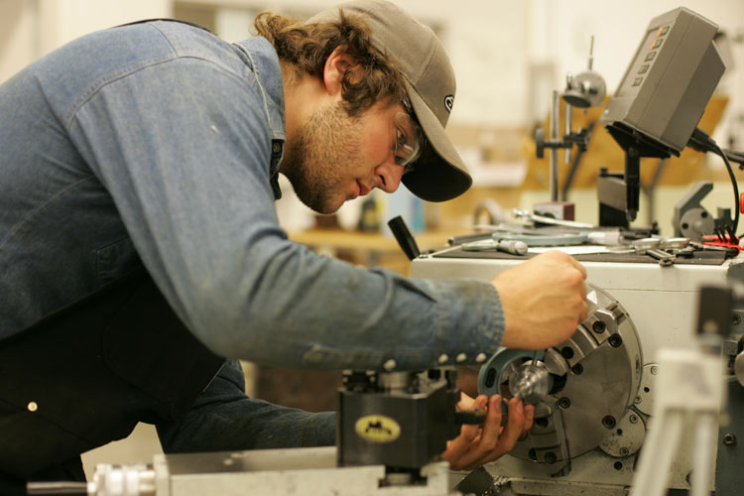
Variable Costs
Variable costs are those costs that vary directly with the level of output. The more you produce the higher the costs.
Examples:-
Raw Materials
Postage & Packaging
Wages
Commission
If a manufacturer doubled output then these costs would double.

Slide 15
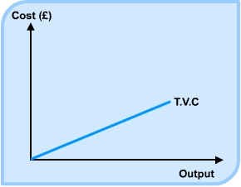
Variable Costs

Slide 16
Task
Complete the fixed and variable costs worksheet – easy version.
Notes:
Btec Workbook

Slide 17
Direct vs Indirect
A direct cost is directly related to output e.g. the cost of wood in a furniture factory.
An indirect cost is independent of output, for example the cost of staff uniforms.

Slide 18
Total Costs
These are when fixed costs are added to the variable costs.
TC = FC + VC
Sometimes you will need to work out the full amount of variable costs to do this you need the following calculation:-
VC of 1 unit X number of units sold

Slide 19
Task
Complete the Calculating Total Costs worksheet – easy version.
Notes:
Btec Workbook

Slide 20
Task
Complete the Calculating Costs Task Sheet
Notes:
GoL activity

Slide 21
Starter
What is the formula for total costs?
What are fixed costs?
Give an example of a variable cost
Give an example of a start up cost
What are operating costs?
Calculate total costs if a business sells 3,000 units. The variable cost per unit is 50p. Fixed costs are £800.

Slide 22
What are Sales?
Various terms used:-
Sales
Revenues
Income
Turnover
Takings
Sales (Revenue) is the amount of money a business receives from selling its products.

Slide 23
Sources of Revenue
Businesses can also receive revenue from other sources.
Name all the different ways a Pets at Home store receives revenue. Think about the products and services it sells!

Slide 24
Calculating Revenue
For example, if the toy producer sells 300,000 dolls at a price of £5 each:
Total Revenue = 300,000 X £5 = £1,500,000
A formula to remember:
Total Revenue = volume sold X average selling price

Slide 25
Task - Calculating Revenue
Product | Quantity | Price (unit) | Sales
Blue | 5,000 | £10 | ?
Red | 2,500 | £12 | ?
Pink | 8,000 | £11 | ?
Purple | 4,000 | £10 | ?
Total | 19,500 | - | ?

Slide 26
Calculating Sales - Answers
Product | Quantity | Price (unit) | Sales
Blue | 5,000 | £10 | £50,000
Red | 2,500 | £12 | £30,000
Pink | 8,000 | £11 | £88,000
Purple | 4,000 | £10 | £40,000
Total | 19,500 | - | £208,000

Slide 27
Task
Complete the Calculating Revenue worksheet – easy version.
Notes:
Btec Workbook

Slide 28
Task
Complete the Calculating Revenue Task Sheet.
Notes:
GoL Activity

Slide 29
Spot the Error & Correct
Total Costs = Fixed Costs X Variable Costs
Rent is an example of a variable cost
Petrol is not an example of an operating cost
If a business sells 5,000 units at £11 their revenue is: 5,000 / £11
Total variable costs is calculated by adding all the costs together
TC = £2,800 + (£9 x 250) = 5,050

Slide 30
Expenditure
Is the opposite of revenue.
It is all the money a business pays out i.e. costs.

Slide 31
Profit
Profit is the difference between revenue and costs.
This determines whether or not a business makes any profit.
For Example:
If the doll manufacturer produces and sells 300,000 dolls, they sell for £5, fixed costs are £400,000 and variable costs are £2 per unit then:
Profit =
£5 x 300,000 – (£400,000 + (£2 x £300,000)) = £500,000
Profit = Total Revenue – Total Costs

Slide 32
Profit or Loss?!?!
Sales | Costs | Profit or Loss
£100,000 | £75,000 | ?
£100,000 | £125,000 | ?
Total sales greater than total costs Total costs greater than total sales Total sales equal total costs |  | = Profit = Loss = Break-Even

Slide 33
Profit or Loss?!?!
Sales | Costs | Profit or Loss
£100,000 | £75,000 | £25,000 (profit)
£100,000 | £125,000 | £25,000 (loss)
Total sales greater than total costs Total costs greater than total sales Total sales equal total costs |  | = Profit = Loss = Break-Even

Slide 34
Example
Gwen and John’s pasta restaurant charges £10 for three courses and an average of 800 customers per week. The variable costs are £4 per customer and the restaurant has fixed costs of £3,400 per week.
Calculate the profit

Slide 35
Answer
Calculate revenue:
Price X No. of customers
£10 X 800 = £8,000
Calculate total costs:
Fixed costs + Total Variable Costs (No. of customers
X variable fixed costs per meal)
£3,400 + (800 X £4 = £3,200) = £6,600
Calculate Profit:
Total Revenue – Total Costs
£8,000 – (£3,400 + £3,200) = £1,400 per week

Slide 36
Questions
During the summer weeks, Devon Ice Cream has average sales of 4,000 units over the summer. Each ice cream sells for £1 and has a variable cost of 25p. Fixed costs are £800.
Calculate the total cost for the business in the summer weeks.
Calculate Devon Ice Cream’s profit from the summer.

Slide 37
Answer
Total Costs = Fixed Costs + Variable Costs
Variable Costs = variable costs per unit x the number of units sold.
VC = 25p x 4,000 units = £1,000
TC = £800 + £1,000 = £1,800
Profit = Total Sales – Total Costs
Total Sales = volume sold x average selling price
TS = 4,000 units x £1 = £4,000
Total Sales – Total Costs = Profit
£4,000 – £1,800 = £2,200

Slide 38
Questions
If a firm sells 200 widgets at £3.30 and 40 squidgets at £4, what will the firms total revenue be?
If each widget costs £1.20 to make, while each squidget costs £1.50, what are the total variable costs going to be?
If fixed costs are £300, what profit will the business make?

Slide 39
Answer
Total Sales = Volume Sold X Selling Price
Widgets = 200 x £3.30 = £660
Squidgets = 40 x £4 = £160
Total Sales = £660 + £160
= £820

Slide 40
Answer to Part 2
Total Variable Costs = Variable Costs per Unit x Number of Units Sold
Widgets = 200 units x £1.20 = £240
Squidgets = 40 units x £1.50 = £60
Total Variable Costs = £240 + £60
= £300

Slide 41
Answer to Part 3
Profit = Total Sales – Total Costs
Profit = £820 - £600
= £220

Slide 42
Question
BYQ Company has sales of 4,000 units a month, a price of £4, fixed costs of £9,000 and variable costs of a £1.
Calculate the business’ profit.

Slide 43
Answer
Total costs = Fixed costs + Variable costs
£9,000 + (4,000 x £1 = £4,000)
= £13,000
Total sales = volume sold x selling price
4,000 units x £4
= £16,000
£16,000 - £13,000 = £3,000 (Profit)

Slide 44
Task
Complete the Calculating Profit worksheet – easy version.
Notes:
Btec Workbook

Slide 45
Task
Complete the Calculating Profit Task Sheet
Notes:
GoL Acitivity

Slide 46
Task
Complete the Costs, Revenue, Profit Quiz
Complete the Costs, Revenue, Profit MCQs
Complete the Tricky Costs, Revenue, Profit task sheet.
Notes:
GoL Acitivity

