Slide 1
Gross Profit

Slide 2
Definition
The money made from selling a product (revenue) after the costs of producing it (cost of sales) have been deducted.

Slide 3
Formula
Gross Profit = Revenue – Cost of Sales

Slide 4
Task
Last year, a business earned £80,000 in revenue. It's cost of sales was £20,000.
Calculate the gross profit for this business.

Slide 5
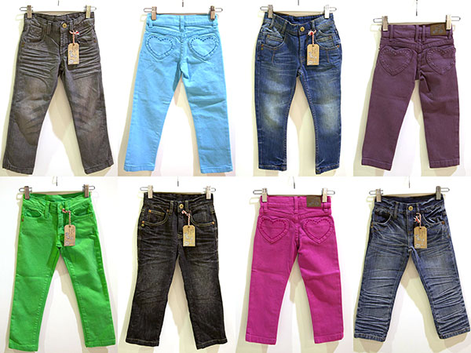
Task
Jamie makes children's fashion jeans. Last year she sold 1,500 pairs at £25 each. Her cost of sales was £12,000.
What is her gross profit?

Slide 6
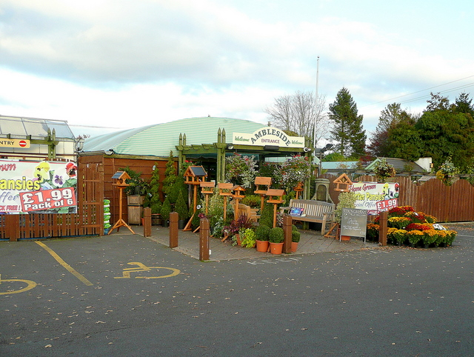
Task
A garden centre sells plants and sheds.
It's revenue from plants last year was £60,000 and it's cost of sales was £15,000.
The revenue from the sale of the sheds was £80,000 and the cost of sales was £25,000.
What would the gross profit be for this business?

Slide 7
Positive and Negative Gross Profit
A business needs a positive gross profit to survive. A negative gross profit figure shows the business making a loss.

Slide 8
Positive Gross Profit Means . . . .
The business has money to pay its expenses.
There may be money for expansion.
The costs of sales aren't too high.
Enough goods are being sold to make a profit.

Slide 9
Negative Gross Profit Means . . . .
There is no money for the business to pay its expenses with a loan or an overdraft.
The costs of sales will be too high – will need to cut costs.
The sales revenue is too low – more goods must be sold.

Slide 10
Net Profit

Slide 11
Definition
The amount you have left after you have deducted the expenses of the business from the gross profit.

Slide 12
Formula
Net Profit = Gross Profit - Expenditure

Slide 13
Task
Jamie has added up her expenditure for her business from the previous year. This included her overheads (such as rent, electricity, telephone etc) and advertising costs. The total was £12,000.
Jamie's gross profit was £25,000.
What will her net profit be?

Slide 14
Positive Net Profit Means . . . .
Gross profit is positive
Expenditure is less than gross profit
The business has money it can use to expand or improve.

Slide 15
Negative Net Profit Means . . . .
Gross profit is low or negative.
Expenditure is too high.
The business is losing money.

Slide 16
Task
Ivan has calculated that he has made a negative net profit. Identify two actions from below that he could take to improve this position.
Buy raw materials from a cheaper supplier.
Buy new equipment.
Reduce his overheads.
Employ more staff.
Spend more on advertising.

Slide 17
task

Slide 18
task
Oliver is a photographer. His gross profit was £25,000 last year but his net profit was only £7,000. He is baffled as he thought his business was doing well.
Explain why Oliver’s net profit is lower than his gross profit. (1 mark)
Identify one way Oliver can improve his net profit. (1 mark)

