Slide 1
Buenos días
Semana 7
Hoy vamos a practicar lo aprendido.
¿Sabes dónde está Ramón?
aseos (los) | toilets
caballeros (los) | gentlemen
conocer | to know (a person)
gimnasio (el) | gym
lavabo (el) | toilets, sink
monitora (la) | instructor (female)
piscina (la) | swimming pool
recepción (la) | reception
recomendar | to recommend
saber | to know (a fact/idea/concept)
sauna (la) | sauna
vestuarios (los) | changing rooms
al lado de | next to
delante de | in front of
detrás de | behind
entre | between
en | in, on, at

Slide 2
Let’s work on the work sheets for 10 minutes
* Now we will watch a video/
ahora vamos a ver un video
* Pay attention and take notes of the places that you find interesting enough to visit/
presta atencion y toma nota de los lugares que te gustaría visitar.

Slide 3
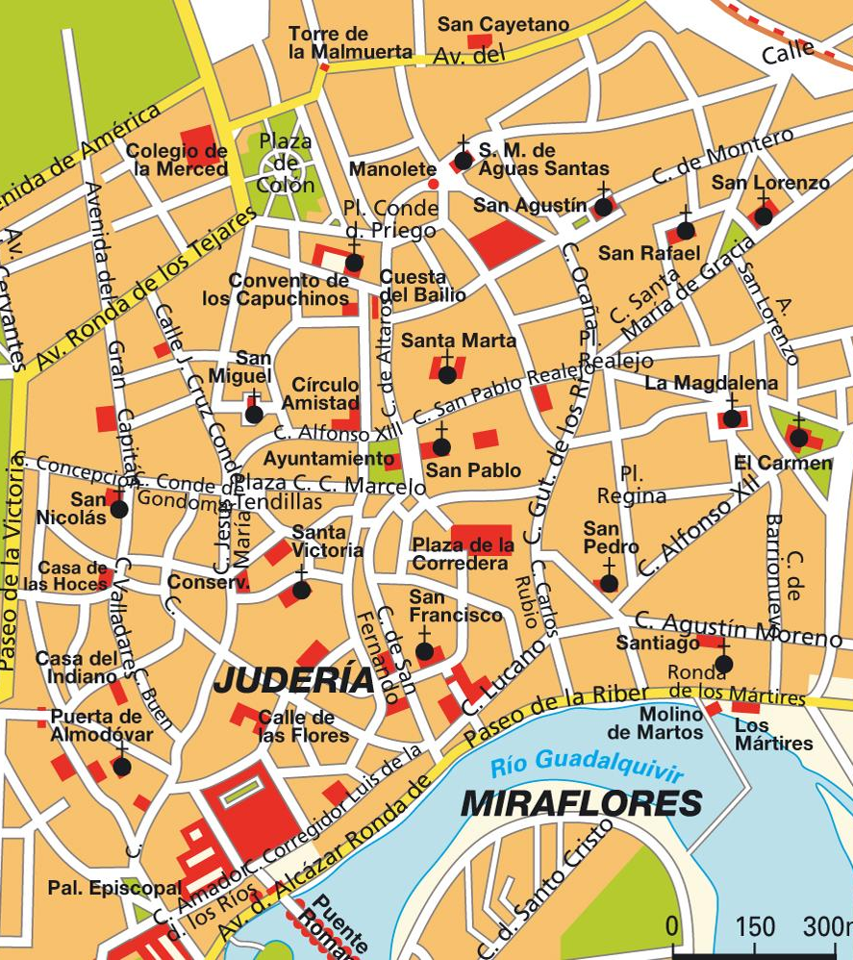
La herencia árabe en España
Córdoba

Slide 4
Córdoba
Now complete the exercises
1. Question: Beginners and intermediates. Click on the link and watch the video.
2. Question: Upper-intermediate and advance. Click on the link and watch the video.

