Slide 1
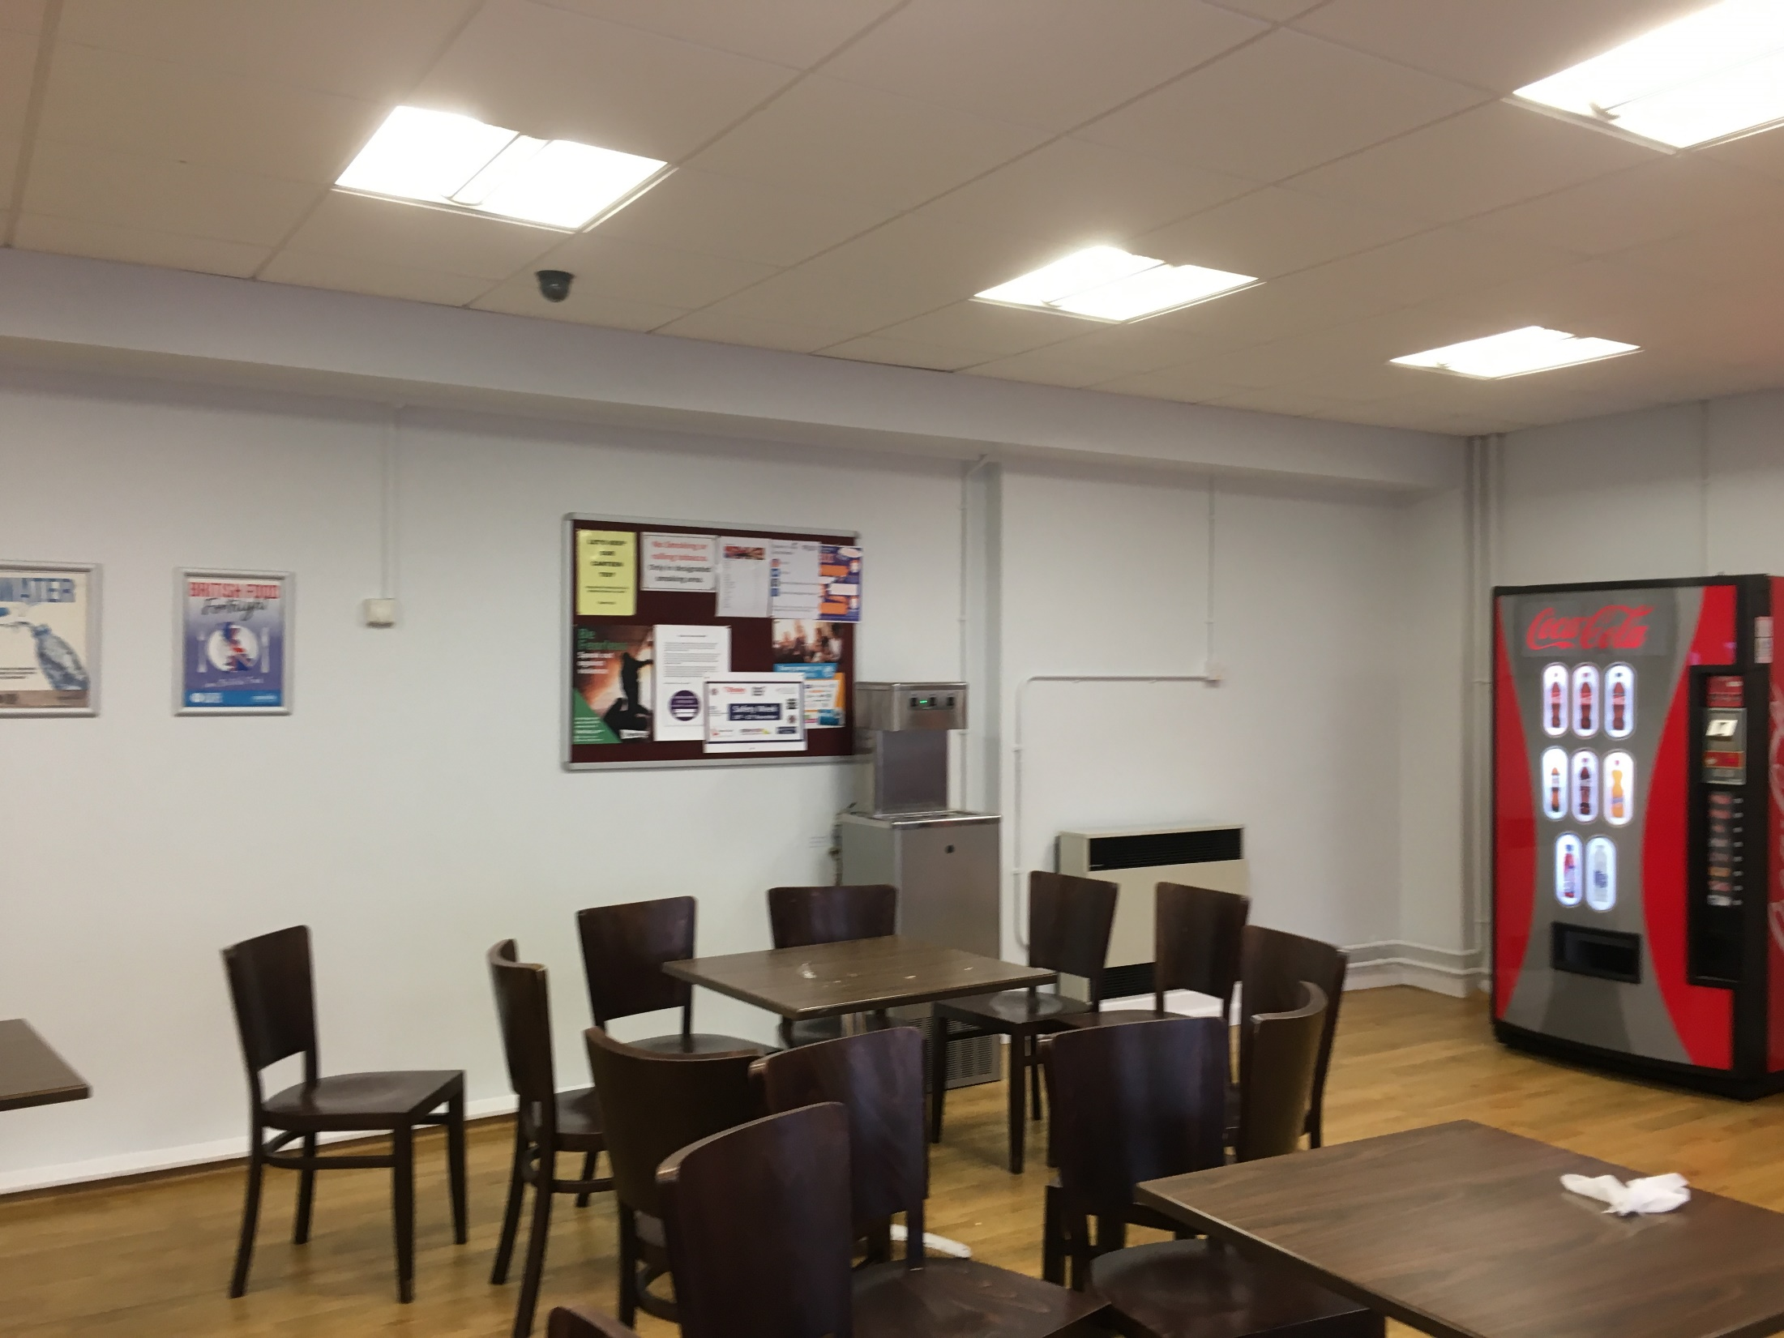
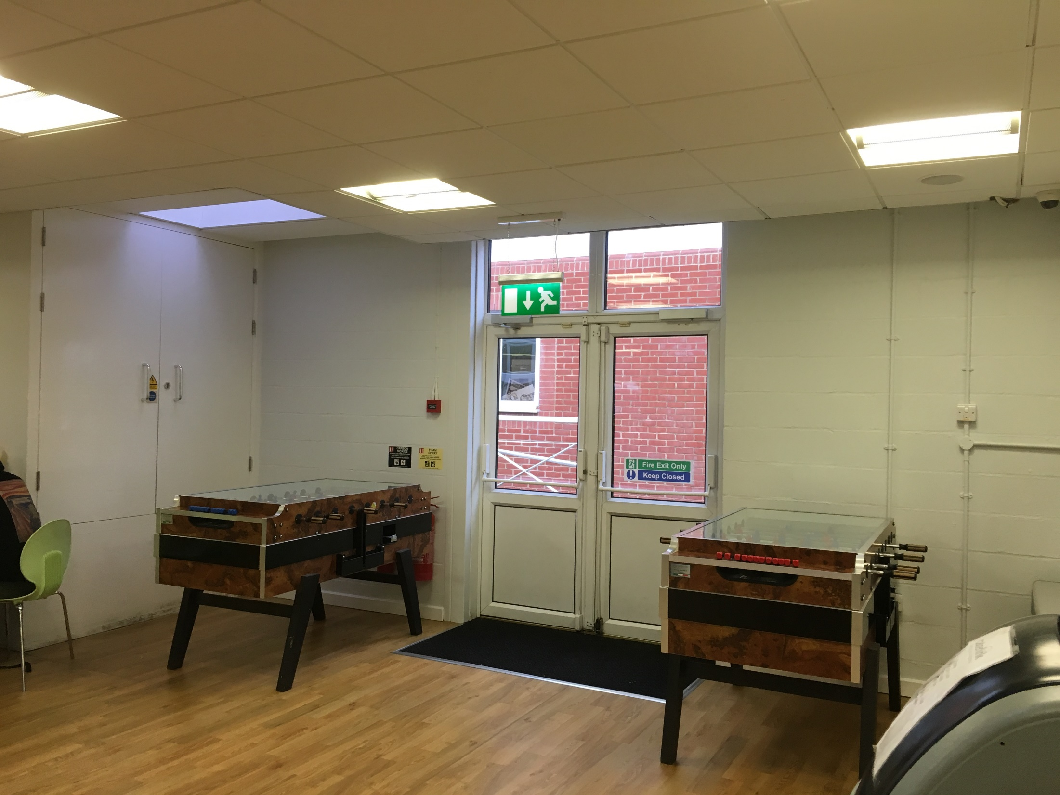
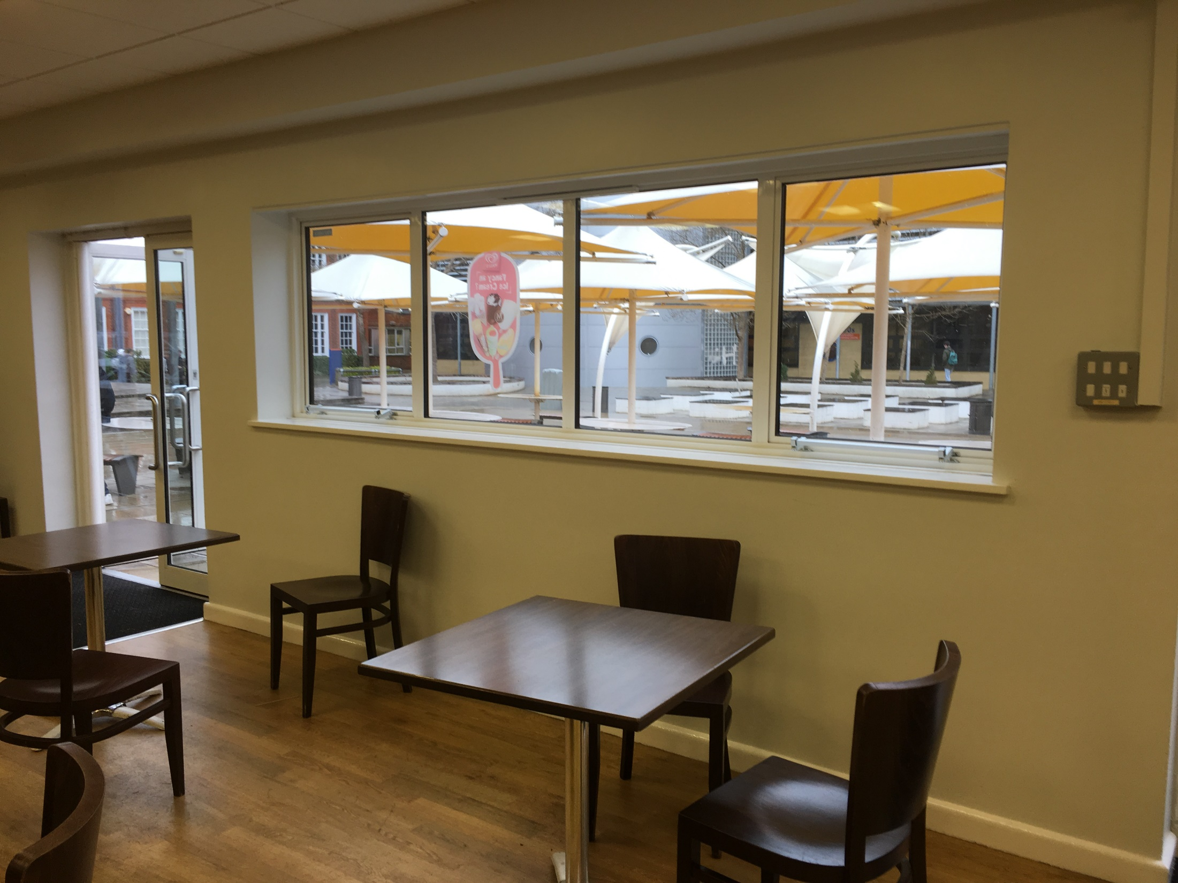
The college spaces…

Slide 2
Your Brief:
Create photo collages to fill the boring spaces in the college canteen
In this lesson we will be using found images, next week you will be able to go out and photograph

Slide 3
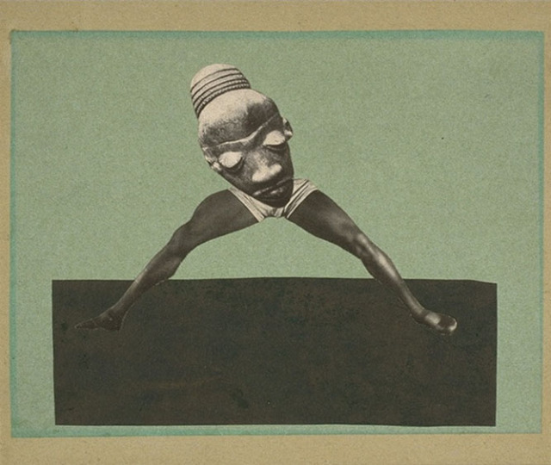
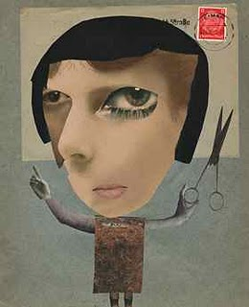
Hannah Hoch

Slide 4
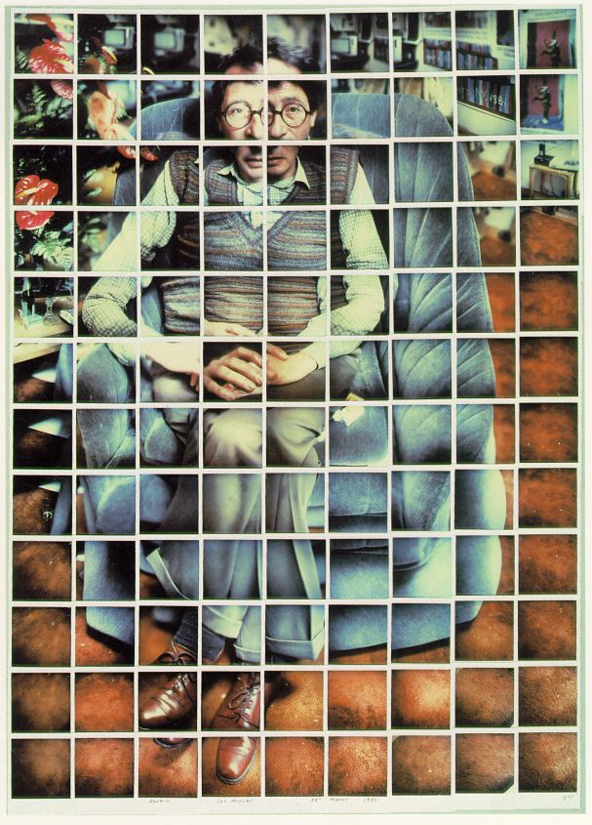
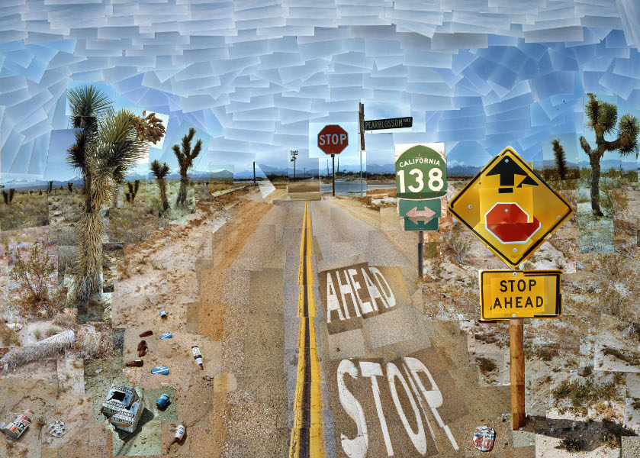
David Hockney

Slide 5
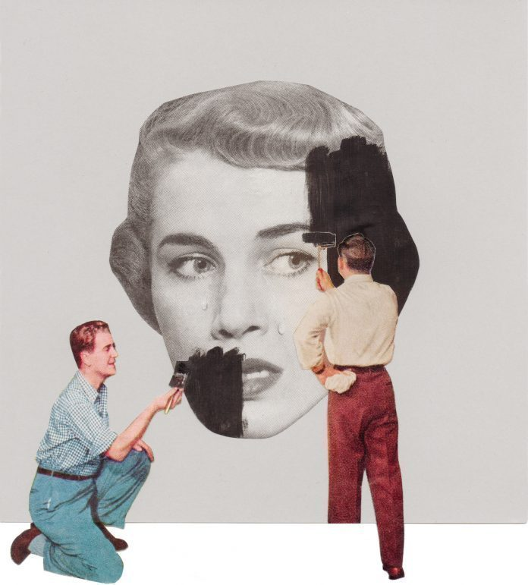
Bri Lamkin

Slide 6
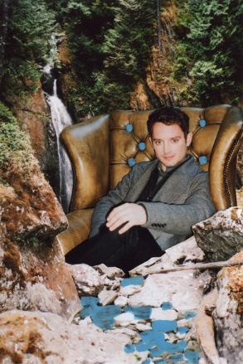
Jessie Craig

Slide 7
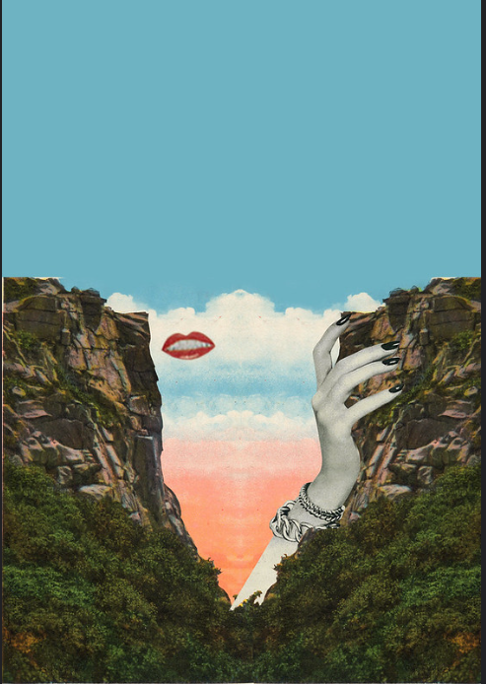
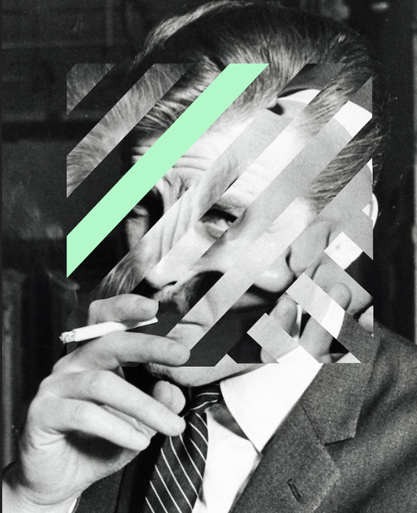
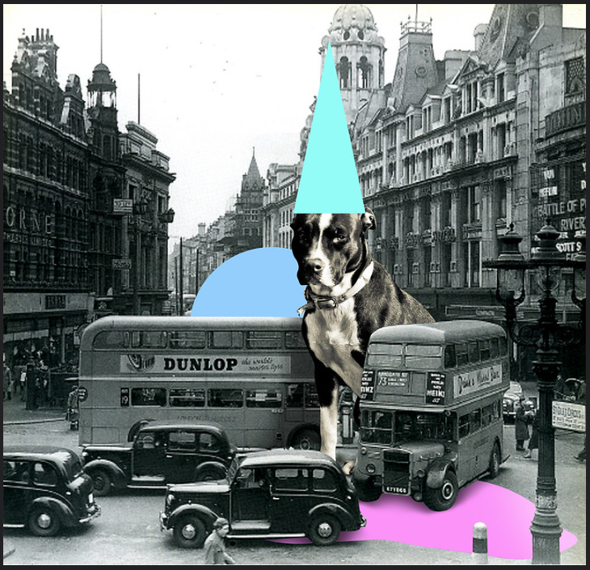
Ashley Edwards

Slide 8
Use google to find a range of sample images for the photo collage you want to create
Save them into your personal area
Aim to get a mixture of portraits, landscapes
and still life photographs

Slide 9
Open Photoshop CC
Create an A4 page
File
New
297mm x 210mm
300dpi
RGB Colour

Slide 10
There are a range of techniques we have used throughout the course that you should use when creating you photo collages:
Quick selection tool
Adjustment layers
Liquify
Lasso tool

